Slide 1
Crossover in Family Law and Estates/Trusts
Robbi Rizzo

Slide 2
Topics:
Premarital Agreements
Separate Property Residence - Moore-Marsden
Separate Property Business – Van Camp/Pereira
Fiduciary Duties
Transmutations
Legal Separation vs. Separated
Standard Family Law Restraining Orders (“ATROs”)
Incapacity or Death during Divorce

Slide 3
Premarital Agreements (Family Code sections 1610-1617)
Must sign before married
Final agreement must be presented at least 7 days before signing
Must be represented by an attorney to waive/limit spousal support
Can address what happens at death, as well as with a divorce
Don’t forget to address rights of reimbursement, not just character
Labor and what it earns is community, unless addressed/altered
Wages, retirement, possibly profits/appreciation
Disclosure is a key component to enforceability

Slide 4
Moore-Marsden – Separate Property Residence
Owned by Spouse A prior to marriage
Title remained in Spouse A’s name
Mortgage payments made with community earnings
Community accrues an interest through pay down of principal or value-added improvements (no interest, taxes, insurance)
No offset for value of occupancy by community
Valued at “time of trial” (not date of separation)
Possible proportionate fair rental value post-separation

Slide 5
MOORE-MARSDEN EXAMPLES
Never changed title, mortgage paid with earnings
Refinanced after marriage, both parties on title
Remodeled during marriage with earnings
What data needed?
FMV and loan balance at date of: Purchase, Marriage, Transmutation (if any), Separation and Trial
Docs re: remodeling funds & value added

Slide 6
Van Camp/Pereira – Separate Property Business
Started/owned by Spouse A prior to marriage
Ownership remained in Spouse A’s name
Worked in business during marriage
Community may share in appreciation during marriage due to Spouse A’s labor
Van Camp = Appreciation primarily due to capital investment, not Spouse A’s labor
Reasonable comp to community, balance is separate
Pereira = Appreciation primarily due to Spouse A’s personal labor
Reasonable return to Spouse A, balance is community

Slide 7
Van Camp Example
Online business started by W before marriage
Significant capital invested prior to marriage
Venture capital investment during marriage
Employees grew significantly during marriage
Market for product expanded due to trends and other circumstances outside W’s control

Slide 8
Pereira Example
Financial services business started by H < marriage
H is sole owner
Services provided by H w/minimal EEs/Ks
H personally involved in all aspects/works long hours
H’s reputation has grown and is well-known

Slide 9
FIDUCIARY DUTIES
Applies during marriage AND after separation, until division of assets/debts is complete
Requires full disclosure and equal access
Duty=highest good faith/fair dealing; no unfair advantage
Must account for/hold as trustee benefit/profit
Family Code sections 721; 1100

Slide 10
FIDUCIARY DUTIES
BUT…
No duty to share investment opportunity after assets are divided
Marriage of Hixson (2003) 111 Cal.App.4th 1116
Duty to disclose ends at entry of Judgment
Marriage of Sorge (2012) 202 Cal.App.4th 626

Slide 11
TRANSMUTATION AGREEMENTS
Dual Representation - DON’T DO IT!!
Refer both parties for Family Law Consult/Rep
Will there be a right to reimbursement?
Family Code section 2640
Right will continue, absent clear/written waiver
Future Property – inheritances or gifts?
No carve out for death only; it will apply to divorce

Slide 12
TRANSMUTATION EXAMPLES
SP$ used to acquire CP
Fixed reimbursement potentially lost
Pre-marriage retirement account
Principal potentially lost
Any appreciation definitely lost
Inheritance or Gifts
Arguably all lost

Slide 13
Legally Separated or (just) Separated?
Legally Separated:
Judgment of Legal Separation entered
Address all issues same as divorce, except still married
Must file new divorce case to terminate marital status
Married, but cannot file “married, filing jointly” tax returns
IRC 7703(a)
Parties must agree or it’s a divorce
Separated:
At least one of the party’s has made the decision the marriage is over and actions match that (e.g. move out)
Community interest in labor stops (e.g. wages, pension)
Community interest in assets continues to trial/division (e.g. residence)
Community liability for new debt in one parties’ name generally stops

Slide 14
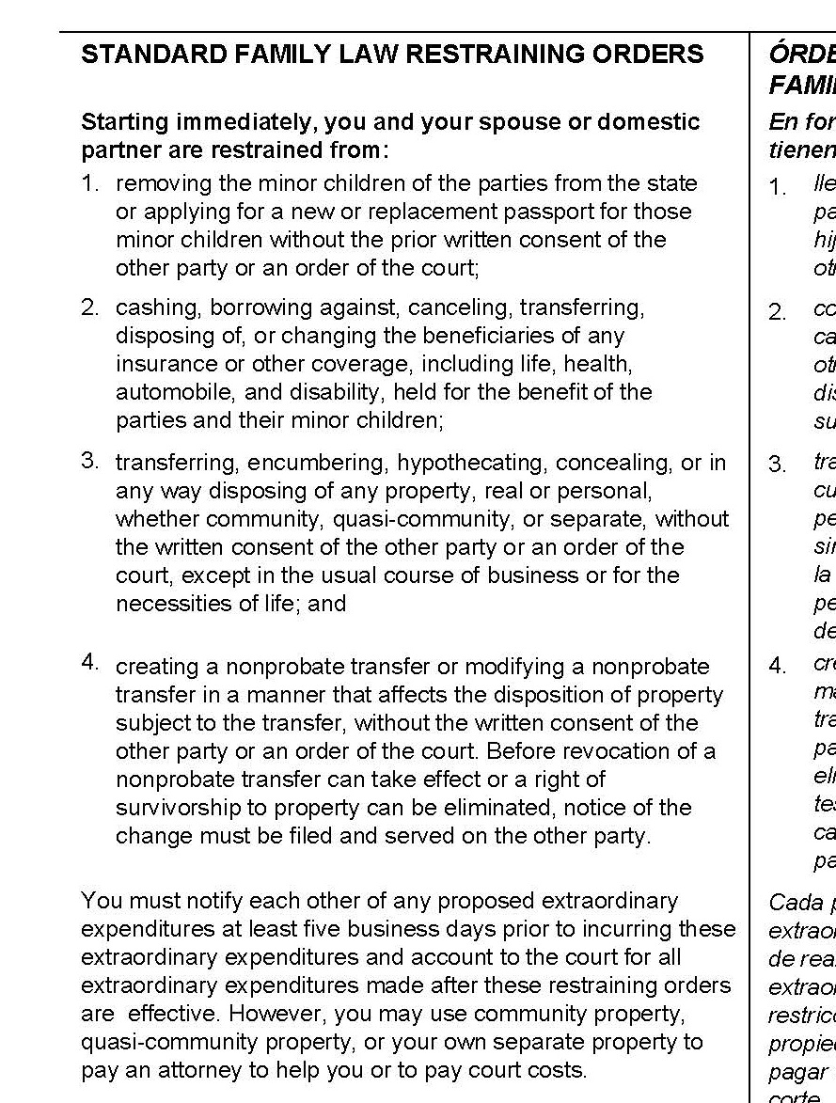
ATROs (Automatic Temporary Restraining Orders)
Page 2 of Summons (FL-110)
Family Code Section 2040
Effective against Petitioner with filing of Petition.
Effective against Respondent with service of Petition on Respondent.

Slide 15
ATRO #1
MINOR CHILDREN
Removal from State
OR
New/Replacement Passport
Requires: Written Consent OR Court Order.

Slide 16
ATRO #2
INSURANCE (life, health, automobile, disability)
DO NOT: Cash
Borrow against
Cancel
Transfer
Dispose of
Change Beneficiaries

Slide 17
ATRO #3
PROPERTY (Real or Personal–Community or Separate)
DO NOT: Transfer
Encumber
Hypothecate
Conceal
Dispose of in any way
Except: Written Consent or Court Order
Usual Course of Business/Necessities of Life

Slide 18
ATRO #4
NONPROBATE TRANSFER
DO NOT: Create or Modify, if affects property
Except: Written Consent or Court Order
Revocation with Notice Served/Filed
Definition: Transfer on Death (not Will)
Revocable Trust, POD Account, Etc.
NOT: Insurance (see #2)

Slide 19
ATRO Other
EXTRAORDINARY EXPENDITURES
Notify each other 5+ days prior to incurring
Account to Court for all incurred while ATROs in effect
ADDITIONAL ACTIONS ALLOWED
Use funds (CP/SP) to pay attorney/court costs
Create/Modify/Revoke a Will
Create Unfunded Revocable/Irrevocable Trust
Eliminate Right of Survivorship w/Notice served/filed
Testamentary Disclaimer

Slide 20
POTENTIAL ACTIONS
Revoke
PoAs
Joint Tenancy
Create
Will
Trust, but don’t fund it
Nonprobate Transfers
Entire Trust
If Client died, what would Client want to happen?
If Opposing Party died, what would Client want to happen?

Slide 21
Incapacity – Divorce Pending
What level of capacity does party have?
What level of capacity is required?
Decision to Divorce
vs.
Marital Settlement Agreement
Powers of Attorney in effect?
Attorney-in-Fact bound by ATROs & Fiduciary Duties
Attorney-in-Fact to be appointed as GAL?

Slide 22
Death – Divorce Pending
Was marital status terminated?
No = Divorce dismissed
Now, Probate Code, not Family Code
Yes = Divorce continues, with someone stepping into deceased Party’s shoes to finish

Slide 23
QUESTIONS?

