Slide 1
THE UNHOUSED: THE LAW AND POLICY DEBATED
Sam Blakeslee
Gregory Francisco Gillett

Slide 2
POLICY: HERE AT HOME

Slide 3
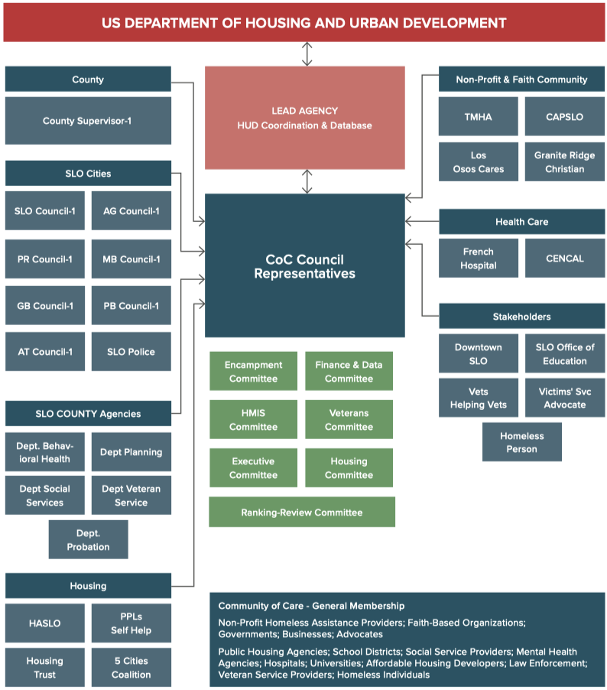
Current Organization

Slide 4
The JPA is a separate government organization created by the member agencies but is legally independent from them. Some of the potential advantages of a JPA include:
Improving eﬃciency by reducing overlapping services
Sharing resources and expertise
Coordinating plans and actions
Create a Joint powers authority
ACCOUNATBILITY
____________________________________________
CONTROL

Slide 5
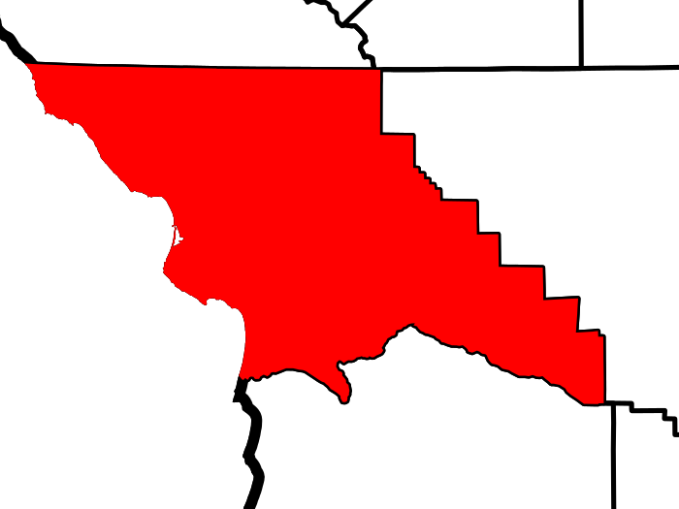
Additional
BENEFITS
OF A JPA
As a legally separate public agency a JPA can hire staﬀ, issue revenue bonds, obtain ﬁnancing, sue or be sued, and manage property. JPA’s typically protect their member agencies from JPA liabilities. Some of the advantages of a JPA include:
Flexibility and ease of formation
Ability to ﬁnance projects
Coordination on regional problems
Improved ability to secure grants with demonstration of regional cooperation
This Photo by Unknown Author is licensed under CC BY-SA

Slide 6
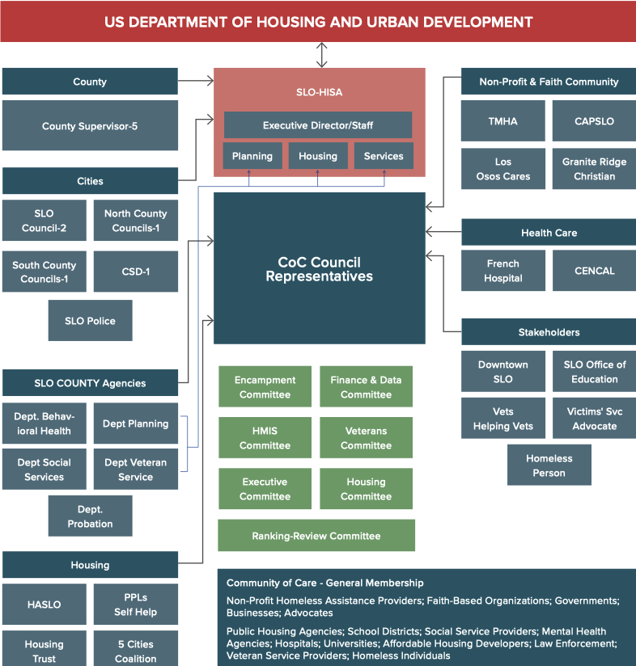
Proposed Organization

Slide 7
Upon the creation of a JPA, pursue a two-pronged approach
This Photo by Unknown Author is licensed under CC BY-NC-ND

Slide 8
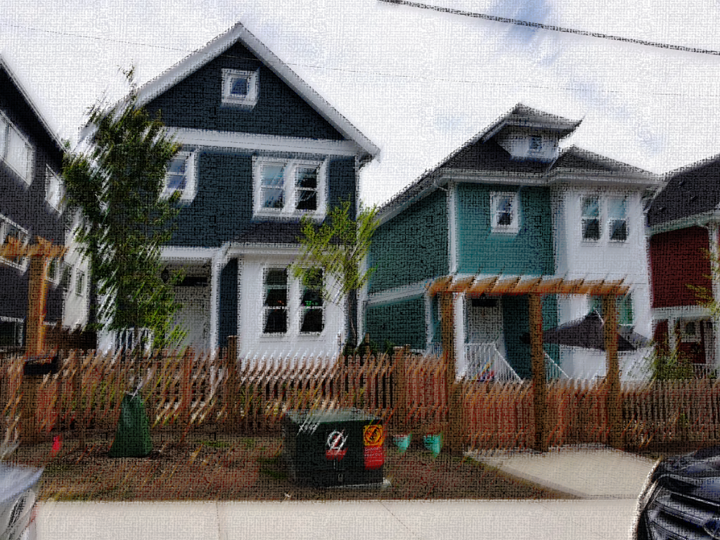
Prong 1: Strategic Housing
Increase the supply of ‘Strategic Housing Solution’ (SHS) units (emergency shelters, residential hotels, group homes, tiny villages, single-room occupancy dwellings, permanent supportive housing) to reduce homelessness by:
Coordinating and aligning jurisdictional strategies related to land use, housing elements, transportation, and funding to support SHS projects;
Identifying and acquiring properties throughout the county to increase the supply of SHS units;
Creating and implementing regional policies and ordinances to streamline permitting procedures, provide density bonuses and builder incentives, reforming parking and setback impediments for SHS projects;
Establishing and enforcing regional and sub-regional benchmarks to increase accountability.
This Photo by Unknown Author is licensed under CC BY-SA

Slide 9
Reform service streams to promote individualized services and quality of care by:
Prong 2:
Individualized services
Prioritizing and enhancing existing programs that focus on holistic and targeted intervention strategies.
Calibrating and enforcing the use of client tracking protocol and database systems (i.e., HMIS).
Creating and utilizing metrics to track inputs and outcomes of coordinated/individualized services.
Establishing benchmarks and real-time feedback mechanisms to support ongoing gap analyses, funding allocations, and service coordination.
This Photo by Unknown Author is licensed under CC BY-NC

Slide 10
County Supervisors immediately create a task force
City council members place the issue on their agenda
Citizens call for reform and reorganization
Next Steps

Slide 11
Why Does this matter?
CALIFORNIA COMEBACK PLAN

Slide 12
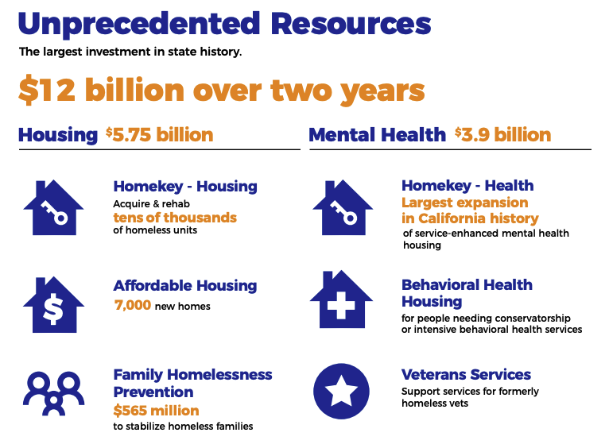

Slide 15
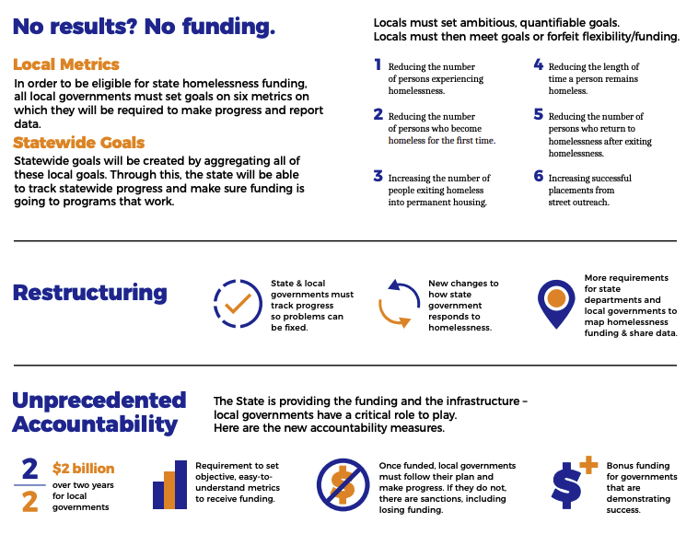

Slide 16
Download the Report
www.actionslo.com

