Slide 1
COUNTY OF SAN LUIS OBISPO
www.slocounty.ca.gov

Slide 2
Topics covered
Lavan v. City of Los Angeles 693 F.3d 1022 (9th Cir. 2012): constitutionality of removing personal property from the right of way
Desertrain v. City of Los Angeles 754 F.3d 1147 (9th Cir. 2014): constitutionality of overnight camping ordinances
Martin v. City of Boise 920 F.3d 584, 592 (9th Cir. 2019): constitutionality of criminalizing sleeping on public property

Slide 3
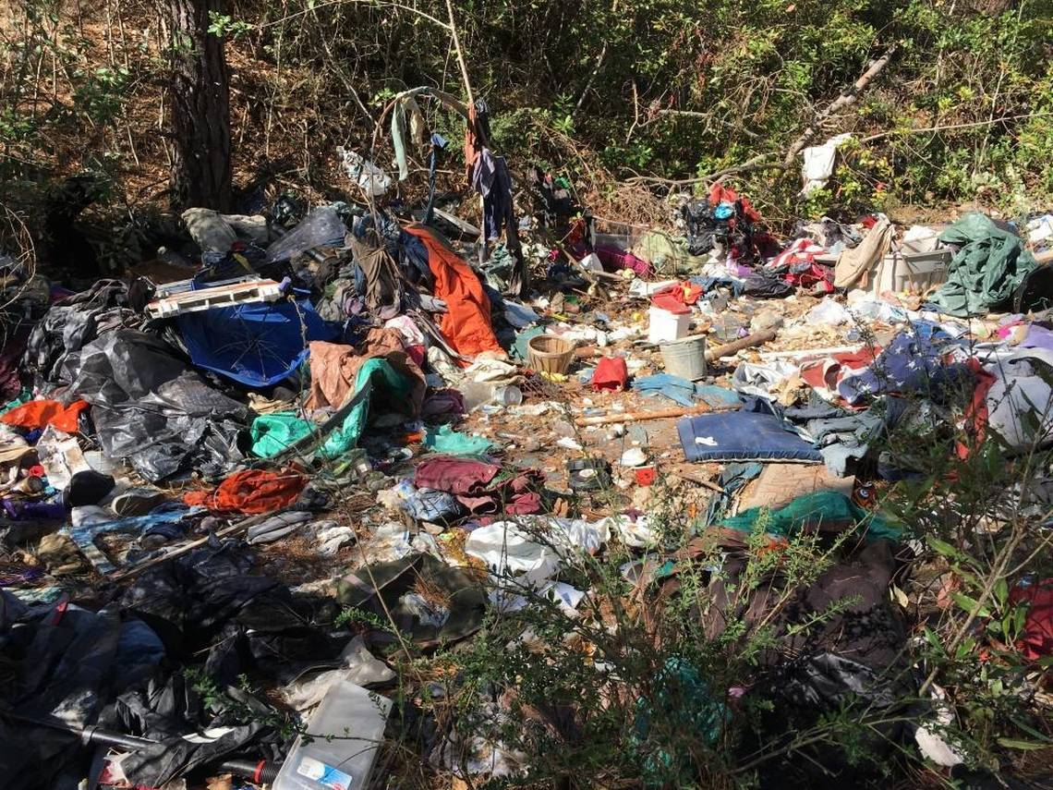
Paso Robles Riverbed

Slide 4
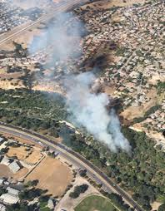
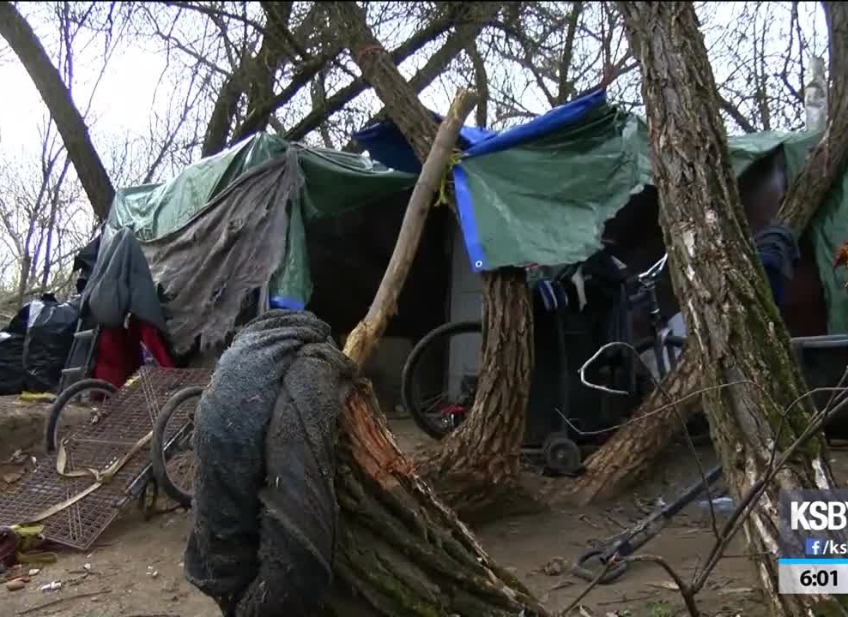
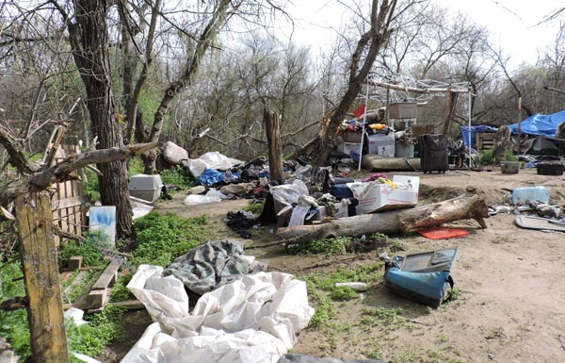

Slide 5
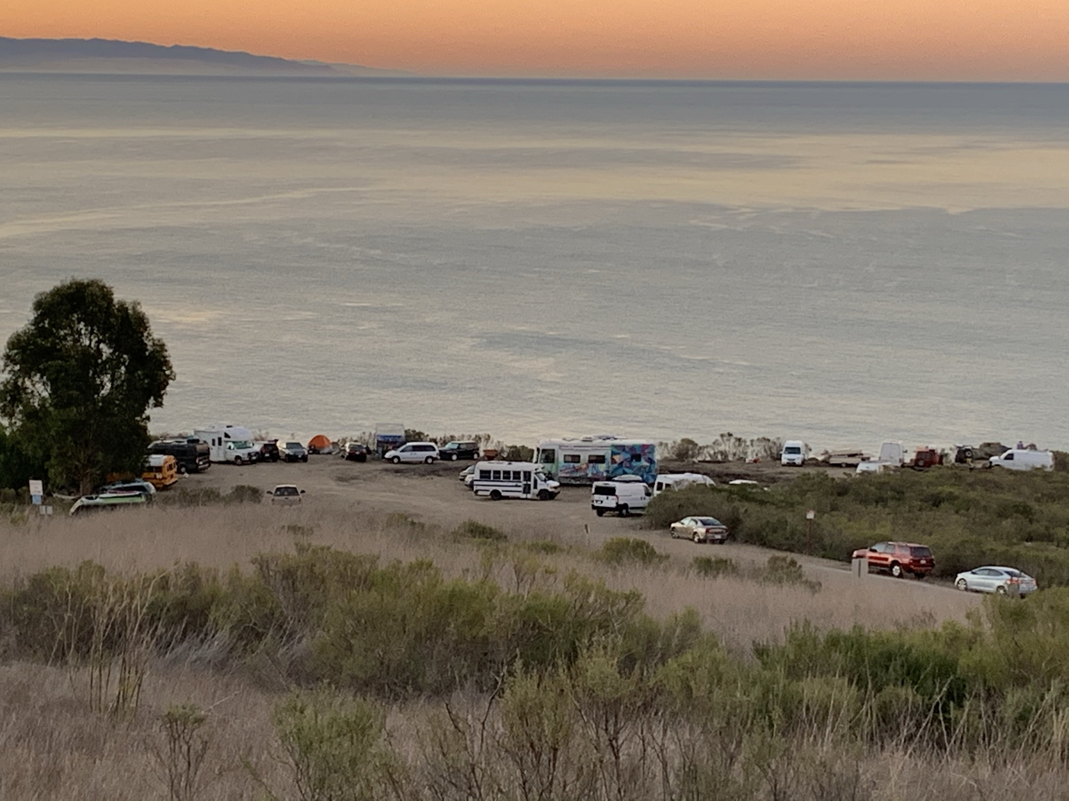
Cave Landing

Slide 6
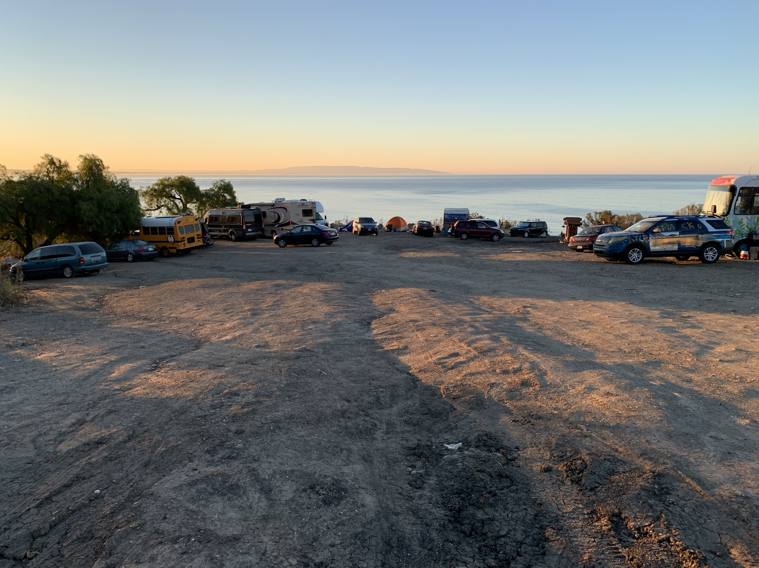

Slide 7
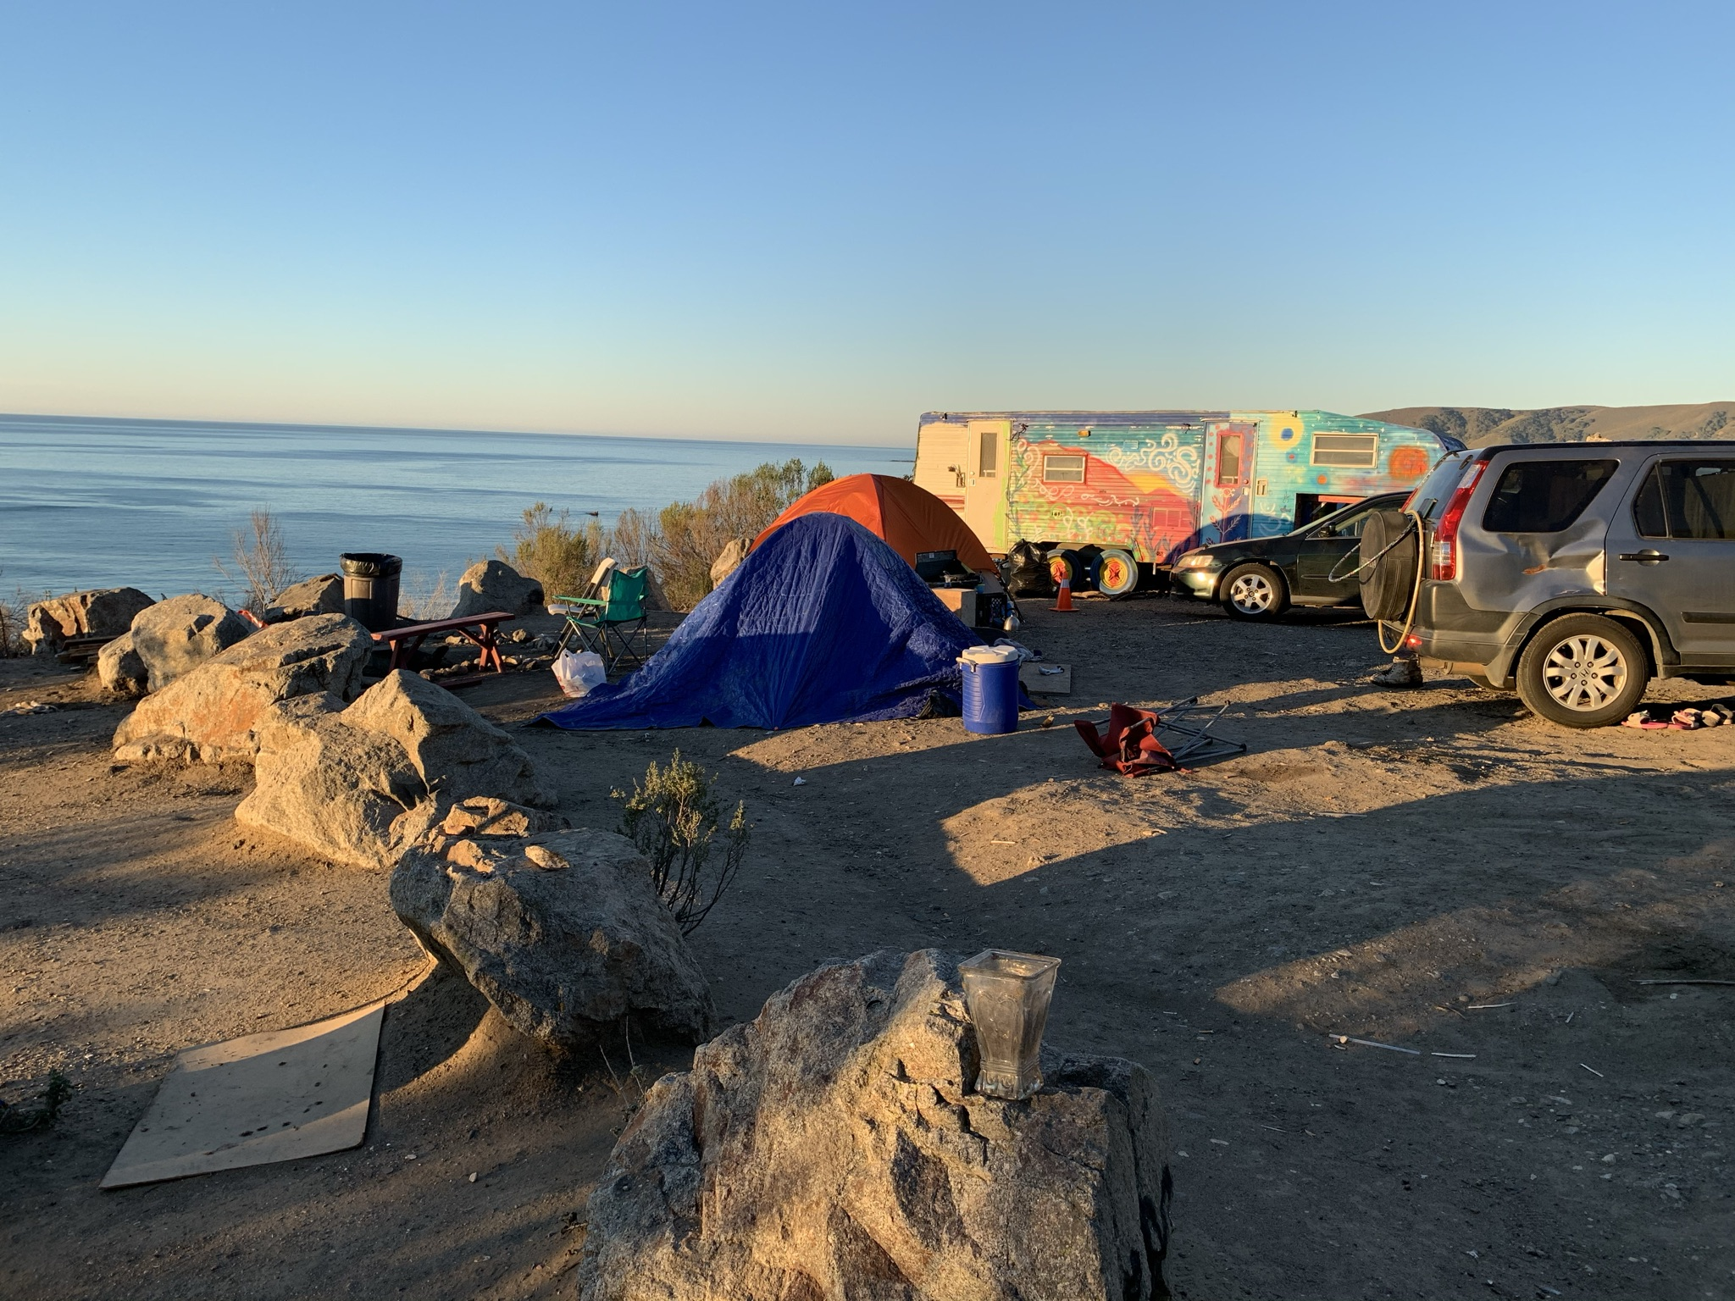

Slide 8
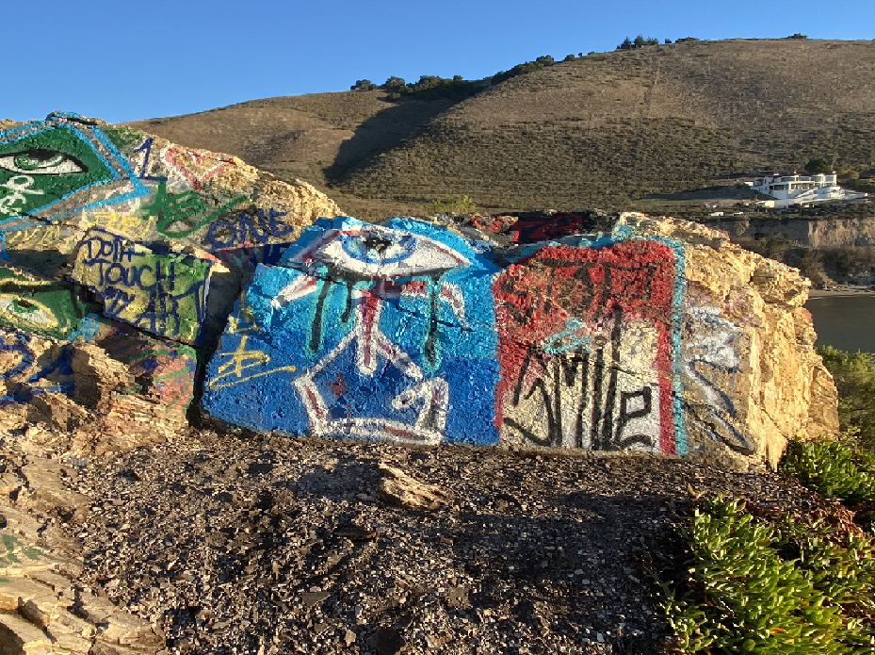

Slide 9
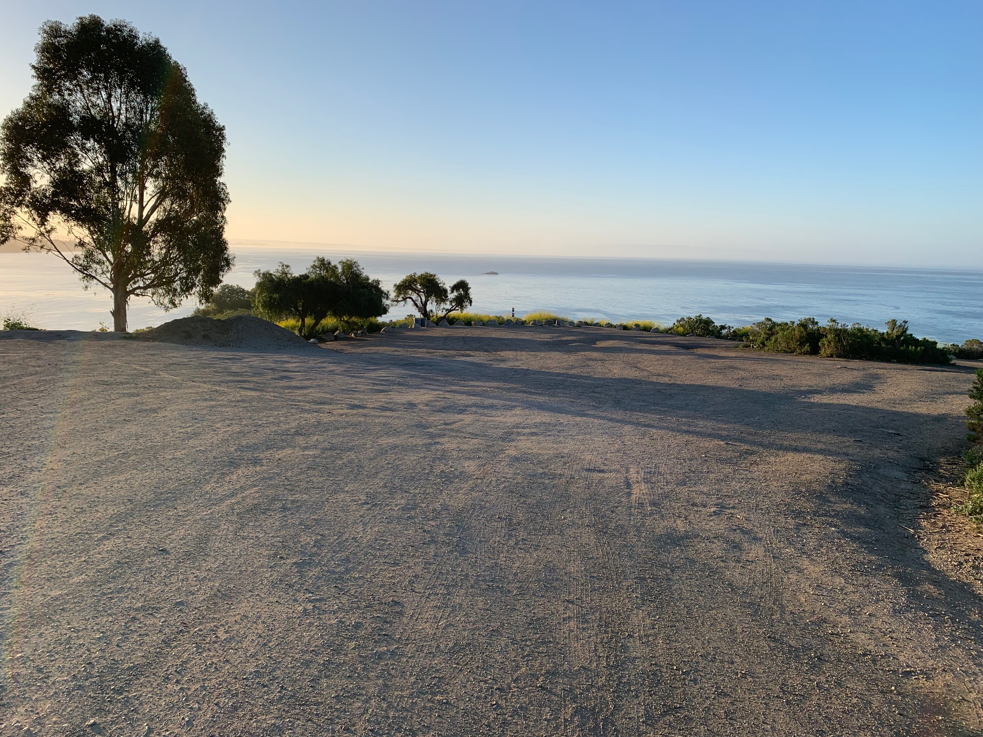

Slide 10
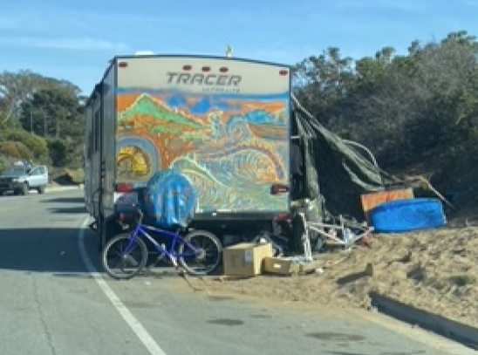
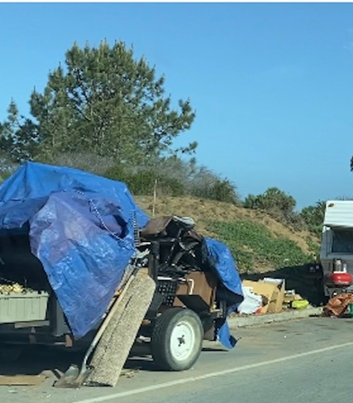
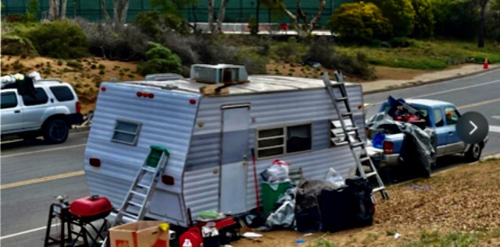
Palisades Avenue, Los Osos

Slide 11
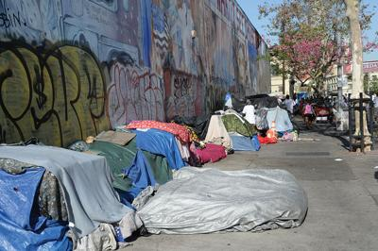
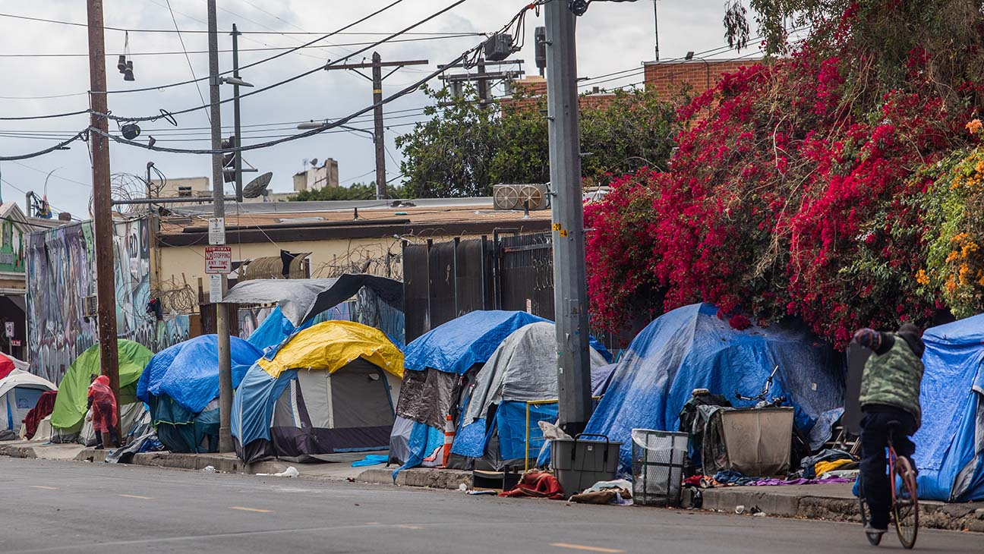

Slide 12
Lavan v. City of Los Angeles 693 F.3d 1022 (9th Cir. 2012): constitutionality of removing personal property from the right of way
The court held “that the Fourth and Fourteenth Amendments protect homeless persons from government seizure and summary destruction of their unabandoned, but momentarily unattended, personal property.”
“This simple rule holds regardless of whether the property in question is an Escalade or an EDAR, a Cadillac or a cart.”

Slide 13
EDAR: Everyone Deserves a Home

Slide 14
Lavan v. City of Los Angeles 693 F.3d 1022 (9th Cir. 2012): constitutionality of removing personal property from the right of way
Provide notice of the pending clean-up unless the property constitutes a hazard
Must separate personal property from the trash and store the personal property for 90 days and “take reasonable steps to give notice that the property has been taken so the owner can pursue available remedies for its return.”

Slide 15
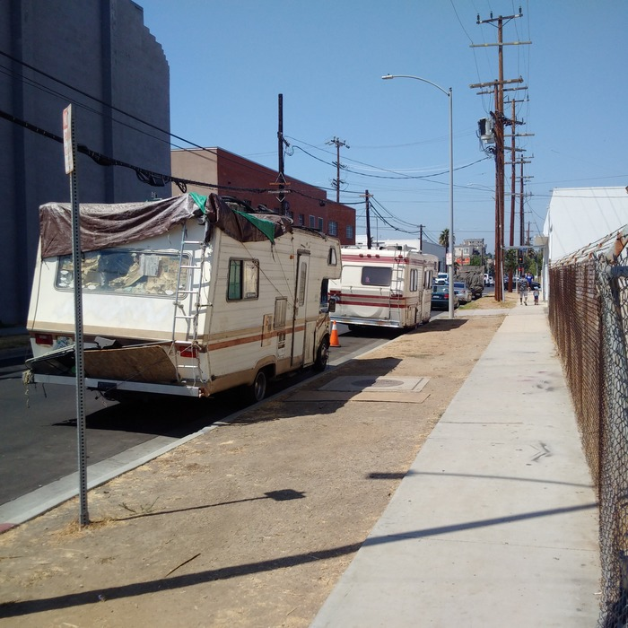
Desertrain v. City of Los Angeles 754 F.3d 1147 (9th Cir. 2014): constitutionality of overnight camping ordinances
In 1983, the City of LA enacted Section 85.02 which was as follows:
USE OF STREETS AND PUBLIC PARKING LOTS FOR HABITATION.
No person shall use a vehicle parked or standing upon any City street, or upon any parking lot owned by the City of Los Angeles and under the control of the City of Los Angeles or under control of the Los Angeles County Department of Beaches and Harbors, as living quarters either overnight, day-by-day, or otherwise.

Slide 16
Lavan v. City of Los Angeles 693 F.3d 1022 (9th Cir. 2012): constitutionality of removing personal property from the right of way
Section 85.02 fails to provide adequate notice of the conduct it criminalizes
“Plaintiffs are left guessing as to what behavior would subject them to citation and arrest by an officer. Is it impermissible to eat food in a vehicle? Is it illegal to keep a sleeping bag? Canned food? Books? What about speaking on a cell phone? Or staying in the car to get out of the rain? These are all actions Plaintiffs were taking when arrested for violation of the ordinance, all of which are otherwise perfectly legal.”

Slide 17
Lavan v. City of Los Angeles 693 F.3d 1022 (9th Cir. 2012): constitutionality of removing personal property from the right of way
Section 85.02 promotes arbitrary enforcement that targets the homeless.
“Arbitrary and discriminatory enforcement is exactly what has occurred here. As noted, Section 85.02 is broad enough to cover any driver in Los Angeles who eats food or transports personal belongings in his or her vehicle. Yet it appears to be applied only to the homeless.”

Slide 18
Martin v. City of Boise 920 F.3d 584, 592 (9th Cir. 2019): constitutionality of criminalizing sleeping on public property
City of Boise Ordinance:
Banned “[o]ccupying, lodging or sleeping in any…place…without…permission.”
Barred the “use [of] any…street, sidewalk, parks or public places as a camping place at any time.”
Imposed criminal penalties.

Slide 19
Martin v. City of Boise 920 F.3d 584, 592 (9th Cir. 2019): constitutionality of criminalizing sleeping on public property
Janet Bell, Robert Martin and nine other unhoused individuals sued the City of Boise claiming the ordinances were unconstitutional under the 8th Amendment because is criminalized them for carrying out basic bodily functions – i.e. the act of sleeping

Slide 20
River of Life Facility
Population of Boise is 226,115 (2019)
867 unhoused individuals in Boise according to 2016 point in time count
3 homeless shelters in the City, all run by private non-profit organizations:
“Sanctuary” has 96 beds and is usually full. Limited restrictions.
Boise Rescue Mission has 2 facilities: “River of Life” (188 beds, men only) and “City Life” (150 beds, women and children only)
Religious based. Lots of religious messaging. After 17 (ROL) or 30 (“CL”) days of stay the individual must enroll in the “Discipleship Program” which is described as “intensive, Christ based residential recovery program” of which “[r]eligious study is the very essence.”

Slide 21
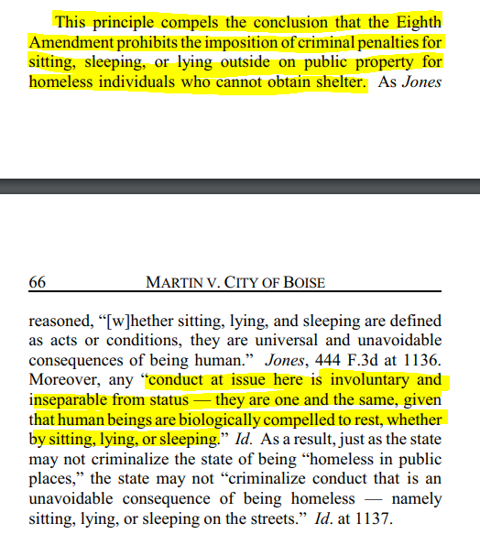

Slide 22
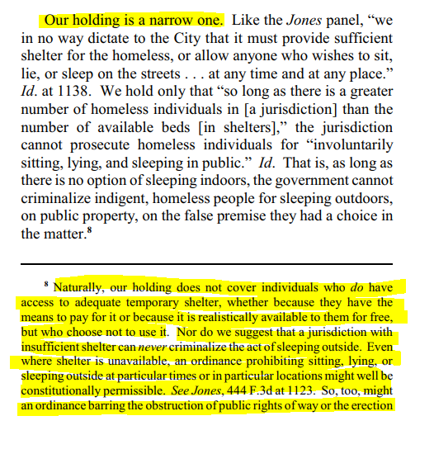

Slide 23
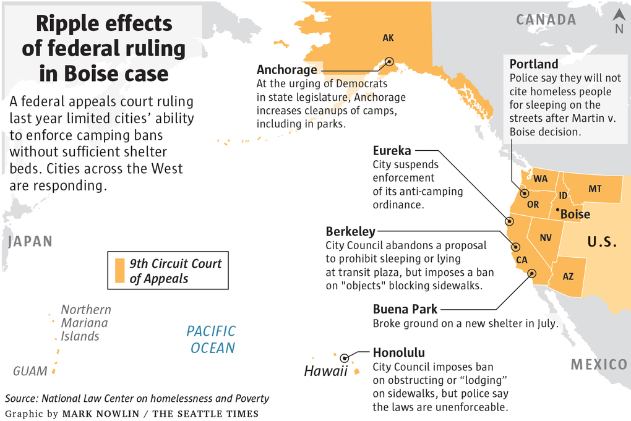
Martin v. City of Boise 920 F.3d 584, 592 (9th Cir. 2019)

Slide 24
Post Martin v. Boise cases:
Gomes v. Cty. of Kauai, 481 F. Supp. 3d 1104, 1106 (D. Haw. 2020); Ordinance prohibiting sleeping in public parks was not unconstitutional because the ordinance was limited to parks and did not apply to public property anywhere.
Young v. City of L.A., 2020 WL 616363, at 5 (C.D. Cal. Feb. 10, 2020); Plaintiff’s allegation that the City has not permitted him to stay at one encampment for the past three years fails to state an Eighth Amendment claim.
Miralle v. City of Oakland, 2018 WL 6199929, at 2 (N.D. Cal. Nov. 28, 2018); “Martin does not establish a constitutional right to occupy public property indefinitely at Plaintiffs' option.”
Yeager v. City of Seattle, 2020 WL 7398748; “The Court will not stretch the self-professed ‘narrow’ holding in Martin to now include non-criminal statues.”

