Slide 1
Mindfulness-Based Cognitive Training
Mick Malotte, MD

Slide 2
The Problem of Burnout
Three Elements:
Emotional Exhaustion
Depersonalization
Feeling of low personal accomplishment

Slide 3
Quality of Care
More diagnostic errors
Excessive testing and referral
Poor patient communication
More shortcuts and poor prescribing habits
Poorer patient compliance and satisfaction

Slide 4
Personal Costs
Suicide
Alcoholism
Broken relationships
Physical illness
Psychological problems

Slide 5
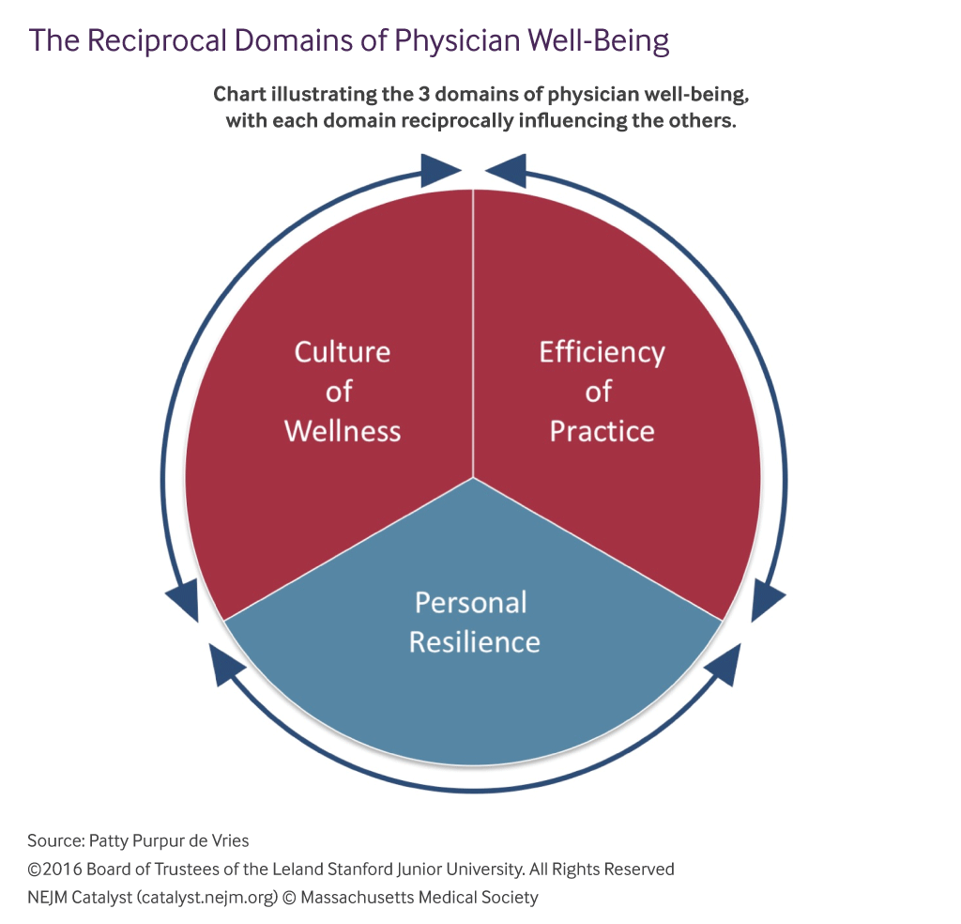

Slide 6
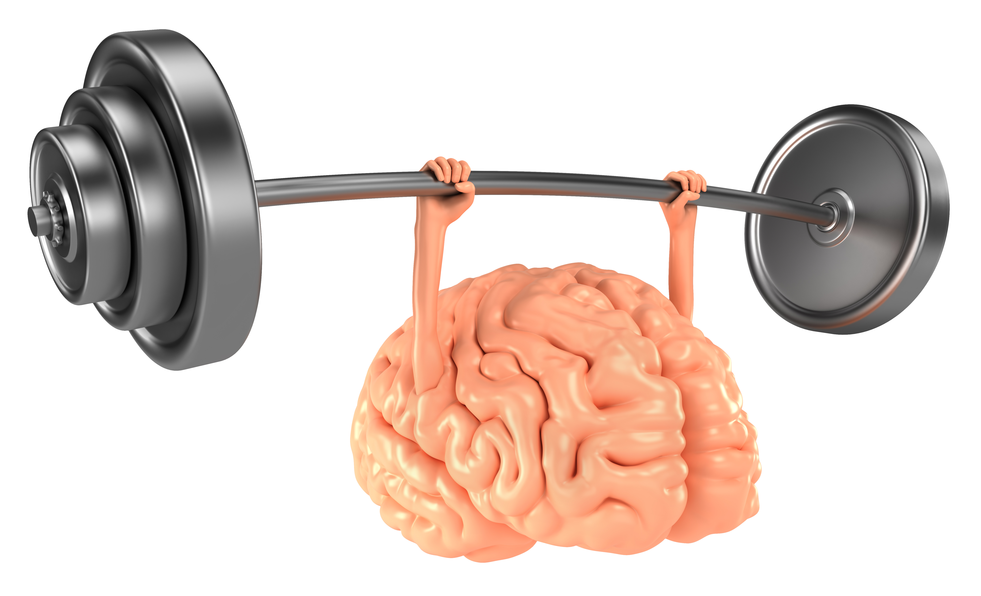

Slide 7
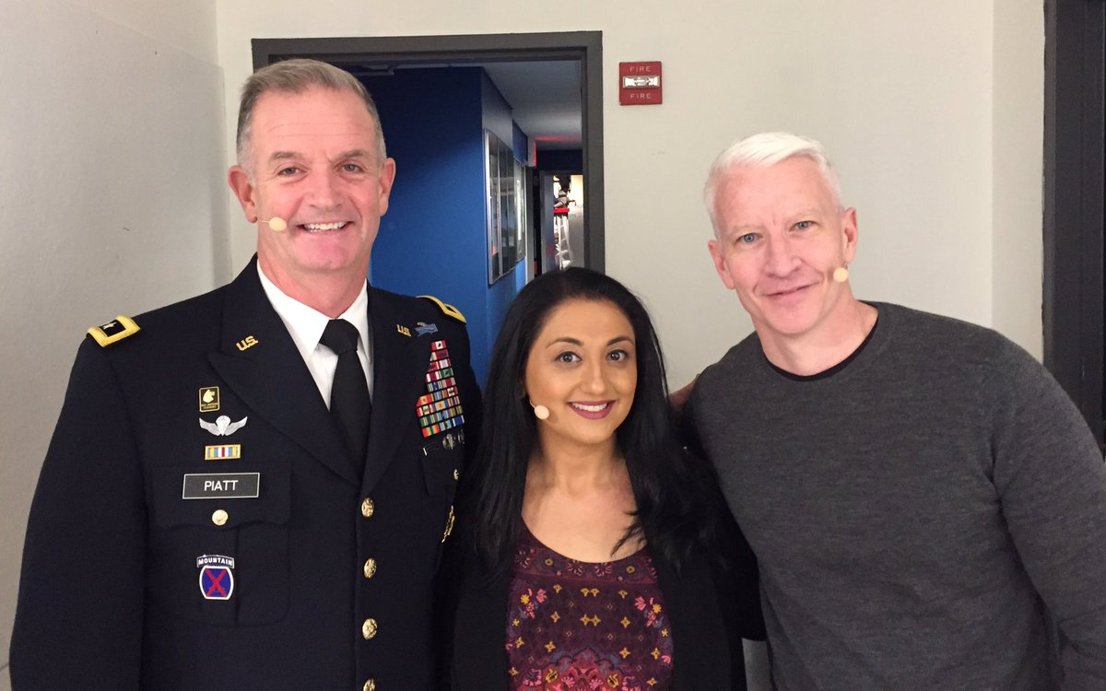

Slide 9
“The faculty of bringing back a wandering attention over and over again is the very root of judgment, character and will…
an education which should improve this faculty would be the education par excellence…
But it is easier to define this ideal than to give practical directions for bringing it about.”
-William James, Principles of Psychology

Slide 10
Three Subsystems of Attention
The Flashlight (Orienting System)
The Floodlight (Alerting System)
The Juggler (Central Executive)

Slide 11
Attention is Powerful
Three subsystems operate across three domains: cognitive, social and emotional
Functions with working memory
At the root of information processing

Slide 12
Attention is Vulnerable
Our mind is very distractible
The Default Mode Network
Three forces degrade attention: Stress, Poor Mood, and Threat

Slide 13
Attention is Trainable
Mindfulness exercises train all three subsystems
Surprising upside potential
Positively impacts many areas of life

Slide 16
Push-Ups for the Mind
A Suite of Skills
Gradually Builds Over Weeks
Paying Attention to Attention
Finding our Flashlight
Keeping the Flashlight Steady
Connecting with Physical Sensations
Meta Cognitive Awareness

Slide 17
Benefits of Mindfulness Practice
Less reactivity to stress
Improved sustained attention
Improved working memory
Improved mood
Decreased inflammation
Decreased activity in default mode network
Slowed cellular aging

Slide 18
How could this help in the practice of law?

Slide 19
Mindfulness Training
Mindfulness-Based Stress Reduction (MBSR)
Enhanced Stress Resilience Training (ESRT)
Book “Peak Mind” by Amishi Jha
Resources at mickmalotte.com

Slide 20
Mindfulness-Based Cognitive Training
Mick Malotte, MD

