Slide 1
Fetal Alcohol Spectrum Disorder: what judges and lawyers should know
Hon. Charles S. Crandall,
San Luis Obispo Superior Court (ret.)
Nisha Abdulcader, M.D.
Notes:
Steve to begin with intros, etc.

Slide 2
FETAL ALCOHOL SPECTRUM DISORDER
Institute of Medicine of The National Academies of Science 1996
Fetal Alcohol Syndrome
Partial Fetal Alcohol Syndrome
Alcohol Related
Neurodevelopmental
Disorder
Notes:
Nisha

Slide 3


Alcohol Related Neurodevelopmental Disorder
Notes:
Steve then Nisha

Slide 4
Communication
Social Interactions
Self Regulation
FASD Affects All Areas of Functioning
Daily Living Skills
Learning
Executive Functioning
Notes:
Nisha

Slide 5
TYPICAL IMPAIRMENTS of PRENATAL ALCOHOL EXPOSURE
Difficulty with Memory (storing and retrieving information)
Difficulty controlling impulses (acting before thinking)
Difficulty predicting consequences of behaviors
Inconsistent abilities ("on" and "off" days)
Difficulty focusing, easily distracted
Attention deficits/hyperactivity
Difficulty organizing
Over or under responsiveness to sensory stimulation
Ability to repeat instructions, but not put them into action (can "talk the talk" but can’t "walk the walk")
Notes:
Nisha

Slide 6

Each child is affected differently and may not exhibit all identified characteristics
Notes:
Nisha

Slide 7
Diagnosing Prenatal ALCOHOL Exposure
    NO ONE BLOOD TEST OR IMAGING FOR DIAGNOSIS
    NEUROPSYCHOLOGICAL PROFILE IS Important
Notes:
Nisha

Slide 8
What is the prevalence of FASD in the U.S. ?
1 per 100,00 livebirths
1 per 1,000 livebirths
1 per 200 livebirths
1 per 20 livebirths
Notes:
Steve

Slide 9
what is the annual yearly cost to U.S. taxpayers for children with FASD?
1 Trillion Dollars Per Year
3.4 Billion Dollars Per Year
2 Billion Dollars Per Year
750 Million Dollars Per Year
Notes:
Steve

Slide 10
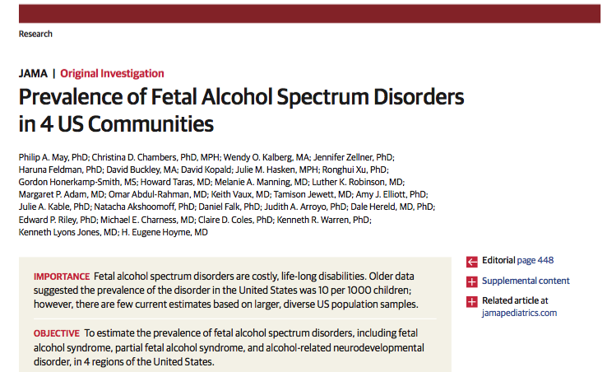
Prevalence across the four communities was as high as 5%
Prevalence in San Diego Unified School System 1st and 2nd grade students was 2.3%
There are approximately
200,000 new cases of FASD per year in the U.S.
U.S lifetime cost per person is $2.5 million
Cost in the U.S. is $3.4 billion per year
Notes:
Steve to Nisha --- what would we expect to see in SLO?

Slide 11
What is the LEAST amount of alcohol considered to be risky to the developing fetus?
Two glasses of wine per night throughout the pregnancy
Two glasses of wine per night just throughout the first trimester of pregnancy
Three glasses of wine per occasion on 2 occasions during the pregnancy
Three glasses of wine per occasion on 2 occasions per week throughout the pregnancy
Notes:
Steve

Slide 12
National Institute on Alcohol Abuse and Alcoholism (NIAAA)
Criteria for Risky Prenatal Alcohol Exposure
≥ 6 Drinks Per Week For ≥ 2 Weeks During Pregnancy
≥ 3 Drinks Per Occasion On ≥ 2 Occasions During Pregnancy
Notes:
Steve

Slide 13


During Pregnancy
THERE IS NO SAFE AMOUNT!!
Notes:
Nisha

Slide 14
What is the percentage of Juveniles with FASD who haVE encountered the juvenile justice system?
30%
40%
50%
60%
Notes:
Steve

Slide 15
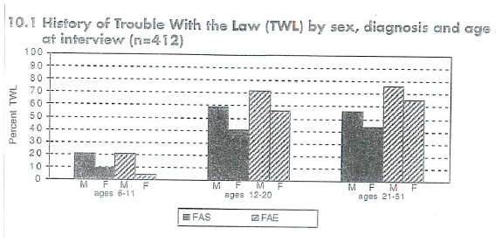
Streissguth A.P. et al. Understanding the Occurrence of Secondary Disabilities in Clients with Fetal Alcohol Syndrome and Fetal Alcohol Effects. Final Report August 1996
Notes:
Steve

Slide 16

FASD Screening Program San Diego Juvenile Detention Facility
134 – juveniles screened for FASD
32 (24%) screened positive
Notes:
Steve
This pilot program was provided as a free clinical service in cooperation with the Probation Department, Office of the Juvenile Public Defender and juvenile judges

Slide 17
San Diego Regional Center:
Provides A Wide Array of Services for Individuals with Developmental Disabilities
Fetal Alcohol
Spectrum Disorder 28.8%
PREVALENCE
San Diego Regional Center
Not a single child was previously reported by their parents to have FASD
Notes:
Steve

Slide 18
Clinical Study of Foster and Adopted Children with Prenatal Alcohol Exposure
547 KIDS seen in clinic, 156 of whom met criteria for FASD (28.5%)
  80.1% Of those 156 kids had never been diagnosed with FASD
  6.4% of those 156 kids had been Misdiagnosed with some other condition
86.5% of the kids who met FASD criteria were receiving belated diagnoses
Ira Chasnoff, M.D. 2015
Notes:
Nisha

Slide 19

Early Hurdles to Overcome for Children with FASD
Education Systems *Juvenile dependency * Justice Systems
Notes:
Steve
FAS is just the tip of the iceberg; rest of spectrum ‘invisible’

Slide 20

Margaret Shepard-Moore, MSW, Transitions-Mental Health Association, Mom
Notes:
Steve

Slide 21

Notes:
Nisha

Slide 22
Assessment and Treatment for Children Birth to Five
out-patient County mental health clinic
moderate to severe behavioral issues
prenatally exposed (suspected or known) to substances
Notes:
Martha's Place-CAC 547-1650
February 23
22
Nisha

Slide 23
Martha’s Place Team
Program Supervisor
Pediatricians
Therapists (LMFTs, interns and trainees)
Public Health Nurses
Family Advocate
Administrative Assistant
Medical Records Technician
Student interns
Occupational Therapists – Contract Providers
Notes:
Nisha

Slide 24
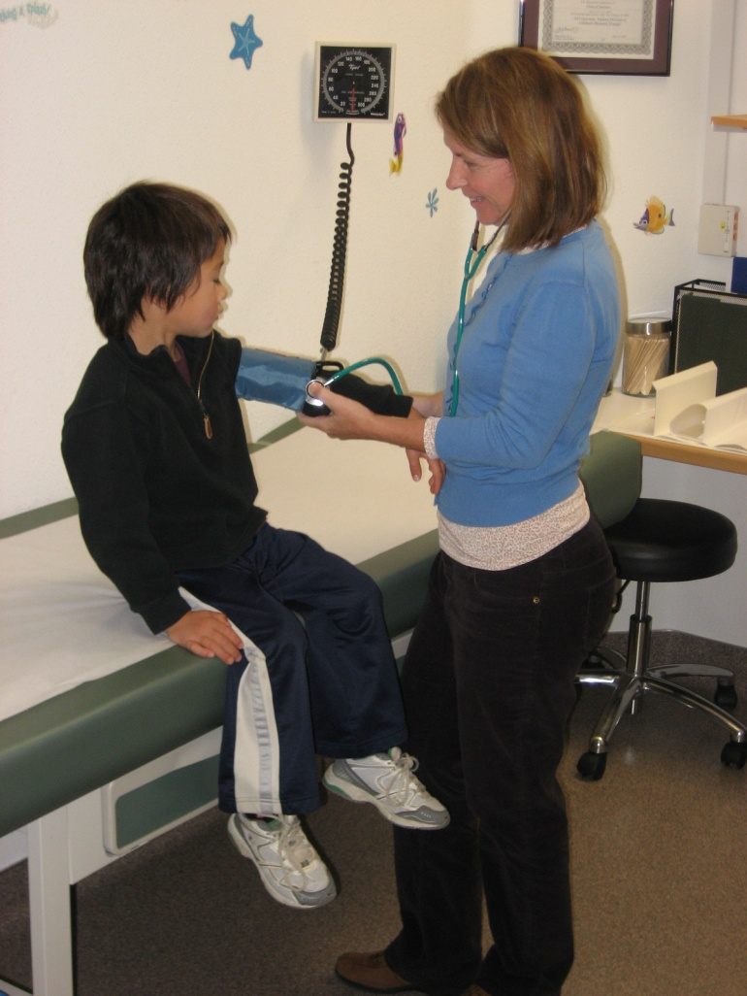
Assessment: Pediatric Evaluation
Full evaluation
  History
  Physical
    Growth
    FAS features
    Anomalies
    Neurologic
    Development
Re-evaluation
Medication management
Notes:
Martha's Place-CAC 547-1650
February 23
24
Nisha

Slide 25
SB 1016 Special Education: Eligibility: FASD
SB1016 is law as of January 1, 2023
SB 1016 Implementation Process
Director of Special Education Division of Department of Education
Implementation subcommittee chaired by Shannon Iacobacci.
Preparing guidelines for the schools
Will work with advocacy groups.
Need buy in of California Association of School Psychologists
Dr. Roxanne Chang Article
Need to development monitoring criteria
There’s A New Pathway to Special Education for Up to 300,000 California Children
Notes:
Steve

Slide 26
What Can Judges and lawyers Do?
Consider FASD diagnosis in individuals who have significant behavior problems. Unlikely any will have a diagnosis of FASD.
Confirmation of alcohol use is critical for ARND diagnosis
STIGMA is rampant. Use non-threatening questioning:
  “Before you knew you were pregnant how much alcohol did you typically use?”
  “ How far along in your pregnancy did your find out you were pregnant?”
Notes:
Steve

Slide 27
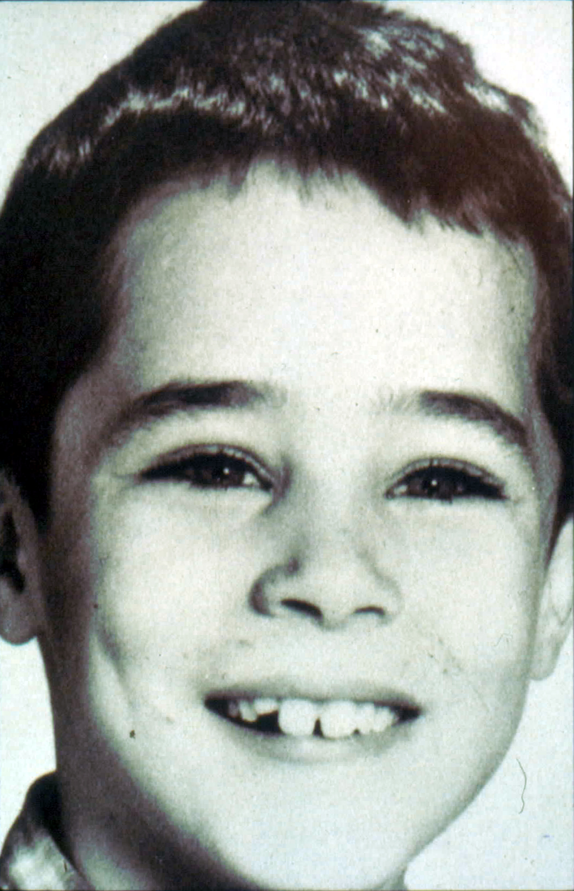
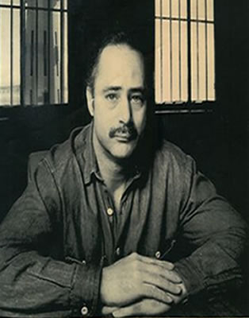
Robert Alton Harris
Executed April 21, 1992
Notes:
Steve

Slide 28
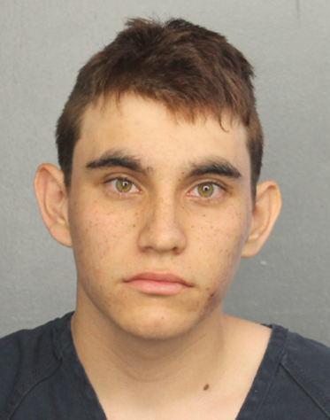
November 1, 2022: sentencing for the murder of 17 High School students and staff in Parkland , FL
(NY Times) FORT LAUDERDALE, Fla. — Brimming with rage, disappointment and grief, relatives confronted the gunman [24-year-old Nicholas Cruz] at a charged two-day sentencing hearing in which they repeatedly denounced the criminal justice system for sparing his life. . . .
after an emotional three-month trial, a jury recommended a sentence of life in prison without the possibility of parole. . .
. . . the families of victims wished Mr. Cruz a painful existence in prison and a painful death. Some discounted his defense lawyers’ arguments that his brain was damaged since birth by his biological mother’s drinking during pregnancy.…
Notes:
Steve

Slide 29
And yet ….
His prenatal exposure to alcohol was well documented by his biologic mother who admitted in the delivery room to being a severe alcoholic
He had numerous behavioral problems that were evident at an early age. he was expelled twice from preschool , repeated kindergarten, had no extracurricular activities and no friends
He was not diagnosed as having FASD until he was 22 years when his lawyers determined that he had been exposed prenatally to alcohol and requested a physical exam and neuropsychological testing
If he had been diagnosed in the first 5 years of life , he would have had the opportunity to receive support and appropriate intervention programs specifically for FASD

Slide 30

Federal
FASD Respect Act
Over 70 co-sponsors, 24 from California
Sponsors are planning a strong reintroduction in February 2023
For legislative HotLine process, bill needed senatorial unanimity. On December 23, 2022, one Senator had not agreed, and the deadline passed.
Although not heard in House or Senate Committees, almost included in the 2022 Omnibus Bill
Notes:
Steve

Slide 31
SUMMARY
Of all drugs of abuse alcohol has the greatest impact on the developing fetus
FASD is more common than autism and has created public health crisis.
FASD is the number 1 recognizable cause of intellectual and developmental disabilities in the U.S. and is PREVENTABLE
Collaborative treatment is vital (juvenile court, social workers, probation officers, health care providers, educators, physicians, therapists,, psychologists, caregivers and parents)
The earlier FASD children are identified , the greater the chance for success
Notes:
Steve and Nisha

Slide 32

Written materials
2018 JAMA research article on FASD prevalence
“Motherless children” legal paper on FASD in the courts
July2022 parent empowerment newsletter, pages 4-6 (Christine Hoffman)
FASD now! Fact sheet on FASD impacts
Notes:
Steve -- Christine Hoffman is a licensed marriage and family therapist and works for the County of San Luis Obispo as a Behavioral Health Program Supervisor.
She previously worked as a therapist for youth in foster care through the Katie A. program.

Slide 33

ONLINE RESources
Try episode #012 with Ira Chasnoff, M.D.
Notes:
Steve

Slide 34
Judge crandall c.stevens.Crandall@gmaiL@GMAIL.COM
Dr. Nisha abdulcader pediatricdoc@msn.com

