Slide 1
Understanding Federal Civil Rights Enforcement
Matt Nickell & Julius Nam
Assistant United States Attorneys
U.S. Attorney’s Office, Central District of CA
Notes:
Add name & title

Slide 2
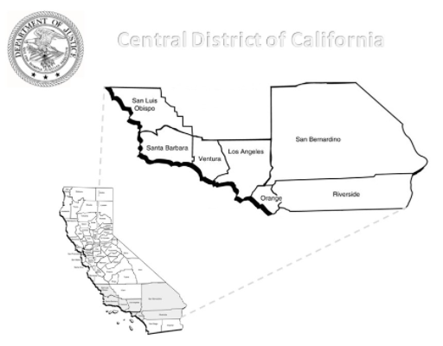
U.S. Attorney’s Office Central District of California
U.S. Department of Justice
3 Offices Covering 7 Counties
LOS ANGELES: LA, Ventura, Santa Barbara, San Luis Obispo
RIVERSIDE: Riverside, San Bernardino
SANTA ANA: Orange

Slide 3
Unique Federal Government Role
Dual Jurisdiction
Successive Prosecution
Separate Remedies

Slide 4
U.S. Attorney’s Office
Criminal Division
Public Corruption and Civil Rights Section
National Security Division
Civil Division
Civil Rights Section
Tax Division
Federal Criminal Charges
Subject Deterrence
Referrals
Civil Enforcement
Assist
Locals

Slide 5
Civil Rights Laws: Criminal Enforcement
Statute | Description
18 U.S.C. § 241 | Conspiracy Against Rights
18 U.S.C. § 242 | Deprivation of Rights Under Color of Law
18 U.S.C. § 245 | Interference of Federally Protected Activities
18 U.S.C. § 247 | Damage to Religious Properties
18 U.S.C. § 248 | Interference to Freedom of Access to Clinic Entrances (FACE Act)
18 U.S.C. § 249 | Hate Crimes
42 U.S.C. § 3631 | Criminal Interference With Right to Fair Housing
18 U.S.C. § 1001 | False Statements
18 U.S.C. §§ 1509-1513 | Obstruction of Justice
18 U.S.C. § 1519 | Falsification of Records

Slide 6
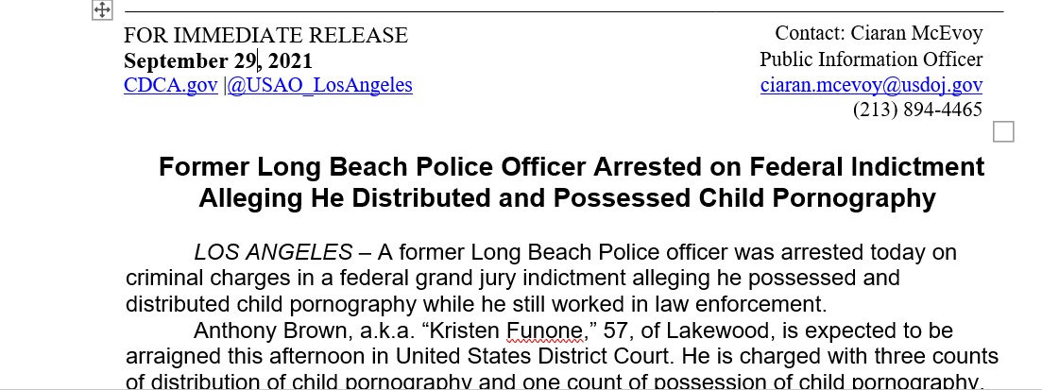
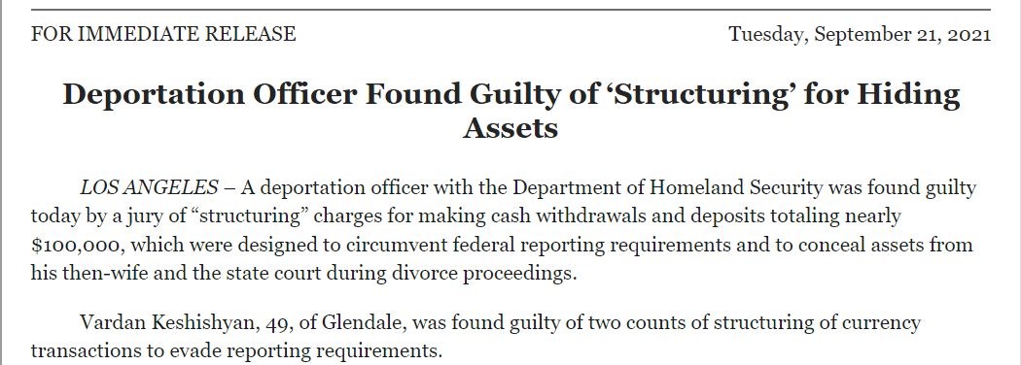
Check on Law Enforcement

Slide 7
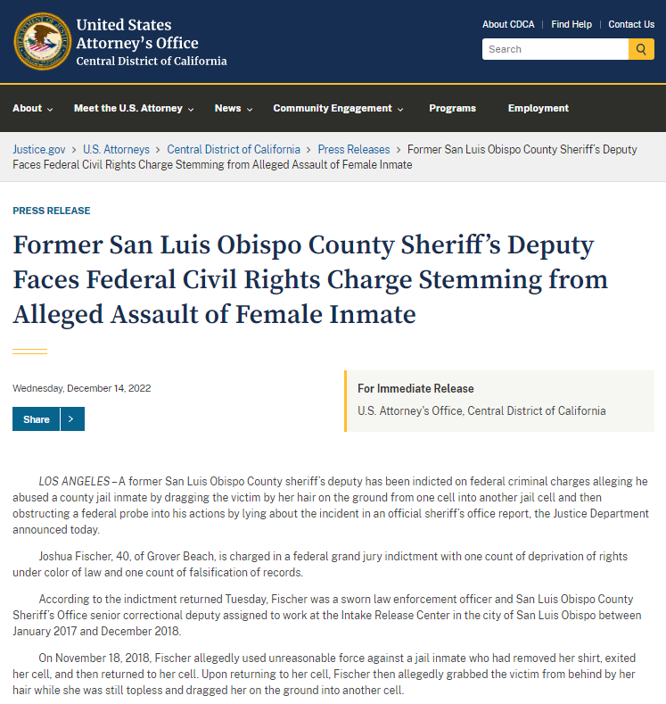

Slide 9
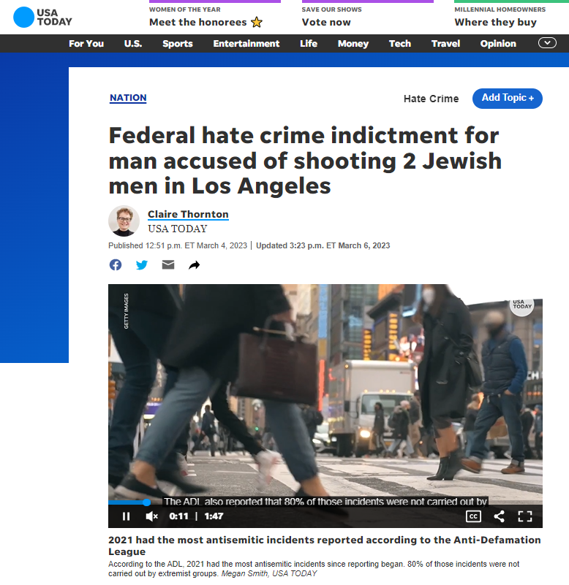

Slide 10
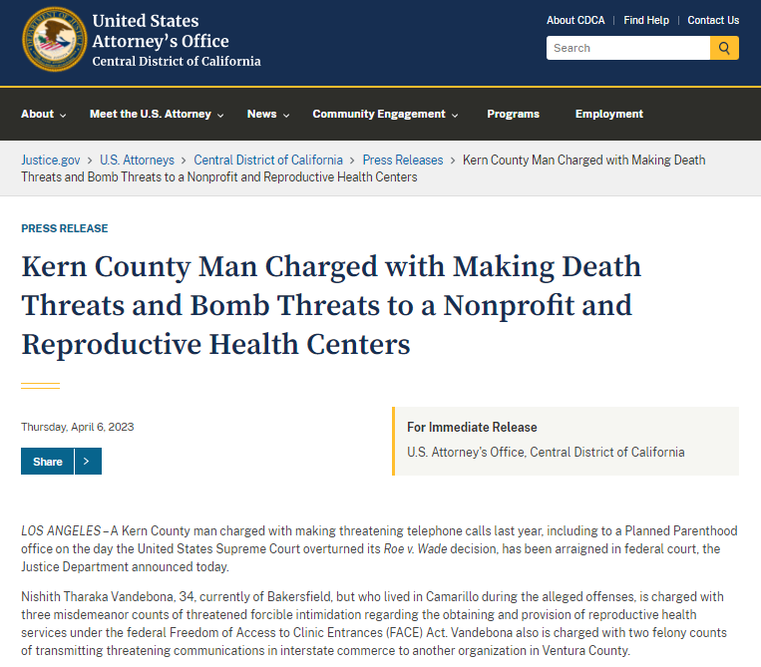

Slide 11
Civil Rights Laws – Civil Enforcement
Civil Rights of Institutionalized Persons Act
Violent Crime Control and Law Enforcement Act of 1994
Americans with Disabilities Act
Civil Rights Act of 1964
Voting Rights Act
Fair Housing Act
Religious Land Use and Institutionalized Persons Act
Equal Credit Opportunity Act
Servicemembers Civil Relief Act
Uniformed Servicemembers Employment and Reemployment Rights Act

Slide 12
Civil Rights of Institutionalized Persons Act (CRIPA), 42 U.S.C. § 1997
Investigations into a “pattern or practice” of unconstitutional or unlawful conditions in correctional institutions
Conditions can include inadequate medical or mental health care, excessive force, failure to prevent violence, and unsanitary living conditions, among others
Can seek equitable relief

Slide 13
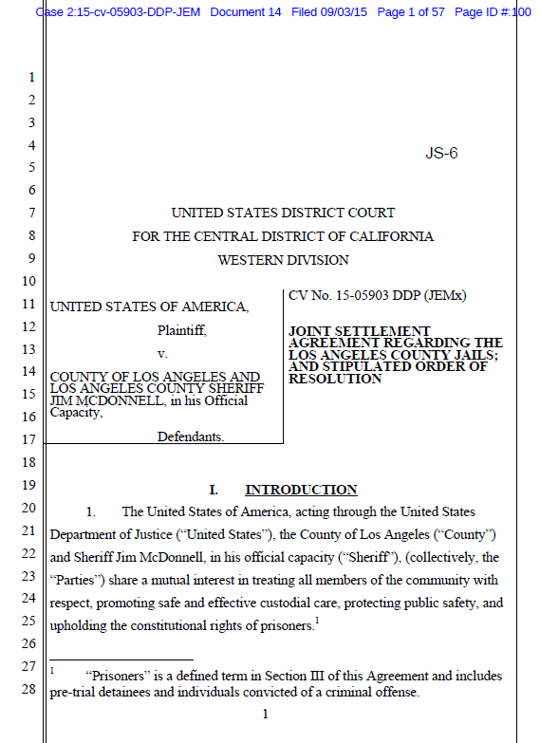
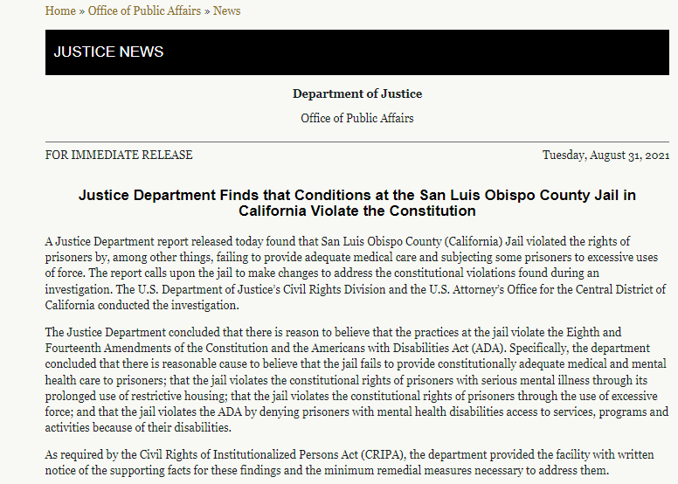

Slide 14
Violent Crime Control and Law Enforcement Act of 1994, 42 U.S.C. § 14141
State and local law enforcement agencies
Areas include excessive force, unlawful stops, searches, or arrests, and discriminatory policing.
Look for pattern or practice of conduct that systemically violates people's rights.

Slide 15
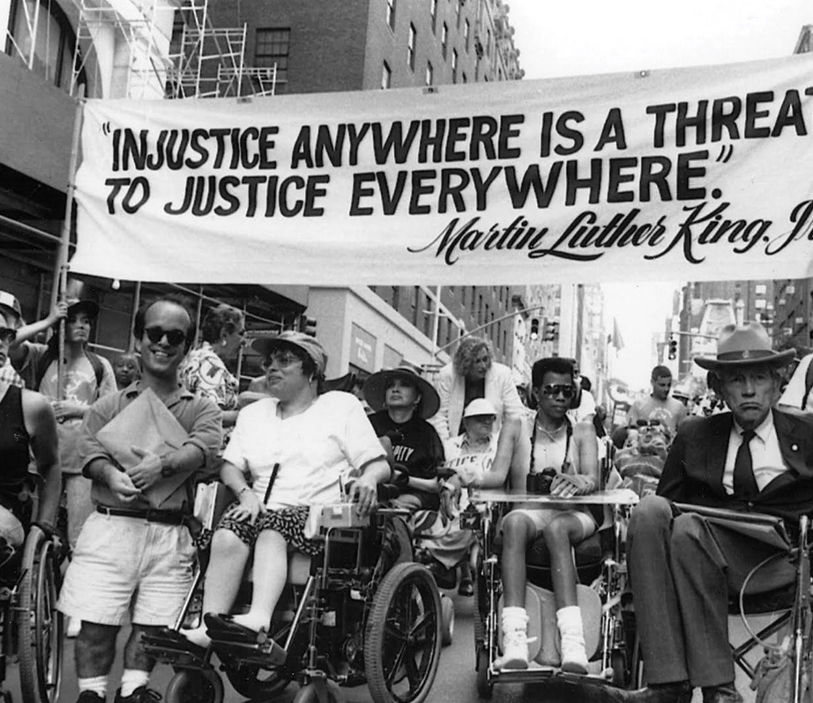
Americans with Disabilities Act 42 U.S.C. § 12101 et al.
Prohibits disability discrimination in:
Employment
Public Accommodations
Transportation
Programs, services, and activities of state and local governments
Reasonable modifications and accommodations

Slide 16
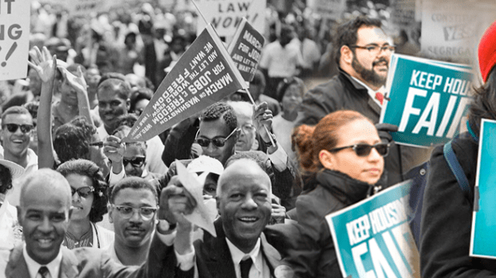
Fair Housing Act 42 U.S.C. Section 3601 et seq.
Prohibits discrimination:
In rental housing, sales, advertising, terms/conditions, and more
By landlords, real estate companies, municipalities, banks, other lending institutions, homeowners insurance companies, and others
On the basis of race, color, religion, sex, national origin, familial status, or disability

Slide 17
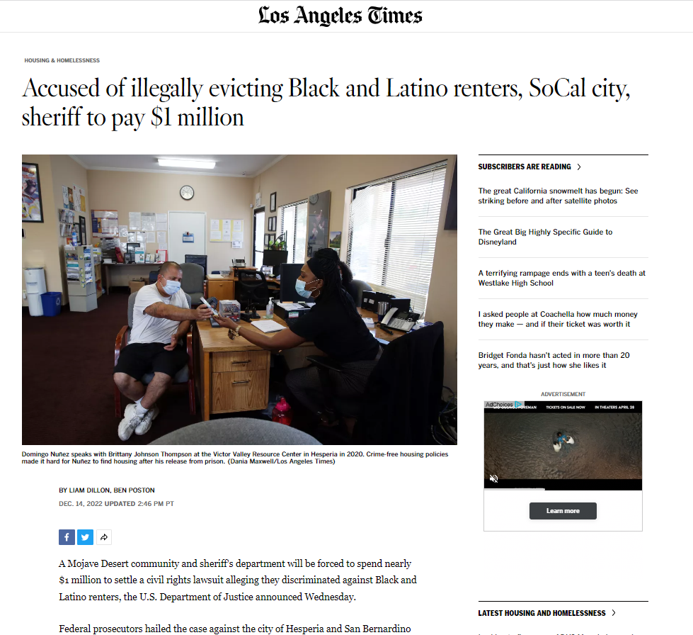

Slide 18
From Complaint to Criminal Judgment / Civil Resolution
Hypothetical Federal Case

Slide 19
Complaint
FBI complaint line / other complaint portal / referral
News or social media
Local partners

Slide 20
Investigation
Victim/witness interviews
Surveillance videos
Social media accounts
Search warrants
Subject interview
Review of publicly available documents

Slide 21
Criminal Charges
Attorney General approvals
Grand Jury Indictment
Arrest Warrant

Slide 22
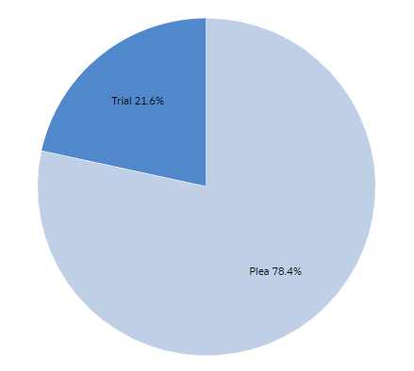
Plea/Trial

Slide 23
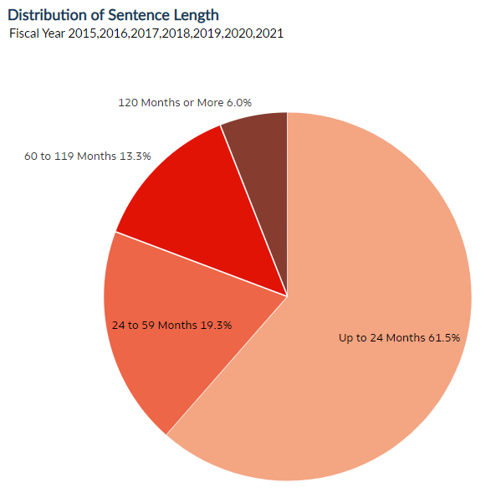
Sentencing
Statutory Maximums
Sentencing Guidelines

Slide 24
Criminal Complaints
Federal Bureau of Investigation
(310) 477-6565
www.fbi.gov/tips

Slide 25
Civil Investigations and Actions
Steps vary by statute enforced
Attorney General or designee approval – needed for some matters
Notice requirements for some investigations and lawsuits
Ex. Civil Rights of Institutionalized Persons Act (CRIPA), 42 U.S.C. 1997 et seq.
Common resolution pathways
Settlements, consent decrees, and monitoring
Lawsuits
Injunctive relief, damages, and civil penalties

Slide 26
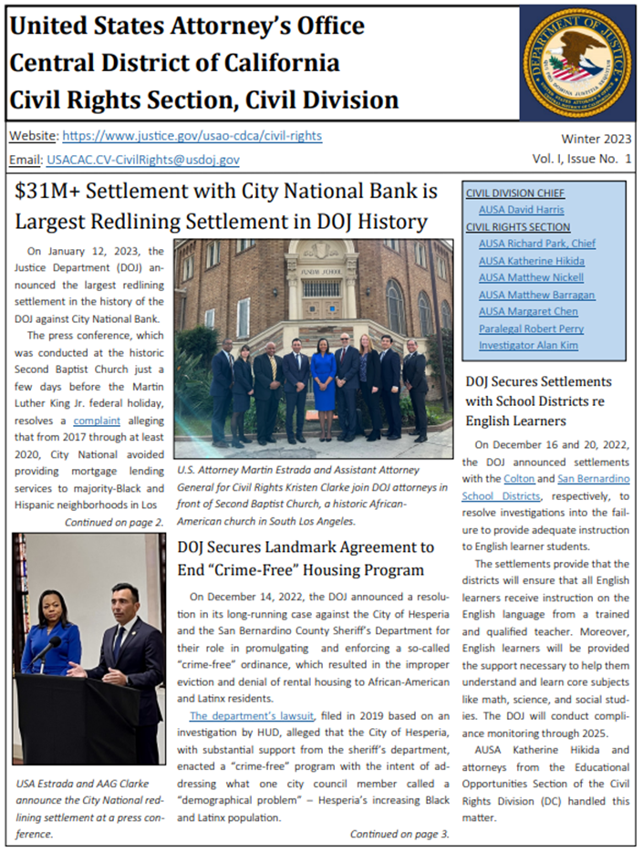

Slide 27
Life of a (Civil) Civil Rights Matter
Preliminary
Inquiry
Formal
Investigation
Findings
(req’d by some statutes)
Settlement or
Consent Decree
Success
Compliance
Monitoring
Negotiations
No Success
Lawsuit &
Judgment

Slide 28
Civil Rights Section, Civil Division United States Attorney’s Office
Section website: https://www.justice.gov/usao-cdca/civil-rights
Section email: CV-CivilRights@usdoj.gov
Complaint form: https://www.justice.gov/media/1161311/dl?inline
Phone: (213) 894-2879

Slide 29
Civil Rights Division - Department of Justice
Website: https://www.justice.gov/crt
Report form: https://civilrights.justice.gov/report/
Sections:
Housing and Civil Enforcement Section
Immigrant and Employee Rights Section
Policy and Strategy Section
Special Litigation Section
Voting Section
Appellate Section
Criminal Section
Disability Rights Section
Educational Opportunities Section
Employment Litigation Section
Federal Coordination and Compliance

Slide 30
Thank you!
Julius Nam, AUSA, Public Corruption and Civil Rights Section, Criminal Division
julius.nam@usdoj.gov, (951) 276-6942
Matt Nickell, AUSA, Civil Rights Section, Civil Division
matthew.nickell@usdoj.gov, (213) 894-8805
U.S. Attorney’s Office: www.justice.gov/usao-cdca

