Slide 1
California’s Legal Deserts
Prof. Lisa R. Pruitt
Martin Luther King, Jr. Professor of Law
University of California, Davis
San Luis Obispo County Bar Association
May 18, 2023

Slide 2
National attention to rural lawyer shortage since 2013

Slide 3
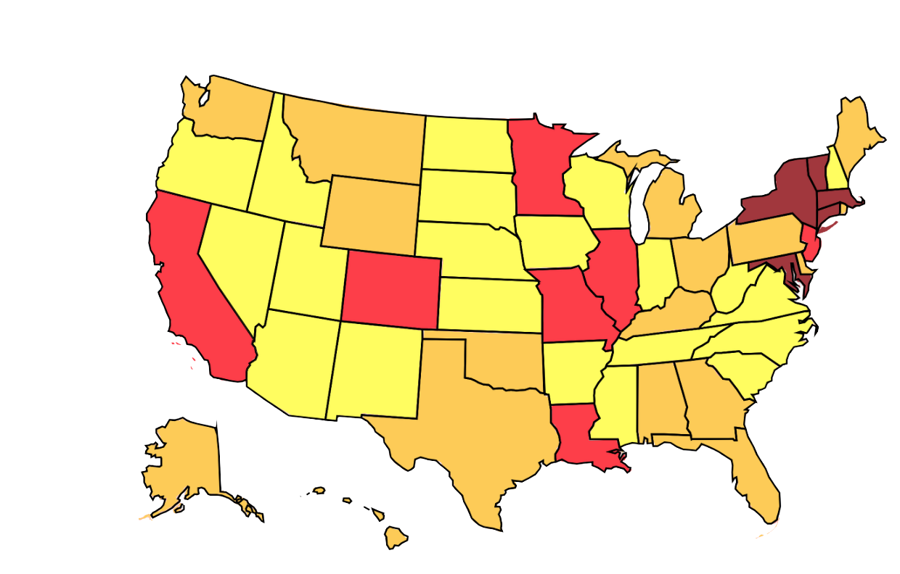
THE SHORTAGE IN NUMBERS
14% of US residents live in rural areas, but only 2% of lawyers practice there
Ethan Bronner, 2013, New York Times
Map from ABA Profile of the Profession (2020)
Lighter the color, worse the shortage (bright yellow)

Slide 5
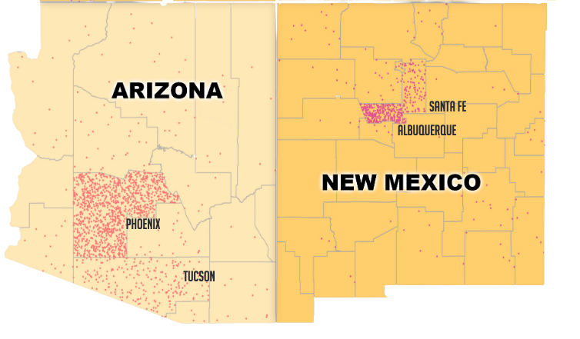
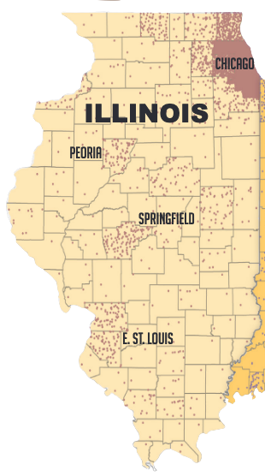
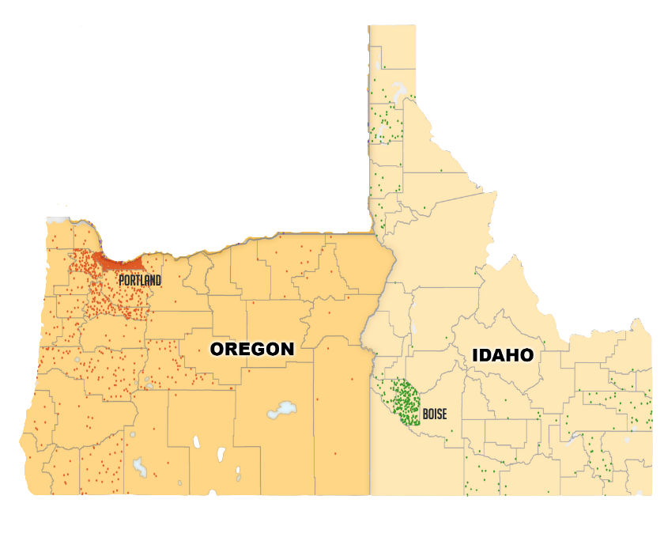
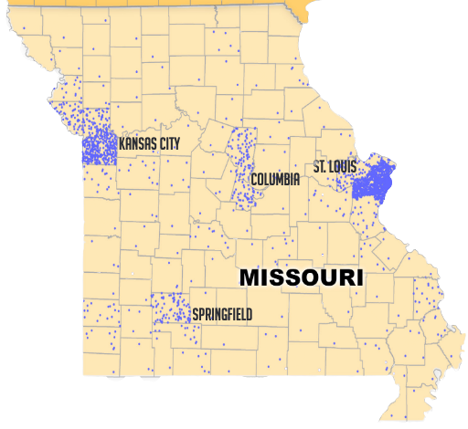
Shortages by Region
West
Northwest
Midwest
Notes:
From ABA Profile of the Legal Profession 2020

Slide 6
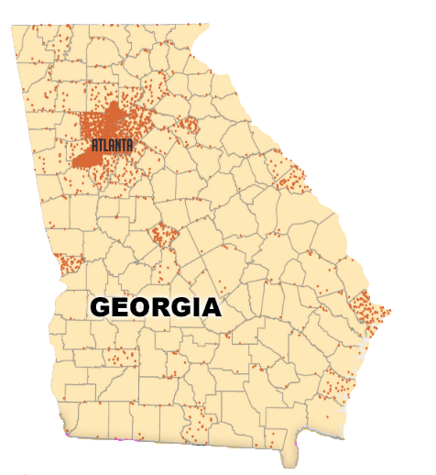
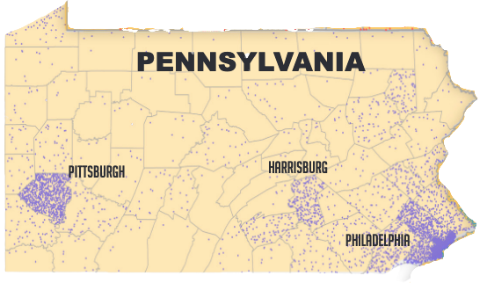
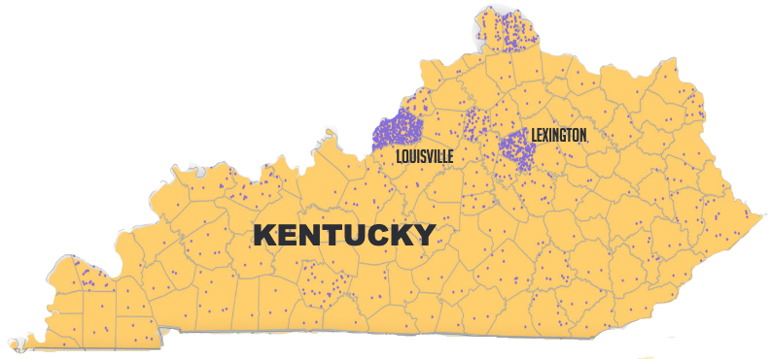
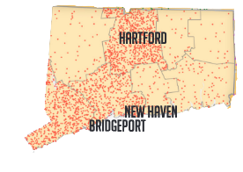
Shortages by Region
South
Northeast
Notes:
From ABA Profile of the Legal Profession 2020

Slide 7
Where are California’s Attorneys?

Slide 8
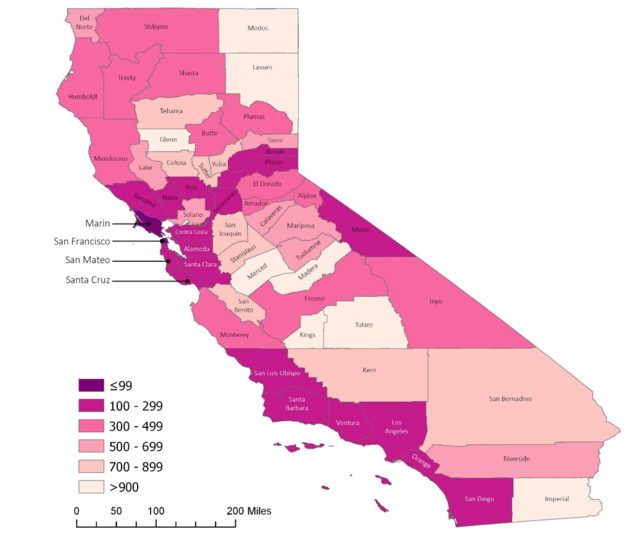
California County-Level Attorney Distribution (2016)
Residents per Attorney by County
San Francisco: 1: 41
Kings: 1:1364

Slide 9
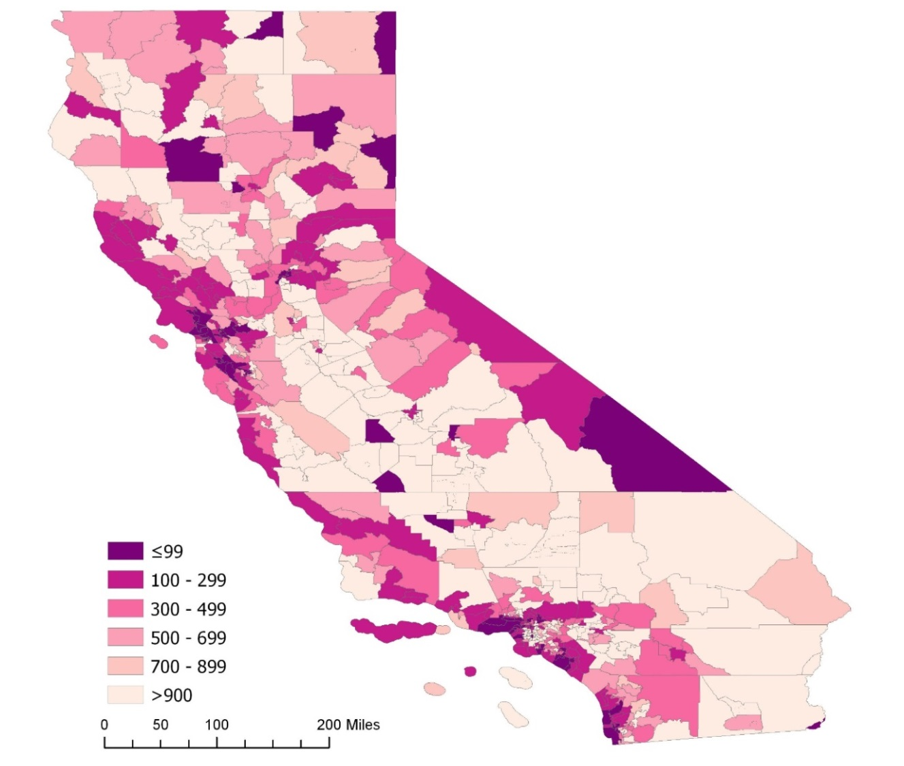
MSSA-Level Attorney Distribution (Medical Service Study Area: Clusters of Census Tracts, sub-county units)
Residents per Attorney (MSSA)

Slide 10
MSSA definitions
Creates of California bureaucracy
“Urban” MSSAs have populations between 75,000 and 125,000 people and reflect recognized community boundaries that share similar socio-economic and demographic characteristics
”Rural” MSSAs have 50,000 or fewer residents and population densities below 250 people per square mile
“Frontier” MSSAs defined by population densities of fewer than 11 persons per square mile.

Slide 11
Advantage of MSSA Data
Finer level of detail than county yields more useful information
Most metropolitan counties contain “rural” MSSAs
Only counties with no “rural” MSSAs are San Francisco and Orange
Fresno County features fifth largest city in the state but also contains 8 rural MSSAs (and only 6 urban MSSAs)
But, county unit remains important because where the courthouse(s) is/are

Slide 12
Statewide Distribution of Lawyers in California (2016)
Notes:
Anujan: This lawyer data is based on State Bar of California Data from 2016, coupled with Census Bureau Data from 2014. The “urban,” “rural” and “frontier” definitions are related to a scale recognized by the government which clusters census tracts. It is the Medical Service Study Area unit or scale—MSSA for short—and I have the definitions for those categories in the next slide.
Note that the lawyer data includes all lawyers in the county, not only those taking private representation. So, the number includes county counsel, judges, prosecutors, and all manner of government lawyers, be they employed by the federal, state or local government units.
Sierra County anecdote: data show five lawyers, but only one takes private clients; all others are government lawyers.

Slide 13
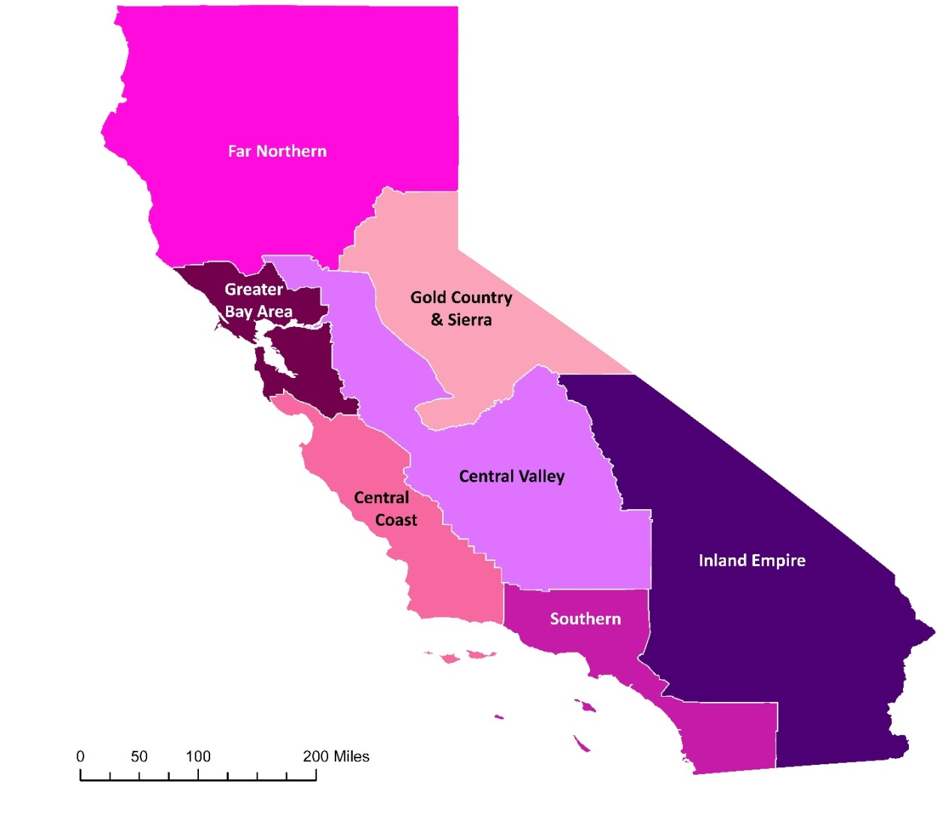
California’s regions

Slide 14
Regional Distribution: Residents per Attorney and Lawyers per Square Mile
Notes:
This table also includes information on the poverty rate, which we depict visually (by county level) on the next slide

Slide 15
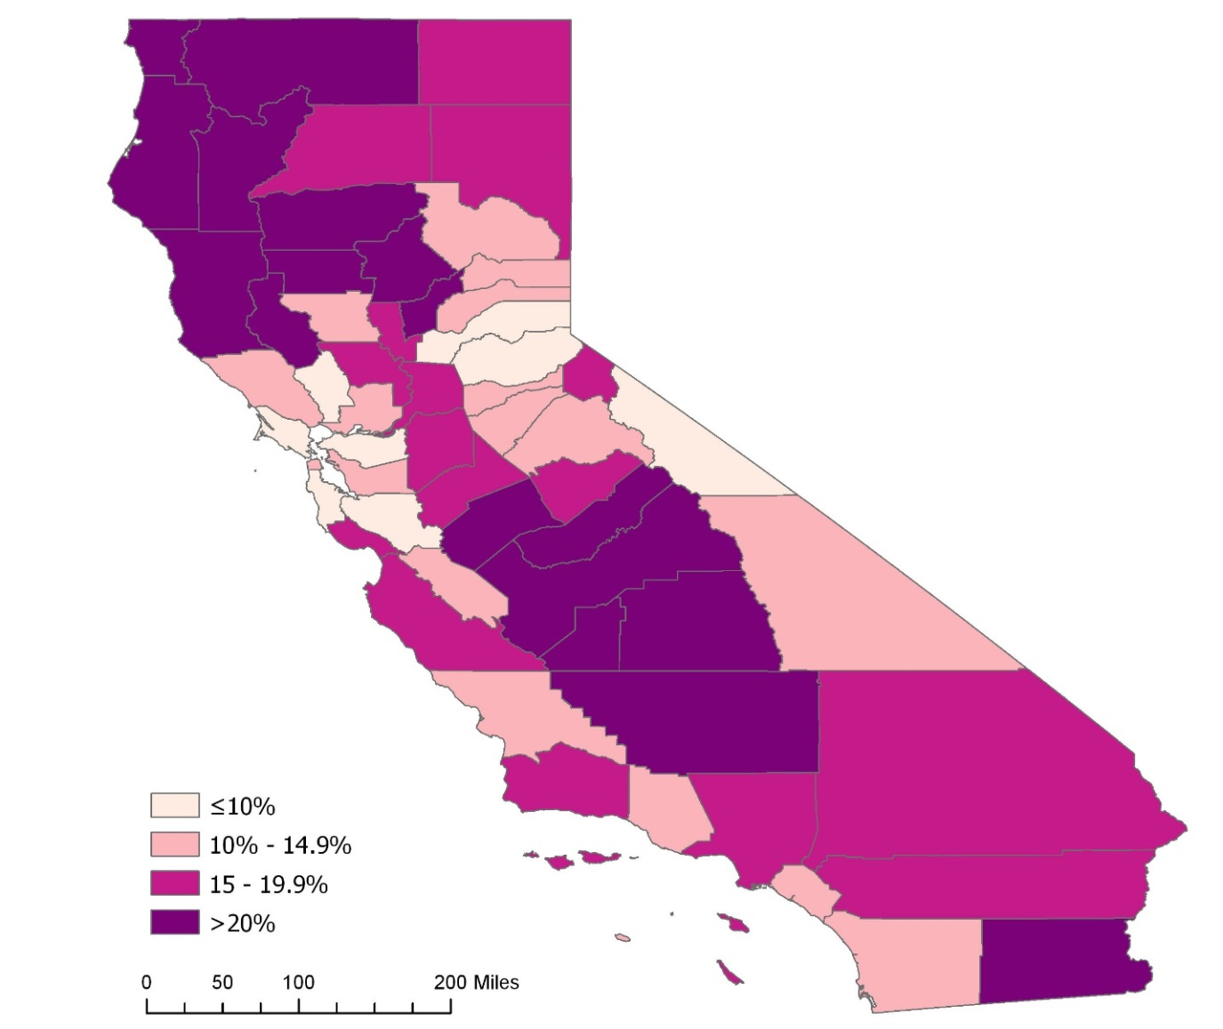
County-Level Poverty Rate

Slide 16
County-level Attorney Distribution
Map 3: Residents per Attorney by County
Darker = Higher Attorney Density

Slide 17
MSSA-Level Attorney Distribution
Residents per Attorney (MSSA)

Slide 18
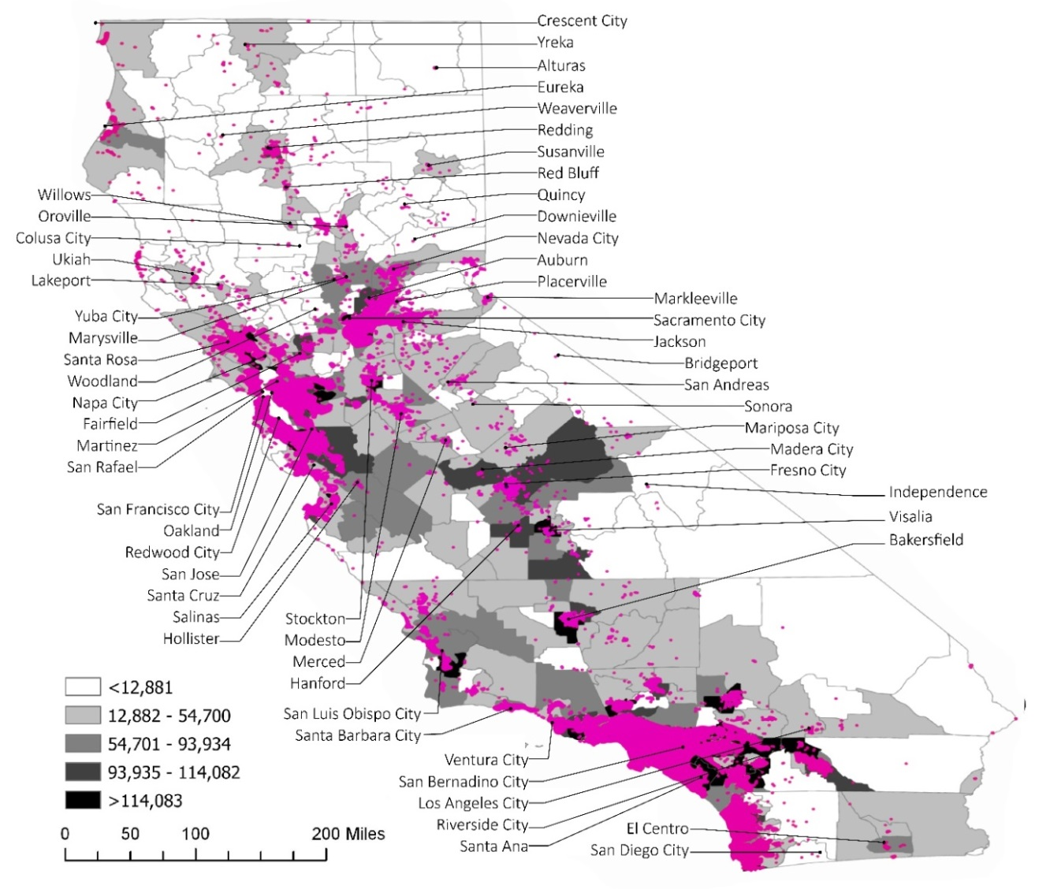
Mapping Attorney Presence in California (2016): The Meeker Data
Population (by MSSA) and Attorneys (Pink Dots)
Notes:
Meeker’s data .. Includes inactive and active attorneys ….

Slide 19
Fresno County
6000 square miles, 98% rural or frontier
37% of county’s population rural or frontier, but just 5% of attorneys are
Fresno (City) 5th largest in California
Urban attorney-to-residents ratio: 1:417
Rural/Frontier ratio: 1:2887
Each urban attorneys serves 0.06 square miles
Each rural/frontier attorney serves 48 square miles

Slide 20
Shasta County
4000 square miles
County: 180K residents
Redding: 92K residents
Attorneys: 443
Redding: 387 attorneys (87%)
Rural attorneys: 33
Frontier attorneys: 23
Redding ratio: 1:257
Outer Shasta Co. ratio: 1:1408

Slide 21
San Luis Obispo (and neighboring counties)

Slide 22
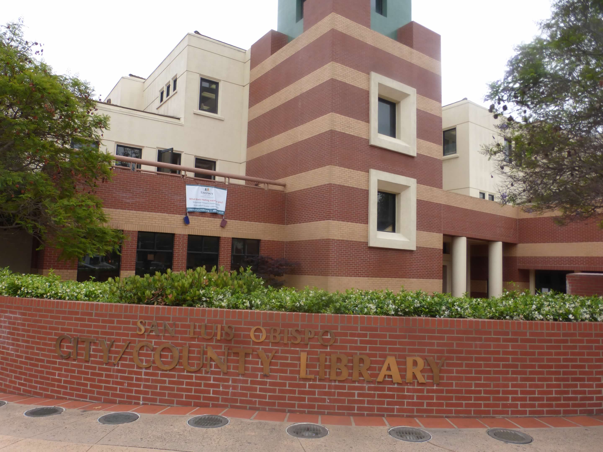
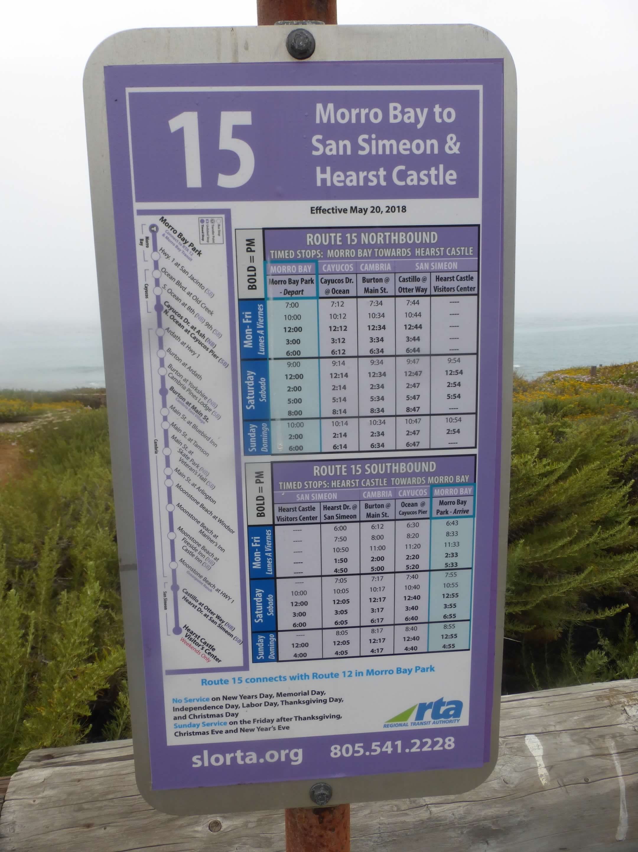
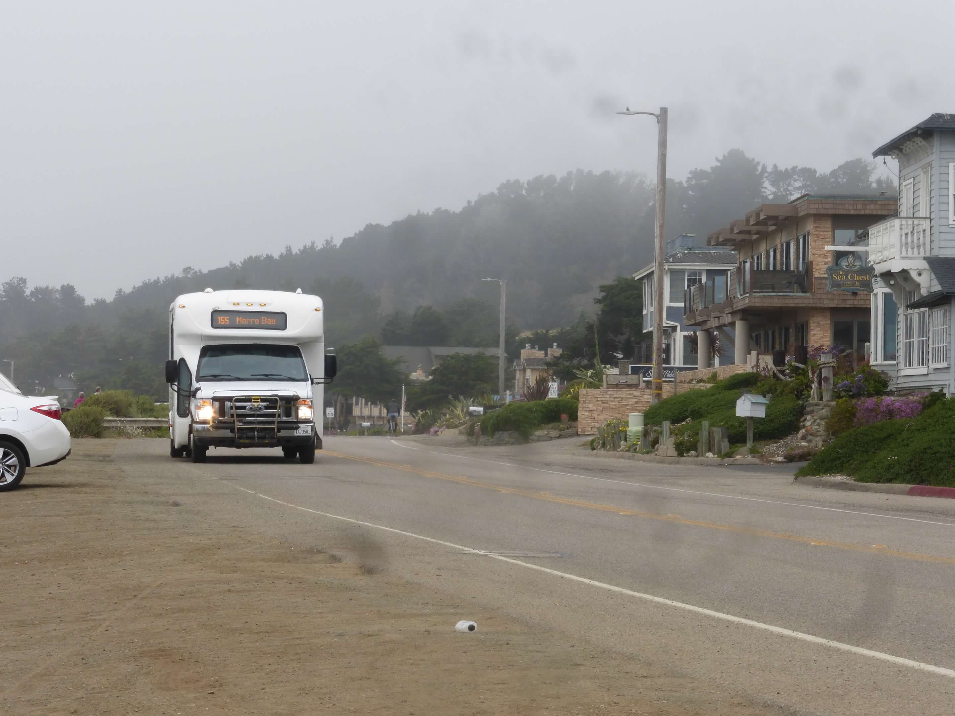
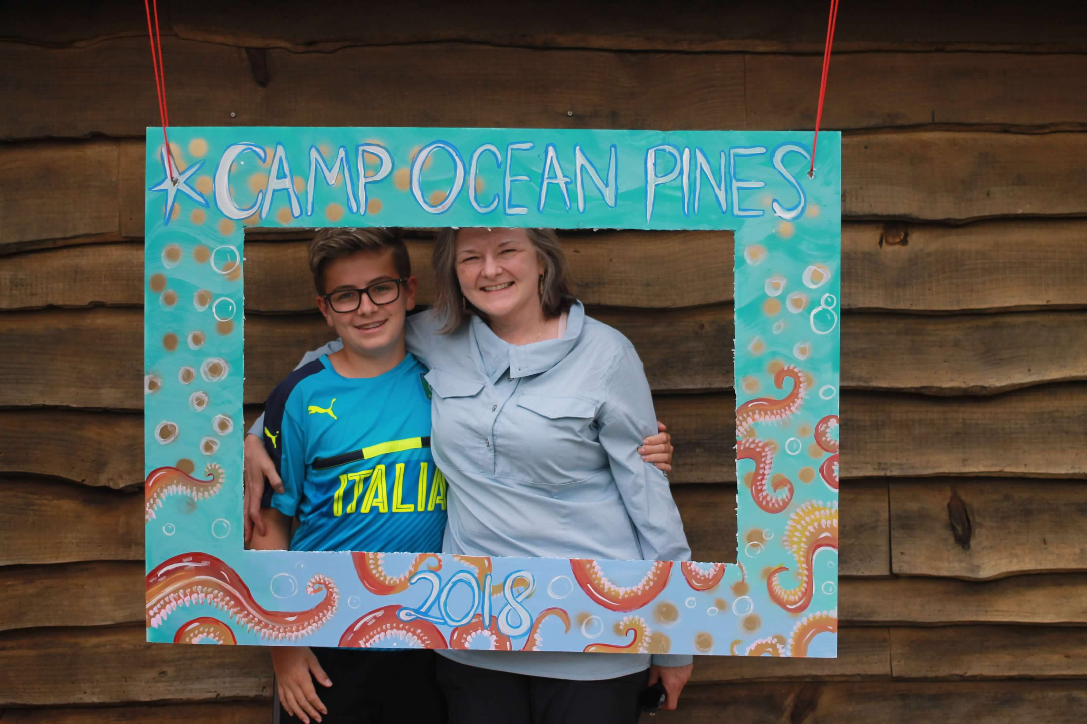
San Luis Obispo County
County

Slide 24
SLO County & SLO City Data (+ Atascadero/Templeton)
Square Miles: 3,616 square miles
SLO County Population: 282,424
Population Per Square Mile: 78.1/square mile
SLO County Number of Attorneys: 997
SLO County Ratio of Attorneys to Residents: 1:275
SLO County Attorneys per Square Mile: 0.27 attorneys per square mile.
SLO City MSSA Population: 65,939 (compared to 47K for just city) in 10.34 square miles
Attorneys in SLO City MSSA: 479
SLO City MSSA Ratio of Attorney to Residents: 1:138
SLO City Attorneys Per Square Mile:
Atascadero (30K)/Templeton MSSA Population: 38,716
Attorneys in Atascadero/Templeton MSSA: 76
Atascadero/Templeton Ratio of Attorneys to Residents: 1:509
Notes:
The square miles and current population picked up from Wikipedia in May 2023—so a little different from what is in our tables following.

Slide 25
San Luis Obispo County Data (2016) (Population per Lawyer)

Slide 26
San Luis Obispo County Data 2016 (Lawyers per Square Mile)

Slide 27
Monterey County Data 2016 (Population per Lawyer)

Slide 28
Monterey County Data 2016 (Lawyers per square mile)

Slide 29
Santa Barbara County Data 2016 (Population per Lawyer)

Slide 30
Santa Barbara County Data 2016 (Lawyers per square mile)

Slide 31
Kern County Lawyer Data 2016 (Population per Attorney)

Slide 32
Kern County Lawyer Data 2016 (Lawyers per square mile)

Slide 33
SLO and Neighboring County Lawyer Data 2016 (Population per lawyer)

Slide 34
SLO and Neighboring County Lawyer Data 2016 (Lawyers per square mile)

Slide 35
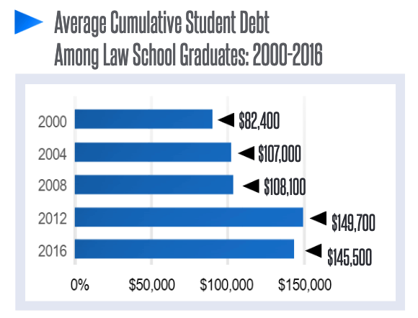
CAUSES OF RURAL LAWYER SHORTAGES
Deterrents to practicing in rural areas can include:
Fiscal
Price to buyout a private practice
Perception of employment and career opportunities
Fear of malpractice
Social & Personal
Culture of urban vs. rural communities
Infrastructure, e.g., K-12 school quality; health care
Ability to find a life partner or for life partner to find a job, etc.

Slide 36
Consequent Lack of Access
Financial Inaccessability
Knowledge gap
Community Inaccessibility
Legal Aid Lawyers can only provide services to clients who meet the income threshold: 125% of the federal poverty line
Travel costs for court-appointed lawyers translate into higher costs for taxpayers
71% of low-income households experienced at least one civil legal problem, but of those reported, 86% received inadequate or no legal help
Hub & Spoke model:
Organizations often have lawyers based in a small city hub, who travel to rural areas as needed
Criminal Law Consequences
Lack of lawyers in rural areas translate to longer jail stays for the same charge as in urban areas; a 27% steeper rise in jail populations than in urban areas

Slide 37
Responses to the Shortage
1. Finacial incentives to rural practice
South Dakota Rural Lawyer Stipend + N.D., too!
Student Loan Repayment Programs
2. Inucbators
The Arkansas Rural Practice Incubator Project
Others in Iowa, Montana, Nebraska, New Mexico, North Dakota, Vermont
3. Succession Planning
State Bar of Georgia’s Succession Planning Pilot Program
Colorado’s Rural Virtual Practice Program
National programs: Equal Justice Works & Legal Services Corporation's Rural Summer Legal Corps,
4. Channeling Urban Resources to Rural Areas
Telephonic and videoconferencing
The Bay Area Rural Justice Collaborative
The Government Law Center at Albany Law School
CLE for pro bono rural work (Ohio & Tennessee)
The Greater Wisconsin Initiative Bus Tour

Slide 38
The Role of Legal Education
During Law School
Clinics that connect students and areas of rural law
Courses that prepare students
After Law School
Student Debt—Loan Forgiveness
Before Law School
Develop the pipeline from rural areas to rural practice
Notes:
Take rural practice seriously!

Slide 39
QUESTIONS? Thank you.

