Slide 1
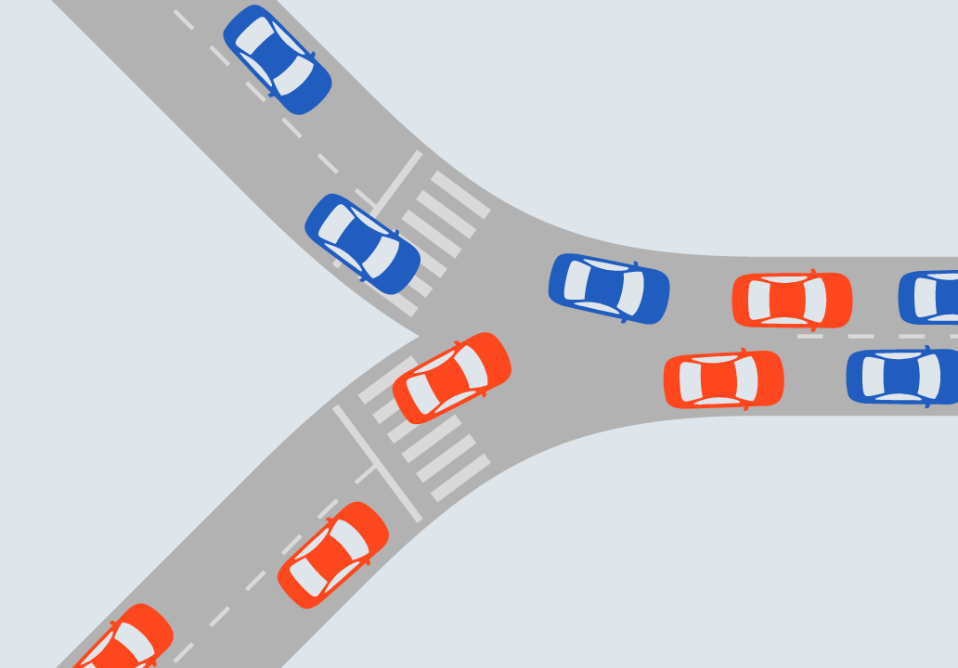
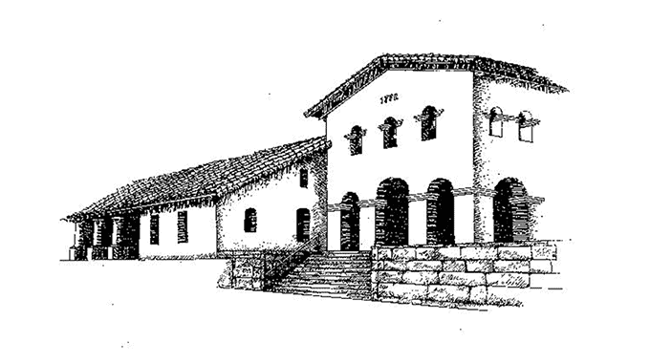
ISSUES IN SUBTRUST ALLOCATION FOR LITIGATORS
Judge Glen Reiser (Ret.)
SAN LUIS OBISPO COUNTY BAR ASSOCIATION

Slide 2
WHY IS THIS EVEN A PROBLEM ?

Slide 3
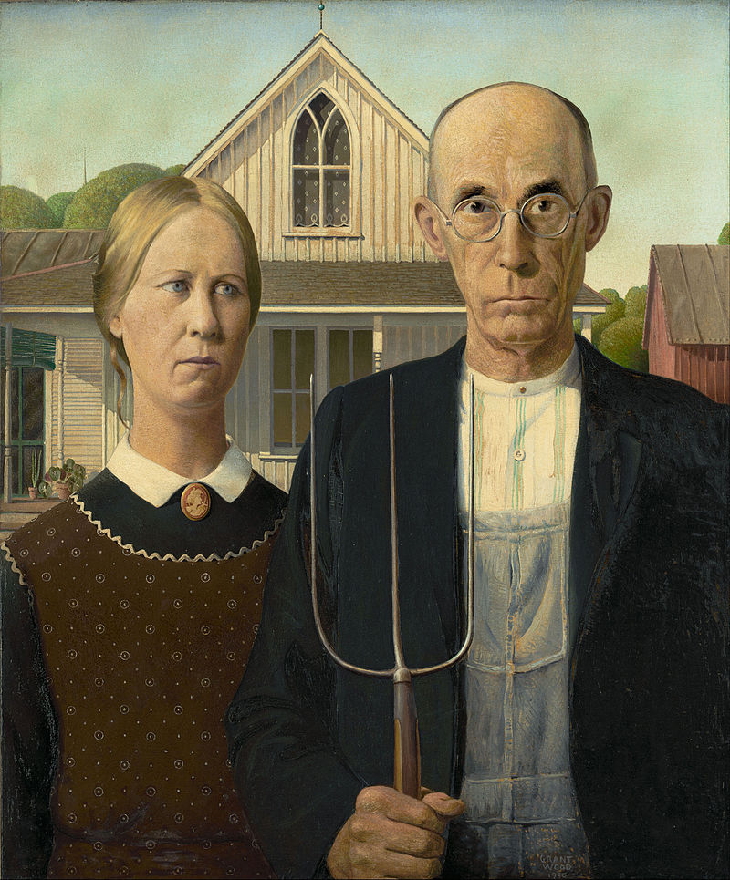
THE ESTATE TAX MARITAL DEDUCTION
Estates of a certain value must pay estate (death) taxes
Deduction is unlimited for all property passing to the surviving spouse
Deduction only defers taxes; it does not eliminate them
Every person has a lifetime credit called the “estate tax exemption” equivalent
If the entire estate passes to the surviving spouse, the lifetime exemption amount of the first spouse was lost prior to 2012

Slide 4
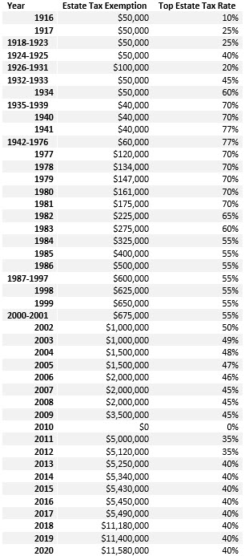
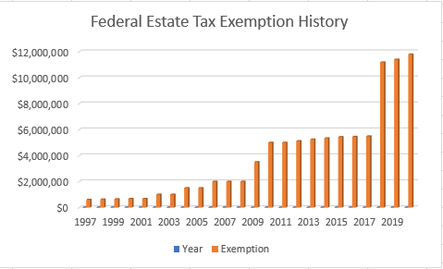
FEDERAL ESTATE TAX RATES
2010 No Estate Tax; but No Stepped-Up Basis 2021 Exemption $11,700,000 Rate: 40%
2022 Exemption $12,060,000 Rate: 40%
2023 Exemption $12,920,000 Rate: 40%

Slide 5
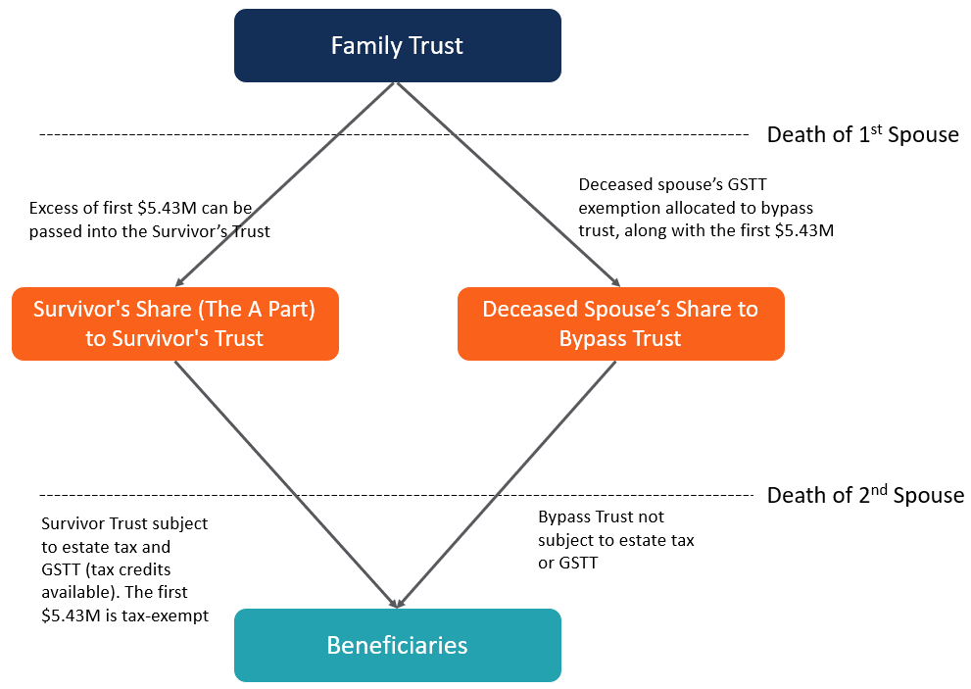
THE “A-B” TRUST– (first death 2015)

Slide 6
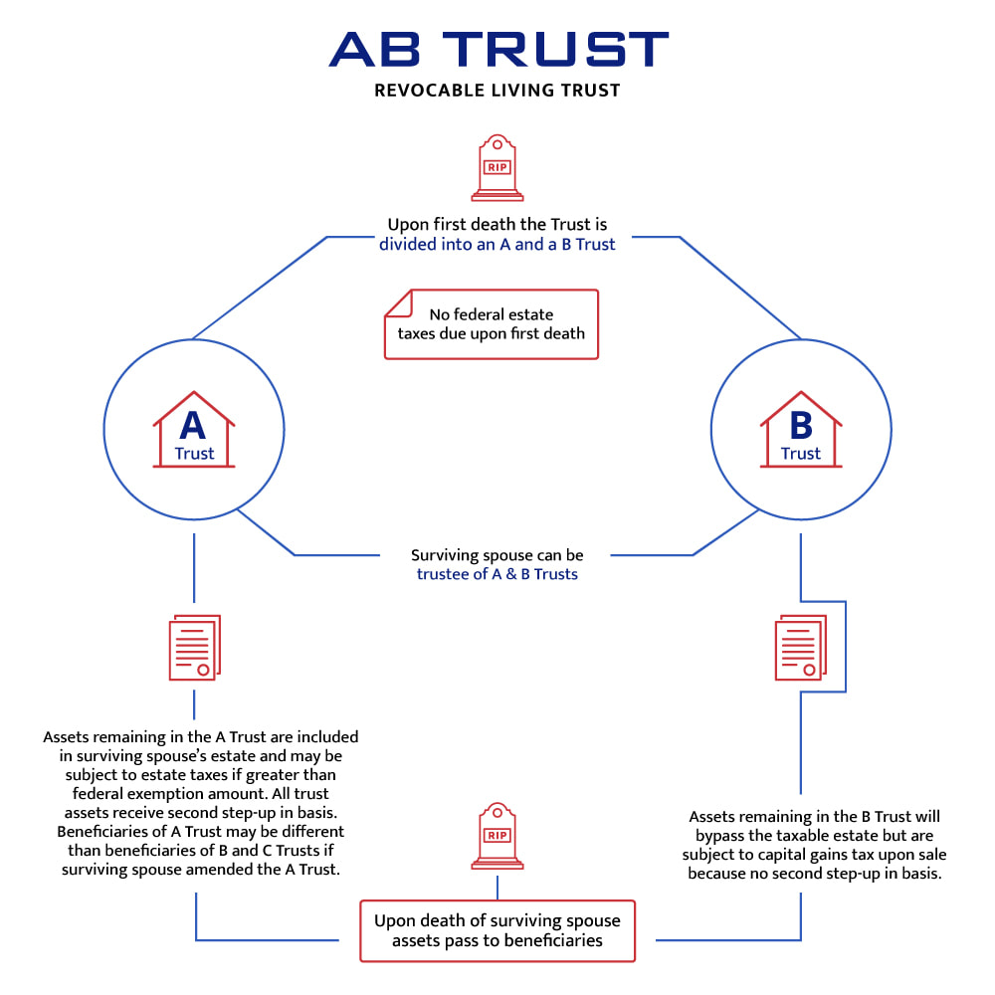
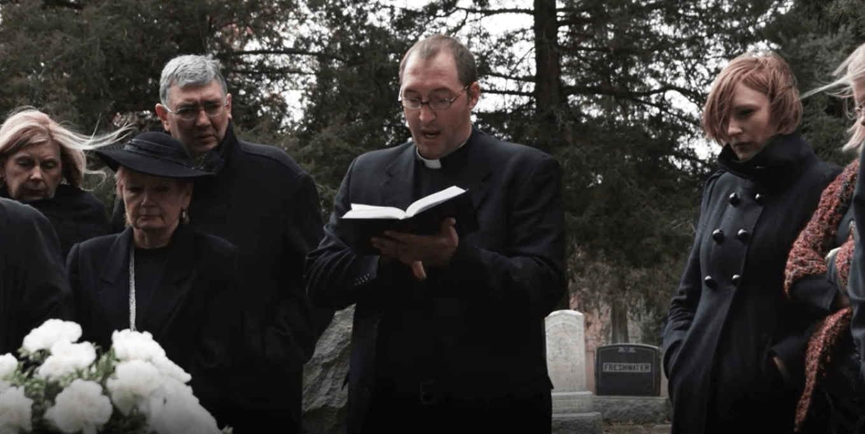
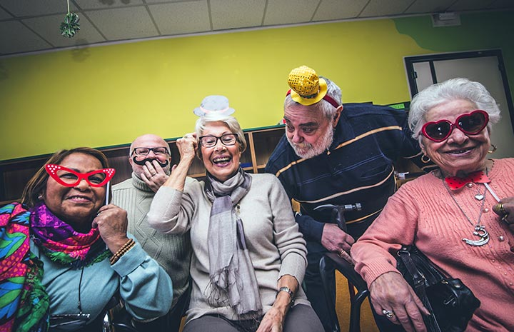

Slide 7
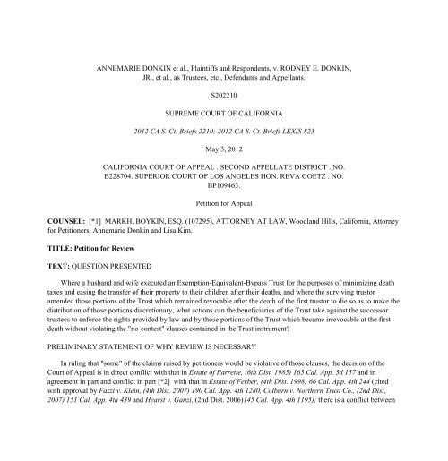
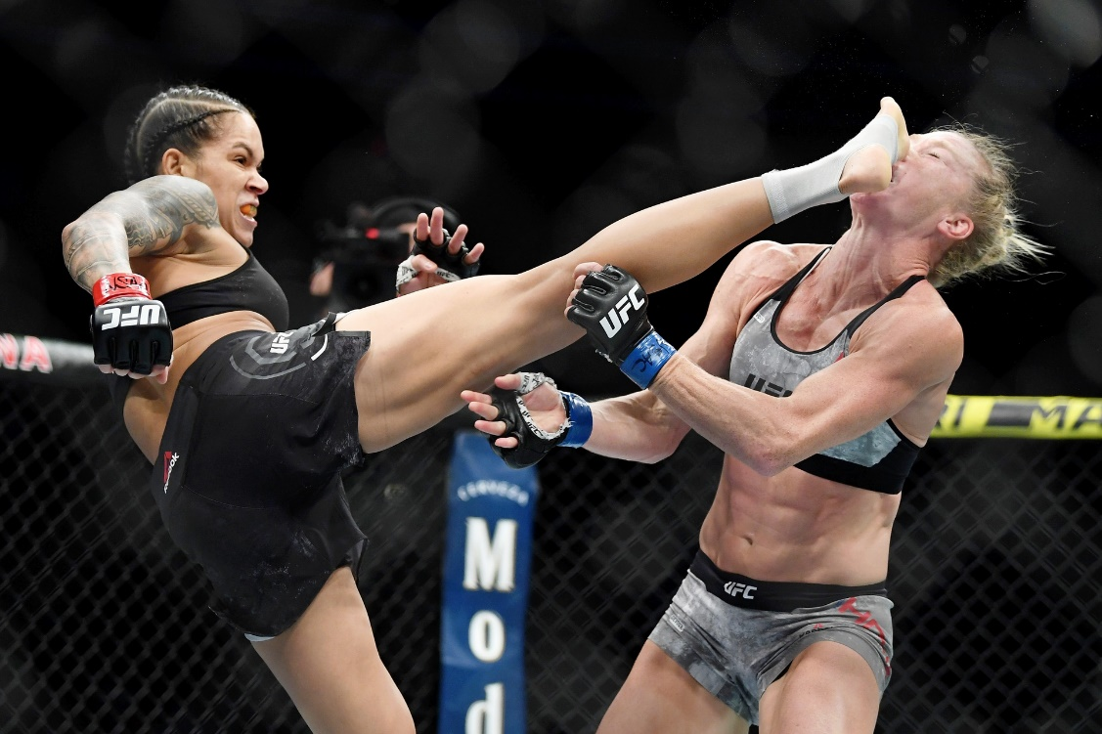
DONKIN (2013) 58 Cal.4th 412

Slide 8
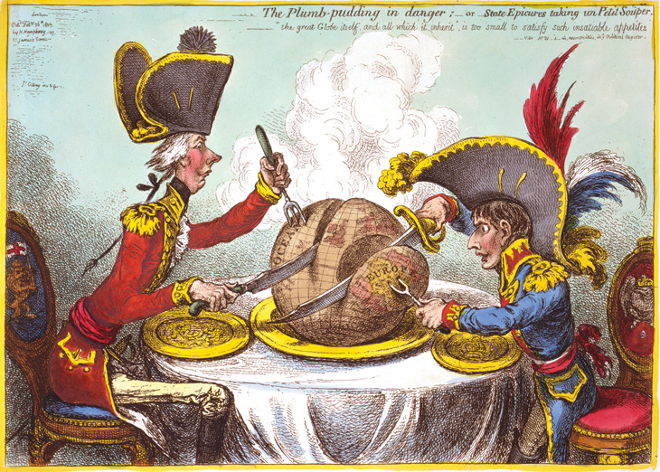
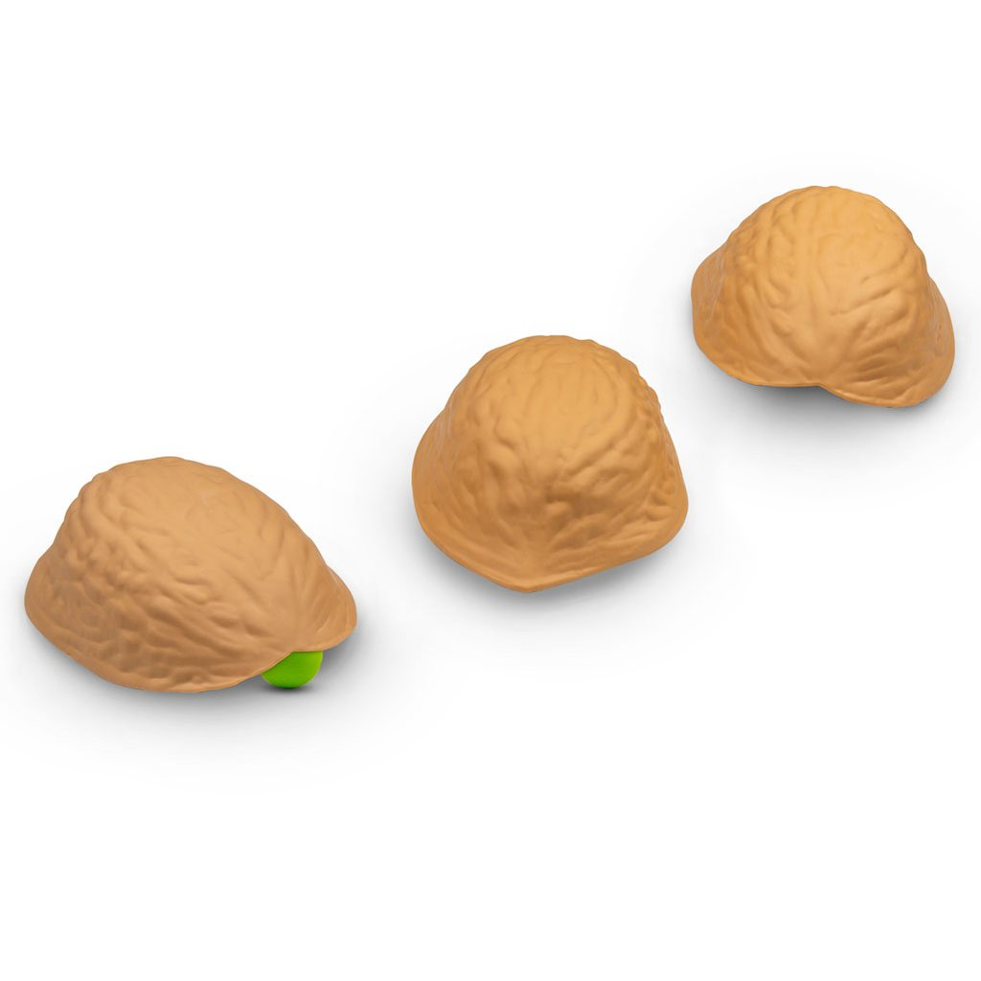
SUBTRUST FUNDING: THE FUNDING OF THE DECEASED SPOUSE’S SHARE OF TRUST ASSETS INTO ONE OR MORE SUBTRUSTS

Slide 9
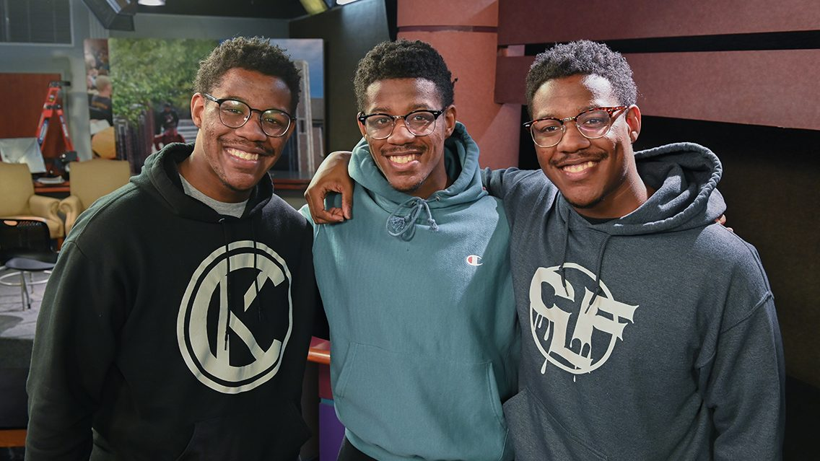
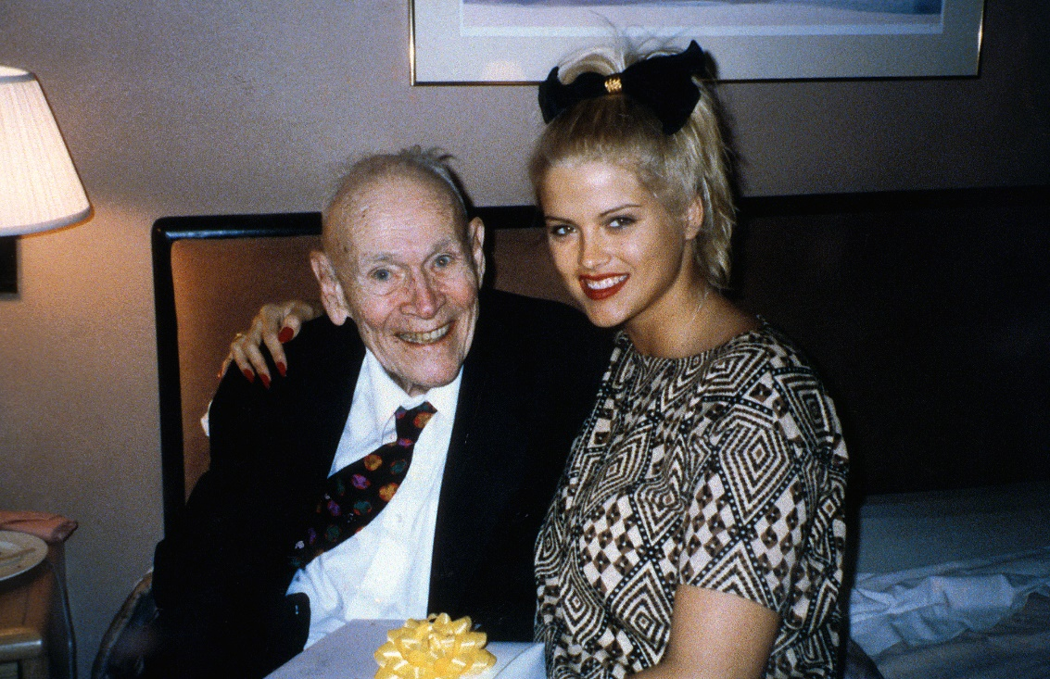
SUBTRUST ALLOCATION: NORMALLY ONLY A PROBLEM WHERE THE CLASS OF SUBTRUST BENEFICIARIES IS DIFFERENT
Not a Problem
A Problem

Slide 10
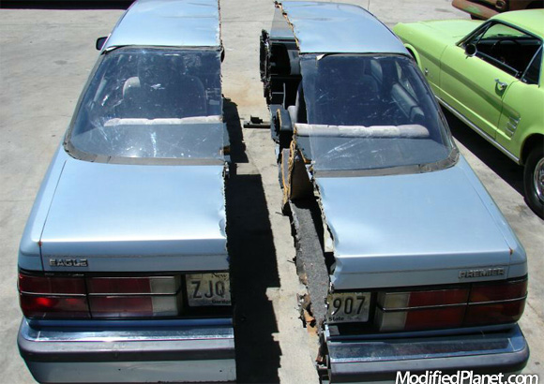
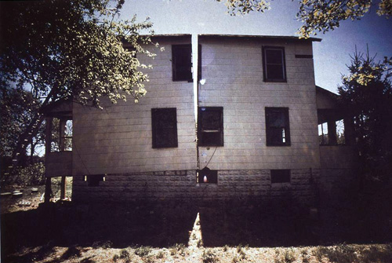
SUBTRUST ALLOCATION: NORMALLY ONLY A PROBLEM WHERE THE SUBTRUST ASSETS ARE NOT ALLOCATED PRO RATA

Slide 11
SURVIVOR TO DIVIDE CORPUS INTO SUBTRUSTS– WHAT’S THE BIG DEAL?
1. What Happens When Successor Does Not Allocate? (Very Often!) Then They Allocate Late (or Never)
2. What Happens When The Survivor Gives Her/His Kids (or Themselves) The Good Stuff?
3. Who Decides What Is CP and What Is SP? (Successor Does All Property Characterization and Tracing)

Slide 12
BYPASS SUBTRUST ALLOCATION RULES
All Trust Assets of Entire Trust Must be Inventoried and Valued as of Date of Death of First Spouse
All Assets of the Trust Must Be Properly Characterized As CP or SP, including Part-CP and Part-SP; and each of the subtrusts funded (separate accounts; asset titling, etc.) outside court supervision
Decedent’s Subtrust (“Bypass”or “Exemption”) Becomes Irrevocable and §16061.7 Notice Is Required
Bypass trust will need a TIN and must file tax returns; its beneficiaries can demand an annual accounting

Slide 13
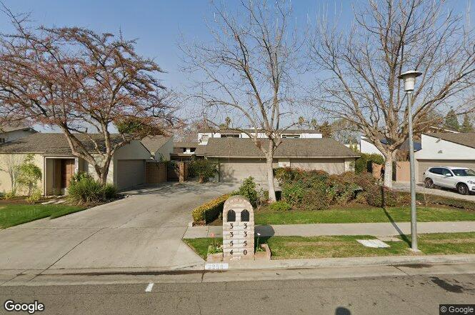
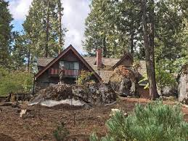
LATE (OR NEVER) SUBTRUST ALLOCATION
Guy and Heidi M. Revocable Trust
Standard “A-B” Trust, three children, Marc, Chris and Mimi, 1/3 each
22 “Schedule A” trust assets, including:
Five cottages on the beachfront bluff at Ocean Beach in San Diego;
SFR in Fresno;
Cabin at Shaver Lake;
Beneficial interest in 13 TDs secured by real property in Fresno; and some cash

Slide 14
LATE (OR NEVER) SUBTRUST ALLOCATION
Guy dies October 17, 2013
Heidi fails to make an asset allocation into Guy’s bypass trust as to Guy’s one-half of the CP trust estate
Instead, on February 19, 2014, Heidi purports to amend the entire trust as follows:
Marc: The Shaver Lake cabin and half the cash and trust deeds;
Chris: The Fresno house and half the cash and trust deeds; and
The San Diego beach bluff cottages to Mimi in a spendthrift trust;
Heidi dies October 25, 2017
COURT’S JOB IS TO EFFECTUATE SETTLOR’S INTENT

Slide 15
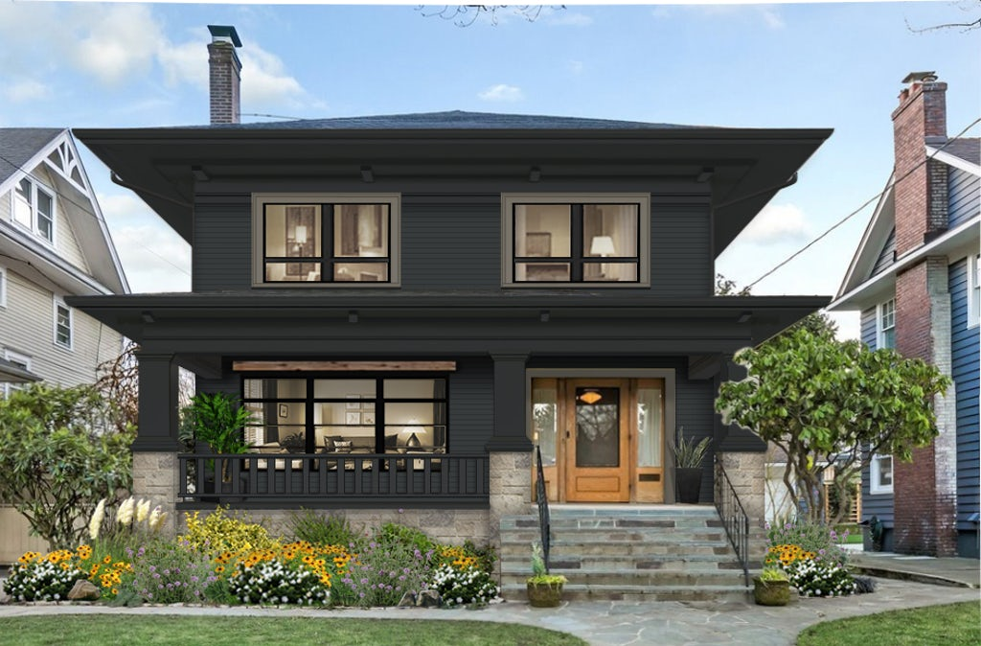
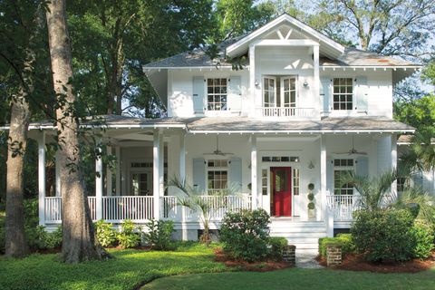
PRO RATA VS. NON-PRO RATA
Division of trust assets upon the death of the first spouse
Blackacre has a value of $1 million
Whiteacre has a value of $1 million

Slide 16
Pro Rata Allocation
Trust
Assets
$2 million
Blackacre ($1 million)
Whiteacre ($1 million)
Survivor’s Share
$1 million
50% of Blackacre ($500,000)
50% of Whiteacre ($500,000)
Decedent’s Share
$1 million
50% of Blackacre ($500,000)
50% of Whiteacre ($500,000)

Slide 17
Non Pro Rata Allocation
Trust
Assets
$2 million
Blackacre ($1 million)
Whiteacre ($1 million)
Survivor’s Share
$1 million
100% of Blackacre ($1,000,000)
Decedent’s Share
$1 million
100% of Whiteacre ($1,000,000)

Slide 18
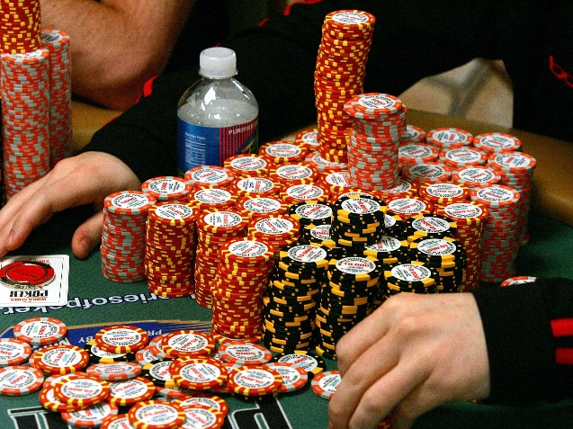
NON PRO RATA ALLOCATION
Who values the assets on first spouse’s death for purposes of allocation?
Put the California real estate in bypass trust so that the expected appreciation does not get taxed at survivor’s death?
Can the survivor reallocate at a later date as asset values increase or decrease?

Slide 19
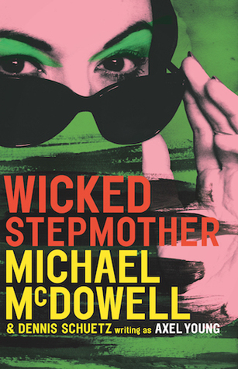
SUBTRUST REALLOCATION
Del and Jane B. Revocable Trust
Del and Dana have two children, Andrea and Dana
Jane dies September 6, 2014
Del, a widower, marries Del/Jane’s neighbor Chris on August 27, 2016
Trust had been allocated upon Jane’s death in 2014, but Del decides to reallocate after he marries Chris
Del revalues the assets and determines that he has overfunded the irrevocable bypass trust by $2.7M, so he moves assets over to the survivor’s trust
Among other things, Del moves Del/Jane Huntington Beach residence from the irrevocable bypass trust to the survivor’s trust, 100% of which he had appointed to Chris
Andrea alleges breach of fiduciary duty by her father both as successor trustee and under the Family Code

Slide 20
CHERRY P CHERRY PICKING THE GOODIES CHERRY PICKING THE CHERRY PICKING THE GOODIES
Survivor’s Kids
Step Kids

Slide 21
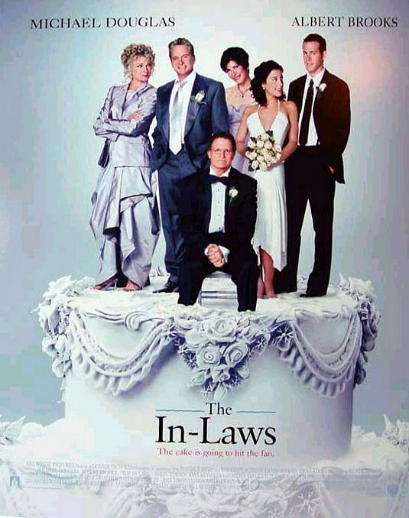
CHERRY PICKING THE GOODIES
Nick and Toni G. Revocable Trust
Nick and Toni have no children, they both want to gift their respective families with their substantial property assets; Trust has a transmutation provision
Toni becomes incapacitated and her nephew becomes Nick’s co-trustee
The nephew uses the DPOA from Toni to allegedly convert assets ; Nick finds out and removes him; the nephew attempts (unsuccessfully) to conserve Nick
Toni predeceases Nick
Nick allocates most of the couple’s properties, all in San Diego, to the survivor’s trust as to which Nick’s relatives are beneficiaries, and gives a “balancing” promissory note to the bypass trust bearing a modest rate of interest
The San Diego assets appreciate significantly in the years following Toni’s passing
Nick then receives inheritance assets from his own family placed into the Trust -- CP after Toni passes?
The bypass beneficiaries (Toni’s relatives) sue the successor trustee for breach of Trust and under the Family Code for breach of fiduciary duty

Slide 22
AMENDING THE SURVIVOR’S TRUST IN WHOLE OR PART

Slide 23
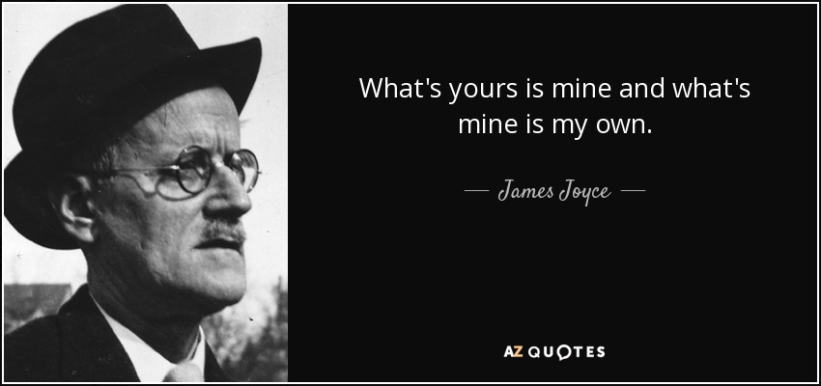
CP/ SP CHARACTERIZATION
Does the surviving spouse hire a forensic analyst to Moore/Marsden each of the initial pre-marriage acquisitions or monetize reimbursements to the deceased spouse on SP contributions to post-marital acquisitions?

Slide 24
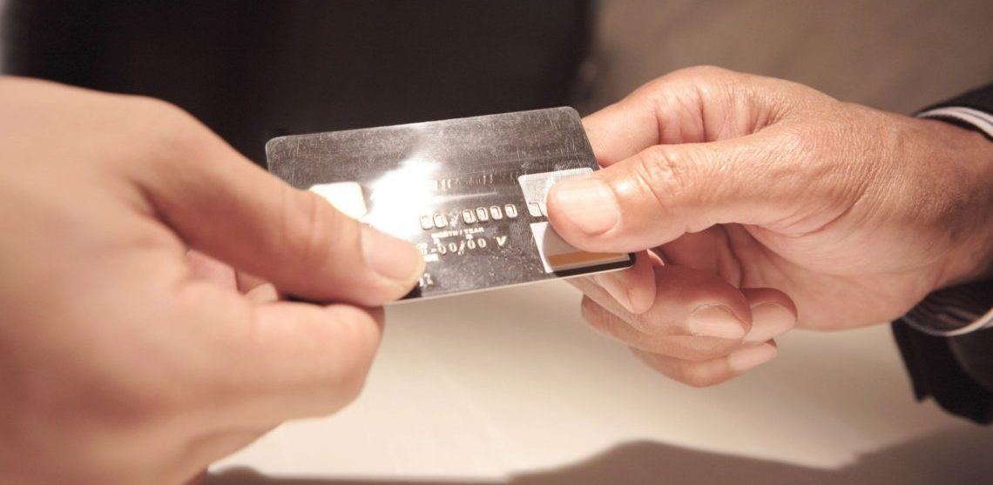
WHICH SUBTRUST ASSETS SUBSIDIZED THE SURVIVOR’S LIFETIME INCOME?

Slide 25
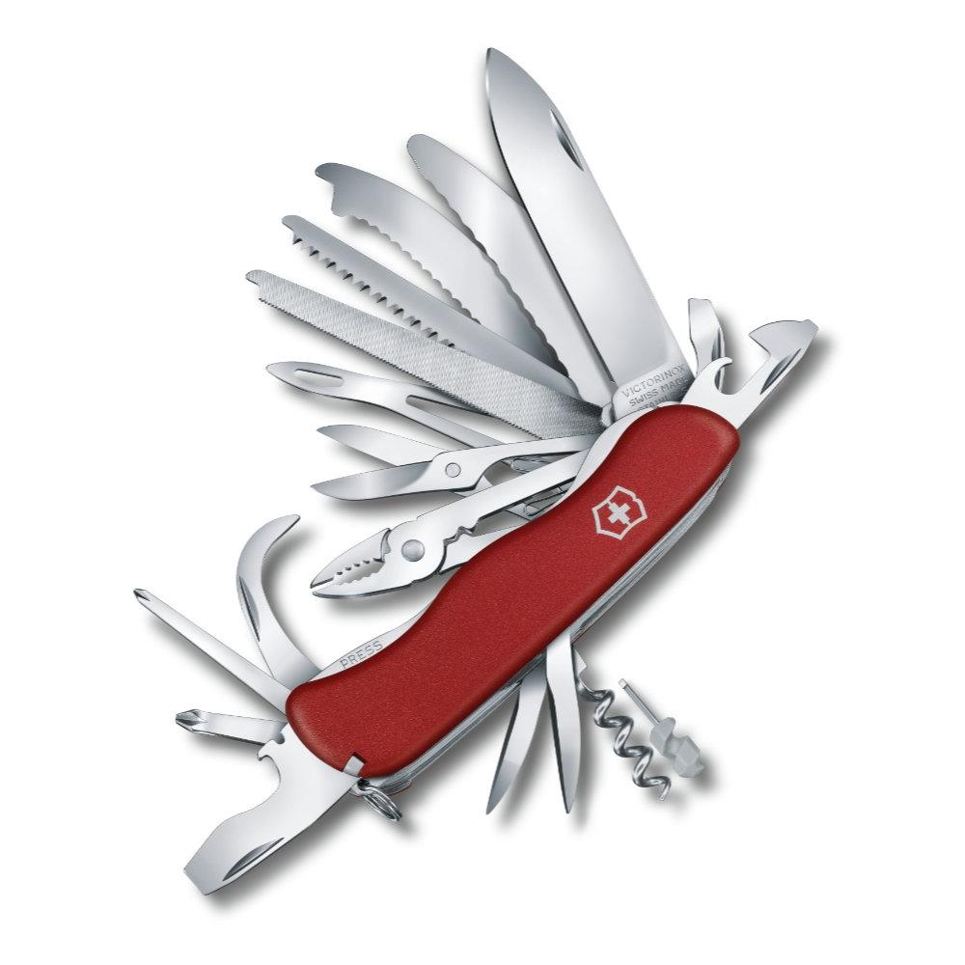
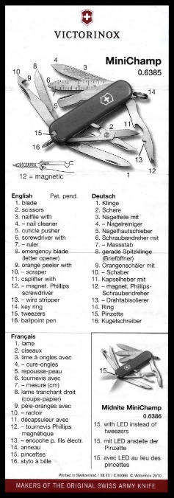
HOW SHOULD YOU LITIGATE THESE CASES?
1. Is the surviving spouse still alive?
If so, petition to instruct the trustee to fix it?
Or petition to remove and allege br/trust and violation of Family Code fiduciary violations?
If survivor is conserved, move under §2580 for the Court to fix it?
2. If surviving spouse is deceased, the successor can no longer fix it … keep in mind Code Civ. Proc. §366.2 and Prob. C. §16061.7

Slide 26
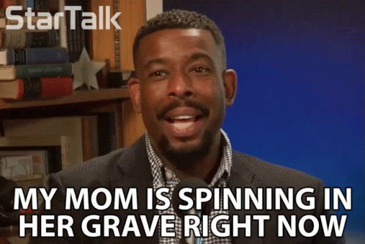
“PORTABILTY” OF DECEDENT SPOUSE’S EXEMPTION
Beginning in 2012, the surviving spouse can defer the deceased spouse’s lifetime exemption credit without requiring a subtrust asset split on the first spouse’s death
Also, estate tax limits are now so high, very few couples qualify, and so the benefit of a second step up in basis for capital gains mitigates against A-B estate planning
Does this mean A-B Trusts will soon become relics of history? [A: Not if you want to go to your grave with little assurance as to who will inherit your assets]

Slide 27
greiser@jamsadr.com

