Slide 1
COUNTY OF SAN LUIS OBISPO
www.slocounty.ca.gov

Slide 2
2023 Update on Diablo Canyon Power Decommissioning Project
Presented by:
Jon Ansolabehere, Assistant County Counsel

Slide 3
Brief Background on DCPP
2 Unit reactor
Parcel P is ~585 acres with ~12,000 acres of surrounding lands
Atomic Energy Commission (now NRC) approved the construction permit in 1968 for unit 1 and 1970 for unit 2
Started operation in 1985 for unit 1 and 1987 for unit 2
Generates ~9% of California’s electricity
NRC reactor licenses expire in 2024 and 2025

Slide 5
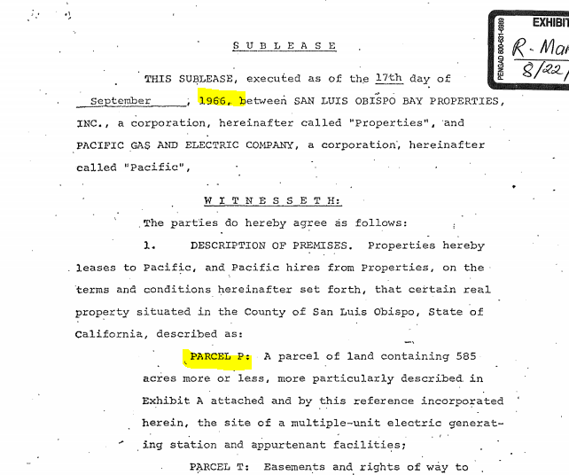
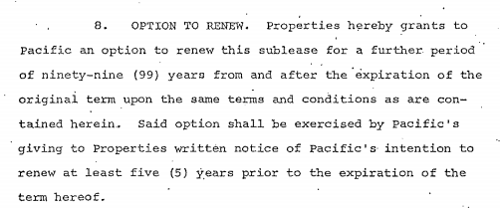
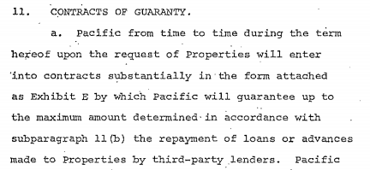

Slide 6
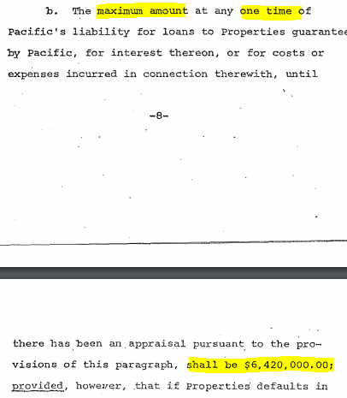
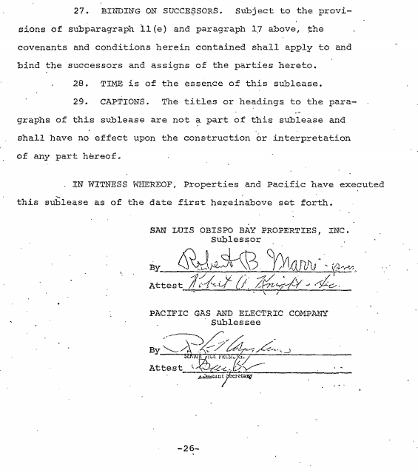
$60,456.783 in 2023 dollars

Slide 7
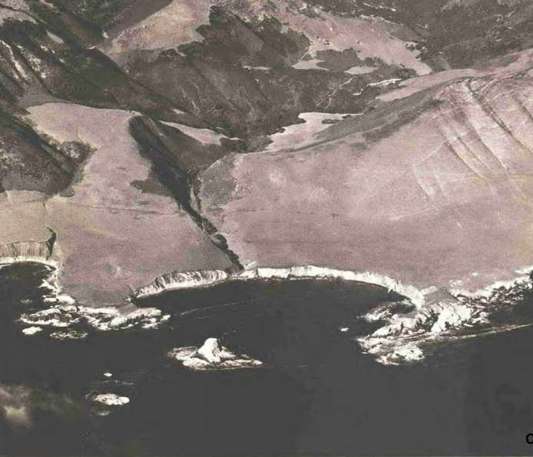

Slide 8
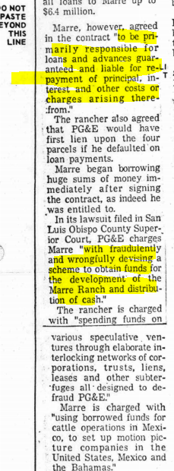
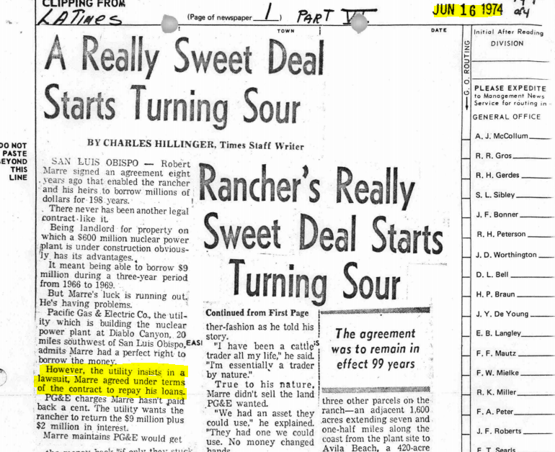

Slide 9
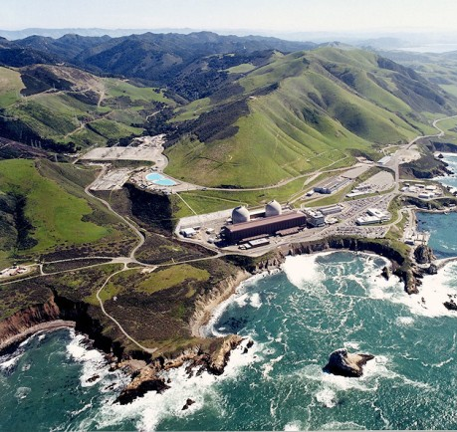
Big Changes Since 2021:
SB 846 and extended operations
Draft EIR about to be released.

Slide 10
Main Agencies involved:
United States Nuclear Regulatory Commission
Handling, storage, transport and disposal of radioactive waste
State Lands Commission
Public Trust Lands
California Coastal Commission
Coastal Act and appellate jurisdiction of County’s LCP
County of San Luis Obispo
Titles 22 and 23 and LCP

Slide 11
Agency Jurisdictions

Slide 12
Draft EIR
Scheduled for release on July 28, 2023
Analyzes potential environmental impacts for:
Decommissioning of Parcel P; and
The transport of waste by barge or by rail from either the Pismo Beach Railyard and/or the Betteravia Industrial Park Santa Maria Valley Railyard facility to Clive, Utah and/or Andrews, Texas.
Current price tag of ~$2.4m

Slide 13
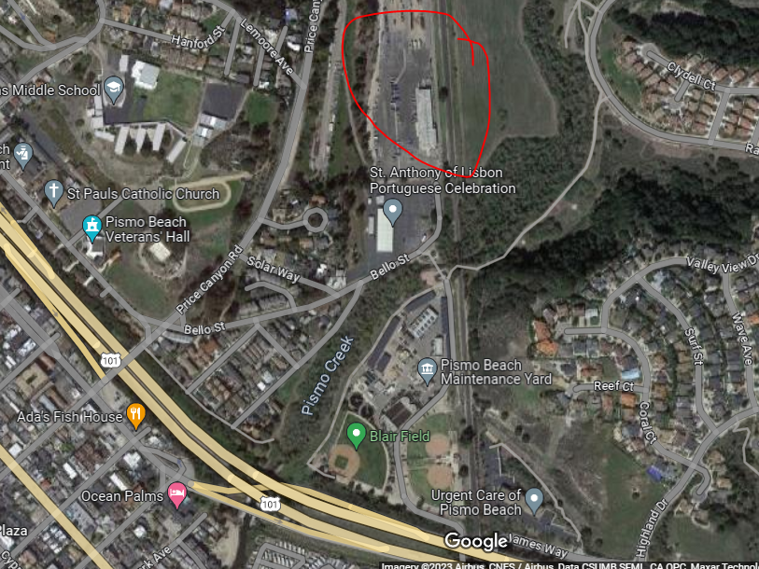

Slide 14
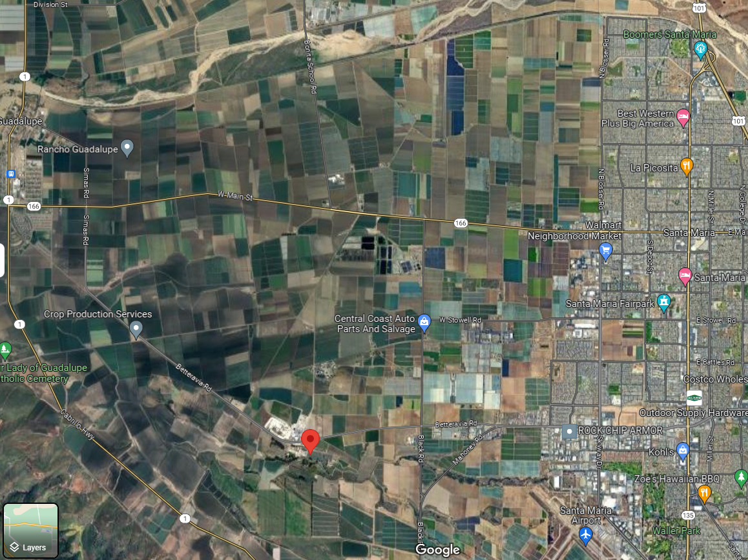

Slide 15
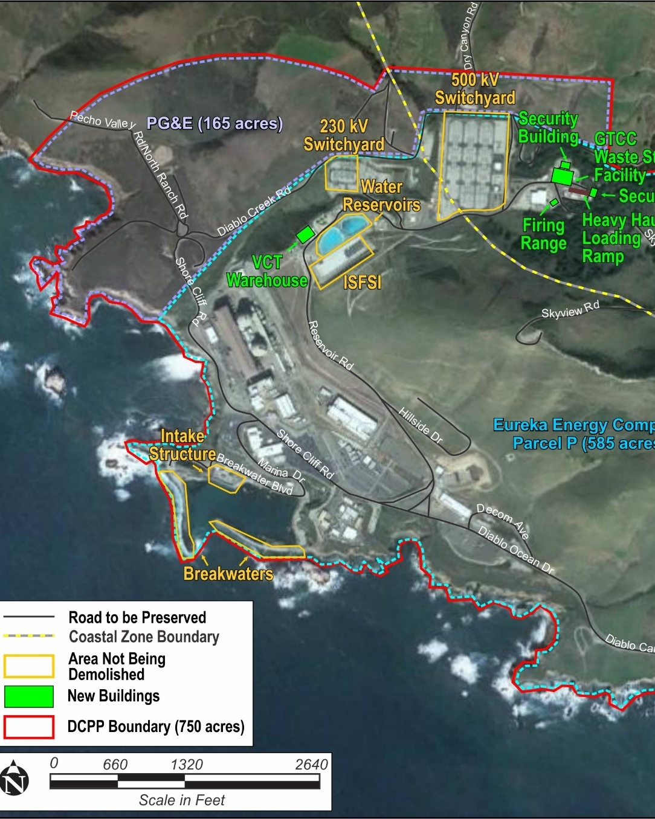
New facilities and facilities to remain:
NEW:
Security Building
GTCC Waste Facility
Heavy Haul Loading Ramp
VCT Warehouse
TO REMAIN:
500 KV and 230 KV switchyards
ISFSI and Water Reservoirs
Breakwaters, marina and intake structure
Firing Range to be relocated

Slide 16
EIR looked at the following:
Phase 1 (2024 - 2031; ~ 7 years): Decommissioning activities.
Phase 2 (2032 – 2039; ~7 years): Completion of soil remediation, final status surveys, final site restoration.
Aesthetics; Air Quality; Biological Resources; Climate Change and Sea-Level Rise; Commercial Fishing; Cultural Resources; Energy; Environmental Justice; Geology, Soils, and Coastal Processes; Greenhouse Gas Emissions; Hazardous and Radiological Materials; Hydrology and Water Quality; Land Use and Planning; Noise; Public Services and Utilities; Recreation and Public Access; State Tide and Submerged Lands Possessing Significant Environmental Values; Transportation; Terrorism; Tribal Cultural Resources; and Wildfire.

Slide 17
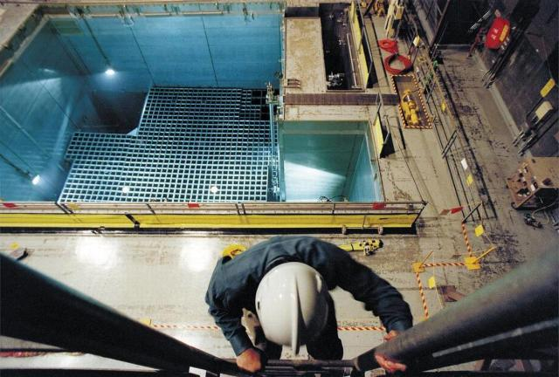
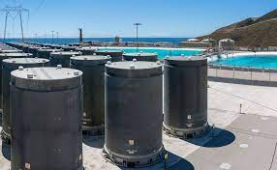
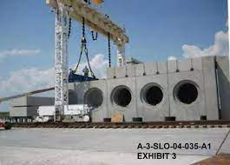
Major EIR Issues
Federal Pre-emption
NRC pre-emption, Atomic Energy Act
Storage of Spent Nuclear Fuel (ISFSI)
Storage of nuclear waste (greater than class C waste facility)
Transportation of nuclear waste
25 MREM (family farmer) site restoration standard
Interstate Commerce Commission Termination Act of 1995
Surface Transportation Board has exclusive jurisdiction over “transportation by rail carriers

Slide 18
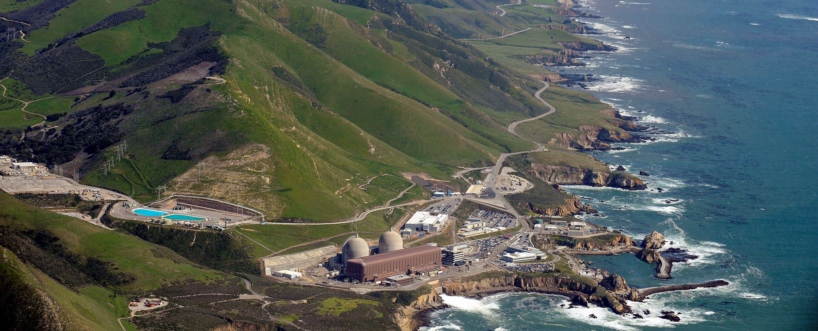
Major EIR and Policy Issues
Impacts Cultural Resources
Coastal Access/CPUC Tribal Lands Transfer Policy
Transportation
Impacts to Air Quality and GHG
Removal of Discharge Structure and Shoreline Armoring

Slide 19
Impacts to Cultural Resources:
AB 52 Process
Consulted with four separate tribes
Locations of specific cultural sites are confidential.
What we learned is that this area is one of the most culturally rich and significant areas in all of California.
Class I CEQA Impact, Significant and Unavoidable Impacts.
Lots of observers for any ground disturbing activities.

Slide 20
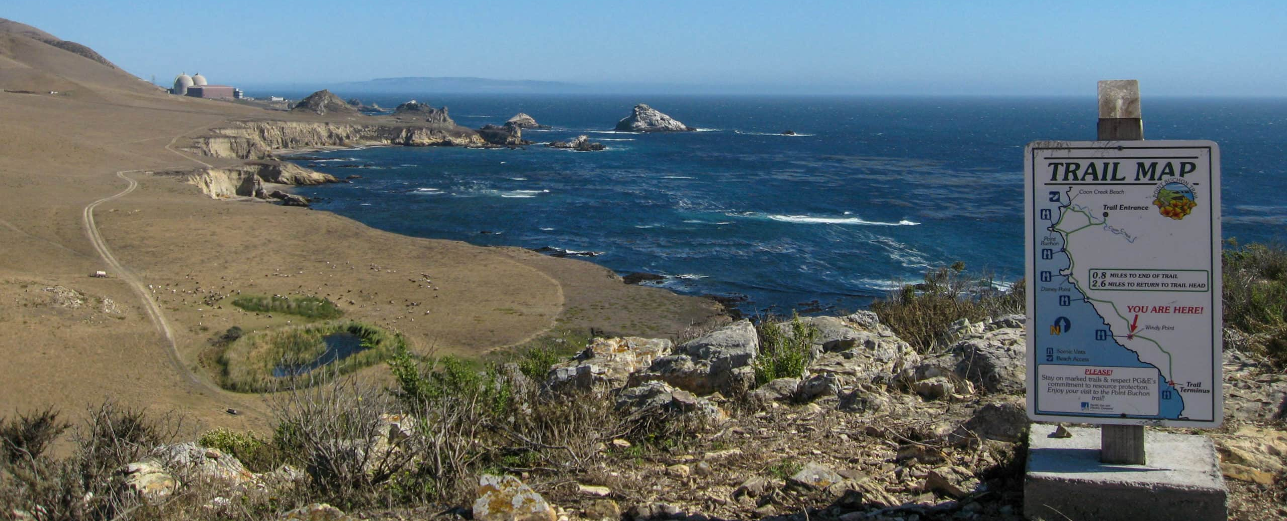
Coastal Access Policies
Cal. Constitution Article X, section 4:
No individual, partnership, or corporation, claiming or possessing the frontage or tidal lands of a harbor, bay, inlet, estuary, or other navigable water in this State, shall be permitted to exclude the right of way to such water whenever it is required for any public purpose, nor to destroy or obstruct the free navigation of such water; and the Legislature shall enact such laws as will give the most liberal construction to this provision, so that access to the navigable waters of this State shall be always attainable for the people thereof.

Slide 21
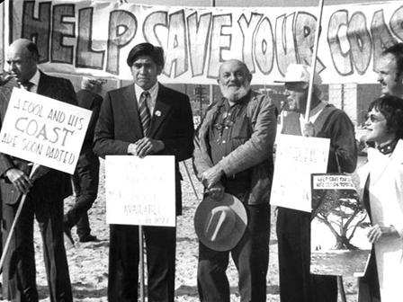
Coastal Access Policies
Pub. Res. Code 30001.5: The Legislature further finds and declares that the basic goals of the state for the coastal zone are to:
(c) Maximize public access to and along the coast and maximize public recreational opportunities in the coastal zone consistent with sound resources conservation principles and constitutionally protected rights of private property owners.

Slide 22
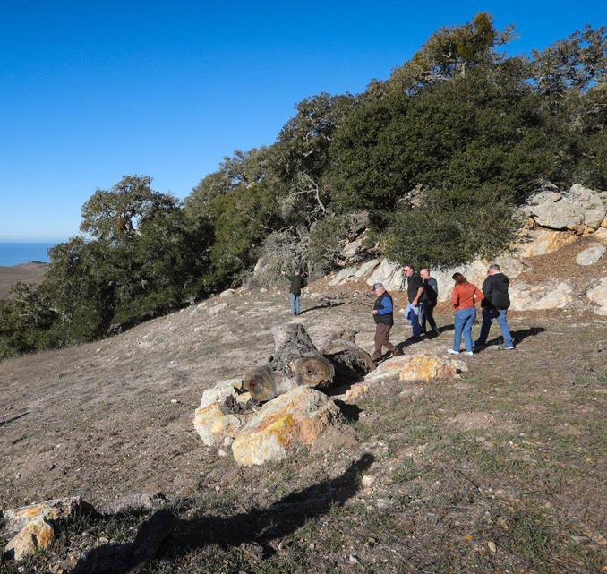
So what can the public expect in the draft EIR regarding coastal access?
Offer of dedication for a floating easement for a public trail across all of PG&E’s property;
Study the land especially for biology and cultural resources for trail location;
And, depending on that study, get entitlements for the trail and build it.
Any trails will be subordinate to interests of the tribe(s) and the CPUC tribal lands transfer policy.

Slide 24
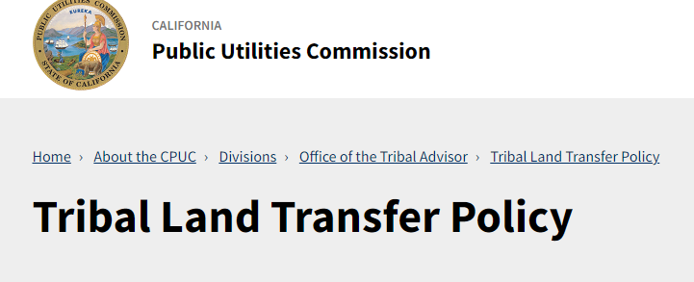
Requires Investor-Owned Utilities (IOUs) to offer ancestral tribe(s) “first right of refusal” when disposing of land.
Policy adopted by the CPUC in 2019.
Guidelines to implement the policy were adopted in 2021.
What this means here is that before PG&E can dispose of any lands, it must first offer it to the appropriate tribe(s).

Slide 25
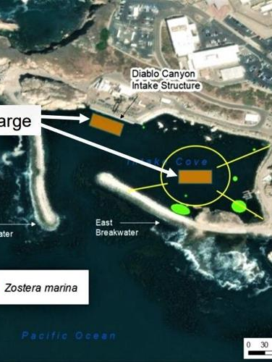
Transportation
Waste will be hauled off primarily via barge and some via trucking to rail transport.
Class A, B and C waste will be barged to Portland or Boardman, Oregon or by rail transport to from Pismo Beach or Santa Maria to Clive, Utah or Andrews, Texas.
Impacts are mitigated to less than significant.

Slide 26
Air Quality and GHG
Air Quality impacts used a “no net increase” threshold of significance and also looked at SLO APCD’s recommended thresholds for stationary sources for industrial projects.
What will we see in the draft EIR?
A “DAMP”;
Offset program which prioritizes local air quality/GHG reduction programs.
Mitigated to less than significant.

Slide 27
Removal of Discharge Structure and Shoreline Armoring

Slide 28
Discharge Structure Removal & Shoreline Armoring

Slide 29
Final Comments:
Draft EIR should be issued for public review on July 28, 2023.
60-day public review period.
Planning Commission then Board of Supervisors.
Possible Appeal to the California Coastal Commission.
Substantial issue determination?
De Novo review.

Slide 30
Questions?

