Slide 1


The Year in
Trust and Estate Litigation
San Luis Obispo County Bar Association – Estate & Trust Section
March 26, 2025
Ciarán O'Sullivan | The Law Office of Ciarán O'Sullivan | 415.391.3711
Matt Owens | Sheppard Mullin | 858.876.3558

Slide 2
WHAT WE WILL COVER TODAY
California Supreme Court and Court of Appeal published decisions affecting our practices
Significant 2024 California legislation affecting our practices
Questions and Answers (time permitting)

Slide 3

Ciarán O’Sullivan
Ciarán has litigated mostly Trusts and Estates cases for more than 27 years, and exclusively since he opened his own practice in 2010. A former chair of BASF’s Trusts and Estates litigation, Ciarán has served on the executive committee of the California Lawyers Association’s (CLA) Trusts and Estates section (TEXCOM) since 2017. He is now also the Trusts and Estates section’s representative on the CLA board.
Ciarán frequently writes and presents, to audiences up and down the state, on topics related to Trusts and Estates litigation law and procedure.

Slide 4
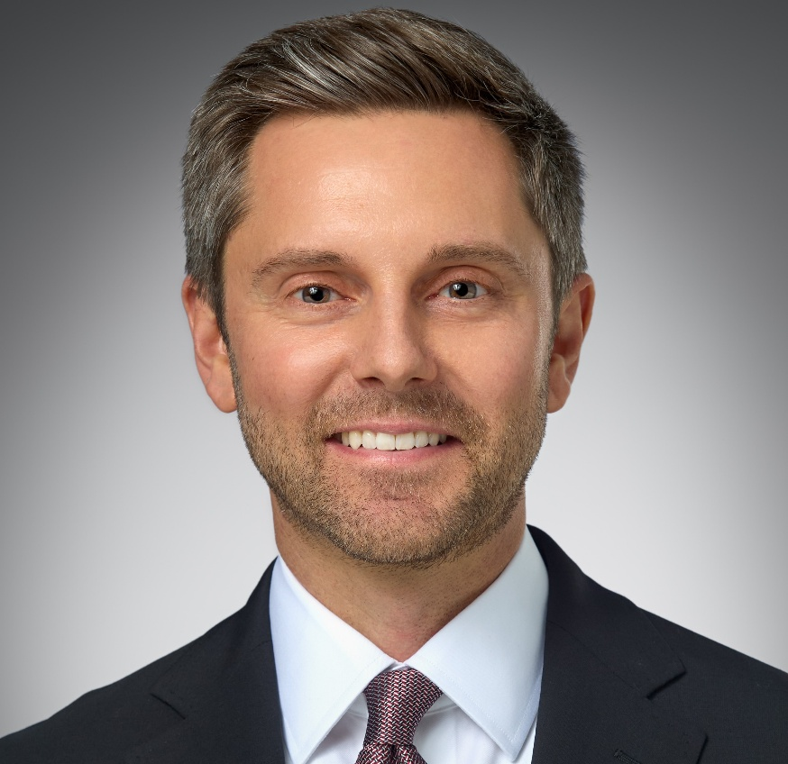
MATT OWENS
Matt is certified as a Specialist in Estate Planning, Trust and Probate Law by the State Bar of California’s Board of Legal Specialization. He handles trust, estate, and inheritance disputes. His clients include high net worth individuals and families, corporate trustees, and private professional fiduciaries.
Matt serves on the Executive Committee of the Trusts and Estates Section of the California Lawyers Association (TEXCOM). Matt is a Fellow of the American College of Trust and Estate Counsel (ACTEC).

Slide 5
Significant cases
Herren v. George S. (1st Dist. 2025) 2025 Cal.App. LEXIS 125
Attorney met with potential client who had been declared incapacitated by two doctors (atty had trustee notification referencing letters, but not letters themselves)
Potential client signed engagement agreement committing to pay $100K retainer
Atty sent demand letter to trustee of potential client’s trust requesting payment
Trustee sought and obtained elder abuse restraining order (EARO) against attorney
Holding on appeal? AFFIRMED
Attorney secured a property right in elder’s property via the engagement agreement through exertion of undue influence amounting to financial elder abuse
Notes:
Matt

Slide 6
Significant cases (cont’d)
Packard v. Packard (4th Dist. 2025) 108 Cal.App.5th 1284
House to one son, with equalizing payment to other; rest of trust shared equally
Settlor handwrote amendment re equalizing payment: “one-half of” value of house
Petition to Reform or Construe Trust Amendment filed more than 120 days after 16061.7 Notice
Dispute over whether this was a contest, to trigger 120-day statute of limitations
Trial court said Yes. Court of Appeal said No.
Court of Appeal said not trying to invalidate trust or amendment, but claiming that Dad meant something else. That’s reformation or construction, and does not violate no-contest clause, which must be strictly construed.
Notes:
Ciaran

Slide 7
Significant cases
Grossman v. Wakeman (2nd Dist. 2024) 104 Cal.App.5th 1012
In 2011, Richard met with attorney, John, regarding changes to his estate plan
Wanted to leave his entire estate to his fourth wife, Elizabeth, and nothing to his son and grandchildren “because Elizabeth will make sure they’re taken care of”
Richard signed trust restatement, prepared by John, leaving estate to Elizabeth
After death, Richard’s son and grandchildren sued John for legal malpractice
Jury found that Richard’s son and grandchildren were the intended beneficiaries of Richard’s estate plan and awarded damages totaling $9.5 million
Holding on appeal? REVERSED
EP attorney did not owe duty of care to client’s heirs because client’s intent to benefit heirs in the estate plan was not clear, certain, and undisputed
Notes:
Matt

Slide 8
Significant cases (cont’d)
Newell v. Superior Court (2nd Dist. 2024) 107 Cal.App.5th 728
Settlor amended trust to name caregiver as trustee and sole beneficiary
Settlor’s daughter contested trust amendment and sought trustee’s removal
Daughter asserted constructive trust claim over trust’s real estate
Daughter also recorded lis pendens; Trustee moved to expunge lis pendens
Notes:
Ciaran

Slide 9
Significant cases (cont’d)
Newell v. Superior Court (2nd Dist. 2024) 107 Cal.App.5th 728, cont’d.
Probate court granted the motion on grounds the petition did not contain a “real property claim” because ownership was held by the trust
Daughter filed a petition for writ of mandate
Ruling on appeal? GRANTED PETITION FOR WRIT OF MANDATE
Petition seeking a change in trustee of a trust that holds real property constitutes a real property claim within the meaning of CCP 405.4

Slide 10
Significant cases (cont’d)
Asaro v. Maniscalco (4th Dist. 2024) 103 Cal.App.5th 717
Trustee breached his fiduciary duties and was ordered to pay the beneficiary the amount of the property taken, plus twice the value
Holding on appeal? Affirmed
PC 859 requires payment of twice the value of the property taken, in addition to return of the property taken (or its value) under PC 856
Notes:
Matt

Slide 11
Significant cases (cont’d)
Asaro v. Maniscalco (4th Dist. 2024) 103 Cal.App.5th 717, cont’d.
May be awarded individually to the person who brought the petition
See also:
  Estate of Ashlock (2020) 45 Cal.App.5th 1066 (2x)
  Conservatorship of Ribal (2019) 31 Cal.App.5th 519 (1x)

Slide 12
Significant cases (cont’d)
Smith v. Myers (3rd Dist. 2024) 103 Cal.App.5th 586
Nearly four years after settlor’s death, beneficiaries of a trust amendment filed a 17200 Petition for an order confirming validity of the amendment and seeking removal of the trustee
Trustee filed an MSA on grounds the petition was barred by the one-year statute of limitations under PC 366.3
Probate Court denied the motion, and the beneficiaries prevailed at trial
Holding on appeal? AFFIRMED
The one-year statute of limitations on claims arising from a decedent’s promise to make a distribution does not apply to claims for distribution under a valid trust amendment.
Notes:
Ciaran – maybe

Slide 13
Significant cases (cont’d)
Trotter v. Van Dyck (4th Dist. 2024) 103 Cal.App.5th 126
Mom exchanged emails with son and EP attorney about amending her trust, and expressed intent to disinherit her stepdaughter
Mom emailed attorney attaching a partially completed EP questionnaire
In section re children/grandchildren, mom included stepdaughter, but wrote “NO CONTACT – WOULD PREFER TO DROP FROM WILL – IF POSSIBLE[.]”
Mom had surgery the next day and died shortly thereafter
Son petitioned for instructions on whether the emails constituted a valid trust amendment; Probate Court determined the writings were insufficient
Holding on appeal? AFFIRMED
Email to estate planning attorney attaching estate planning questionnaire was insufficient to constitute a valid trust amendment
Notes:
Matt

Slide 14
Significant cases (cont’d)
Hamlin v. Jendayi (1st Dist. 2024) 105 Cal.App.5th 1064
Two weeks before death, settlor executed a trust naming her friend as the trustee and sole beneficiary of the Trust
Settlor was survived by two sisters, who would have been intestate heirs
Two sisters petitioned the probate court to invalidate the trust based on undue influence, lack of capacity, and/or forgery
Friend argued sisters lacked standing because they filed a PC 17200 Petition
Probate court granted the sisters’ petition
Holding on appeal? AFFIRMED
Intestate heirs have standing to contest a trust even if they were never named as trust beneficiaries
Notes:
Ciaran

Slide 15
Significant legislation
AB 2016 (2023-2024 Reg. Sess.) (Maienschein) Small Estate Disposition
Amends sections 13100, 13101, 13150, 13151, 13152, and 13154 of the Probate Code, and repeals section 13158 of the Probate Code, relating to estates. It increase to $750,000 the threshold dollar amount for the small estate exception to probate for real property that was the decedent’s primary residence in this state.
Expedited procedure in lieu of full probate administration for decedent’s residence
Changes the petition procedures to apply only to real property that (1) was the decedent’s primary residence in California, and (2) has a gross value that does not exceed $750,000 (adjusted every 3 years)
Notes:
Matt

Slide 16
Significant legislation (cont’d)
AB 3281 (2023-2024 Reg. Sess.) (Committee on Judiciary) Judiciary Omnibus Bill – Changes Affecting Notice to Attorney General
Amends section 1209 by providing that the Breslin Rule does not apply to the Attorney General in a case involving a charitable gift.
Notes:
Ciaran

Slide 17
Significant legislation (cont’d)
SB 1127 (2023-2024 Reg. Sess.) (Niello) Trust Termination by Trustee
This bill amends section 15408 of the Probate Code relating to the unilateral termination of small trusts. It increases the value of a trust that a trustee may terminate without court approval from $50,000 to $100,000, bringing California more in line with that of the majority of other states.
This was a TEXCOM bill
Notes:
Ciaran

Slide 18
Significant legislation (cont’d)
AB 2505 (2023-2024 Reg. Sess.) (Gabriel) Attorneys: Pro Bono Legal Services
AB 2505 adds sections 6073.1 and 6073.2 to the Business and Professions Code and requires attorneys with active licenses to submit an annual report detailing how many pro bono hours they completed in the past calendar year via their profile on the State Bar’s website. The information is kept confidential, but the State Bar may use it to create and publish aggregated reports.
Notes:
Matt

Slide 19
Significant legislation (cont’d)
SB 1458 (Allen): RUFADAA
Revised Uniform Fiduciary Access to Digital Assets Act
Expands RUFADAA to apply to a fiduciary acting as a conservator appointed by the court to manage the estate of a living individual, or an agent acting as an attorney-in-fact who is granted authority under a principal’s power of attorney, whether durable or nondurable
Provides guidance on documentation agent or conservator must provide to custodian to gain authority over the electronic communications sent or received by a principal or conservatee
This was a TEXCOM bill
Notes:
Ciaran – time permitting

Slide 20
QUESTION & ANSWER (TIME PERMITTING)
Follow-up Questions for Ciarán O’Sullivan
The Law Office of Ciarán O'Sullivan
50 California Street, 34th Floor
San Francisco, CA 94111
Phone: (415) 391-3711
Email: ciaran@cosullivanlaw.com
www.cosullivanlaw.com
Follow-up Questions for Matt Owens
Sheppard Mullin
12275 El Camino Real, Suite 100
San Diego, CA 92130-4092
Phone: (858) 876-3558
Email: MOwens@sheppardmullin.com
http://www.sheppardmullin.com/

Slide 21
THANK YOU!

