Slide 1

ETHICAL CONSDERATIONS OF MEDIATORS AND CONFIDENTIALITY ISSUES
PRACTICAL GUIDES FOR PRACTICING LITIGATORS

Slide 2
WHO SAID THIS?
“Discourage litigation. Persuade your neighbors to compromise whenever you can. Point out to them how the nominal winner is often the real loser in fees, and expenses, and a waste of time. As a peacemaker the lawyer has a superior opportunity of being a good man. There will still be business enough.”

Slide 3
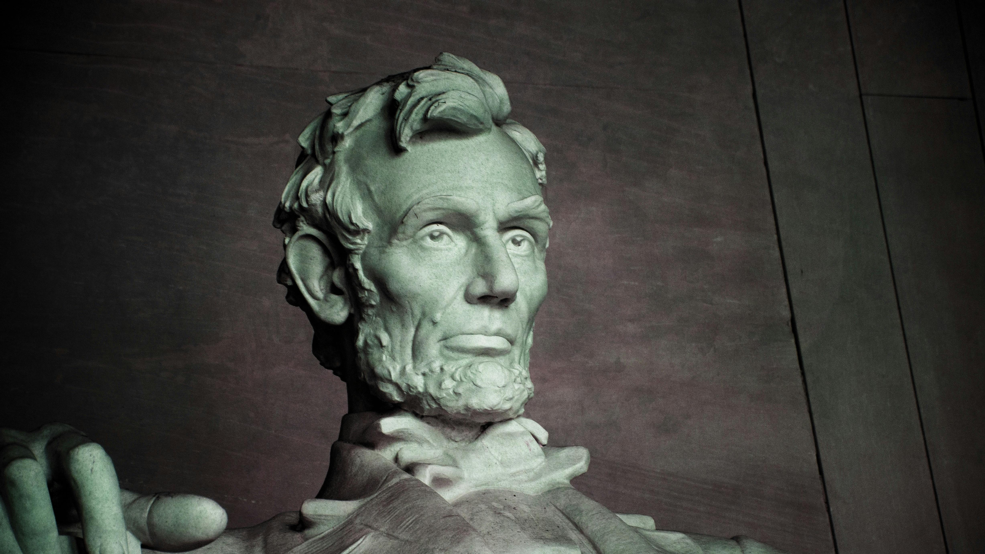
Abraham Lincoln “Notes on the Practice of Law” Circa 1850

Slide 4

ETHICAL OBLIGATIONS OF MEDIATORS
Privately retained mediators versus court-appointed mediators

Slide 5

WHAT IS A COURT-APPOINTED MEDIATOR?
Has agreed to be included on a superior court's list or panel of mediators for general civil cases and is notified by the court or the parties that he or she has been selected to mediate a case within that court's mediation program; or
Has agreed to mediate a general civil case pending in a superior court after being notified by the court or the parties that he or she was recommended, selected, or appointed by that court or will be compensated by that court to mediate a case within that court's mediation program. A mediator who is not on a superior court list or panel and who is selected by the parties is not “recommended, selected, or appointed” by the court within the meaning of this subdivision simply because the court approves the parties' agreement to use this mediator or memorializes the parties' selection in a court order
CRC Rule 3.851
These rules do not apply to Mandatory Settlement Conferences conducted pursuant to CRC Rule 3.1380.
The court can only order a case to mediation if the amount in controversy does not exceed $50,000 for each plaintiff pursuant to CRC Rule 3.891

Slide 6
STATUTORY ETHICAL OBLIGATIONS OF COURT-APPOINTED MEDIATORS
CRC Rules 3.850-3.860
Business & Professions Code sections 6068 and 6106

Slide 7

WHAT ARE THE ETHICAL OBLIGATIONS OF PRIVATELY RETAINED MEDIATORS?

Slide 8

NAME A WORD THAT RHYMES WITH “ORANGE”

Slide 9
THERE ARE NONE

Slide 10
ONE EXCEPTION-BUSINESS & PROFESSIONS CODE SECTION 6173
Added by the Legislature in 2025 for State Bar Certification Program in the ADR field. Requires ADR firms or individuals seeking certification to comply with CRC Rules 3.850-3.860

Slide 11
WHAT THEN ARE A MEDIATOR’S ETHICAL OBLIGATIONS?

Slide 12
IMPARTIALITY AND NEUTRALITY
A mediator cannot favor one side over the other
A mediator must withdraw if their impartiality is impaired
CRC 3.855

Slide 13

DISCLOSURE OBLIGATIONS
A mediator must disclose: 1) all prior/current relationships with parties/counsel/insurers; and 2) any financial or professional interests that could affect neutrality
This duty to disclose is ongoing throughout the mediation process
CRC Rule 3.855

Slide 14

CONFIDENTIALITY
The mediator must comply with applicable laws governing confidentiality (Evidence Code section 1119(a)-(c)
The mediator must inform participants at the outset of the first mediation a general explanation of the confidentiality of mediation sessions
The mediator must not disclose information revealed in confidence in a separate session with a party unless authorized to do so
The mediator must not use information acquired in confidence during a mediation outside of the mediation or for personal gain
CRC Rule 3.854

Slide 15
COMPETENCE/QUALIFICATIONS
A mediator must truthfully represent their background to the court and participants and upon request must provide truthful information regarding their experience, training and education
The obligation to disclose this information is continuing throughout the mediation and if the mediator determines that they do not have the level, knowledge or ability necessary to conduct the mediation, the mediator must decline or withdraw from the mediation
CRC Rule 3.856

Slide 16
VOLUNTARY PARTICIPATION AND SELF-DETERMINATION
A mediator must inform the parties at the outset of the first mediation that any resolution of the dispute requires the voluntary participation of the parties
A mediator must respect the right of any participant the extent to which they decide to participate in the mediation including the right to withdraw at any time
A mediator must refrain from coercing any party to make a decision or to continue to participate in the mediation
CRC Rule 3.853

Slide 17
CONFLICTS OF INTEREST
A mediator must maintain impartiality to all participants at all times
A mediator must make reasonable efforts to keep informed about matters that reasonably could raise a question about his or her ability to conduct the proceedings impartially and must disclose these matters to the parties
The duty to disclose a continuing obligation throughout the mediation process
In a two-party mediation, if any party objects to the mediator after the mediator makes disclosures or discusses a participant's question or concern regarding the mediator's ability to conduct the mediation impartially, the mediator must withdraw
A mediator either must decline to serve as mediator or, if already serving, must withdraw from the mediation if they cannot maintain impartiality or proceeding with the mediation would jeopardize the integrity of the court or of the mediation process
CRC Rule 3.855

Slide 18
QUALITY OF MEDIATION PROCESS
A mediator must use reasonable efforts to move the mediation forward in a timely manner
A mediator must conduct the mediation in a procedurally fair manner
A mediator must inform all participants before the outset of the first mediation that they do not represent any participant as a lawyer
If a mediator determines that it is necessary to terminate or suspend a mediation or that they must withdraw, the mediator must do so without violating the obligation of confidentiality and in a manner that causes the participants the least harm
Since mediators have no actual power, they are not obligated to ensure the substantive fairness of an agreement reached by the parties
CRC Rule 3.857

Slide 19
MEDIATOR FEES
A mediator must disclose to the parties in writing any fees, costs, or charges to be paid to the mediator by the parties. A mediator must abide by any agreement that is reached concerning compensation
The amount or nature of a mediator's fee must not be made contingent on the outcome of the mediation
A mediator must not at any time solicit or accept from or give to any participant or affiliate of a participant any gift, bequest, or favor that might reasonably raise a question concerning the mediator's impartiality
CRC Rule 3.859

Slide 20

MARKETING
A mediator must be truthful and accurate in marketing his or her mediation services. A mediator is responsible for ensuring that both his or her own marketing activities and any marketing activities carried out on his or her behalf by others comply with this rule
A mediator may indicate in his or her marketing materials that he or she is a member of a particular court's panel or list but, unless specifically permitted by the court, must not indicate that he or she is approved, endorsed, certified, or licensed by the court
In marketing his or her mediation services, a mediator must not: 1) promise or guarantee results; or 2) make any statement that directly or indirectly implies bias in favor of one party or participant over another
A mediator must not solicit business from a participant in a mediation proceeding while that mediation is pending
CRC Rule 3.858

Slide 21

This Photo by Unknown Author is licensed under CC BY

Slide 22


Slide 23

BEST PRACTICES FOR MEDIATION
Before Mediation:
Confirm mediator’s qualifications, training, and subject matter competence
Request full conflict disclosures including repeat party/attorney/insurer cases
Confirm fee structure in writing whether it is hourly, half or full day per diem or flat fee (remember no contingent or outcome driven fee)
Prepare your client on confidentiality issues

Slide 24
BEST PRACTICES
During mediation:
Treat all communications as confidential and inadmissible unless otherwise expressly agreed
Avoid requesting or relying on legal advice from an attorney/mediator
Be aware of bias, coercion or undue pressure
Raise conflict or neutrality concerns immediately
Preserve client self-determination in all settlement decisions

Slide 25
CAUCASES WITH MEDIATOR
Ensure
Ensure that they are fully protected
Provide
Provide guidance on clients on what not to disclose
Confirm
Confirm what information may be shared with the other side

Slide 26
POST MEDIATION
Treat
Treat post mediation communications as confidential
Include
Include CCP 664.6 language in settlement agreement
Ensure
Ensure all parties and counsel execute any settlement agreement

Slide 27
CONFIDENTIALITY ISSUES INVOLVING MEDIATION
Governed by Evidence Code sections 1115-1128
Primarily section 1119 which states:
No evidence of anything said or any admission made for the purpose of, in the course of, or pursuant to, a mediation or a mediation consultation is admissible or subject to discovery, and disclosure of the evidence shall not be compelled, in any arbitration, administrative adjudication, civil action, or other noncriminal proceeding in which, pursuant to law, testimony can be compelled to be given
No writing, as defined in Section 250, that is prepared for the purpose of, in the course of, or pursuant to, a mediation or a mediation consultation, is admissible or subject to discovery, and disclosure of the writing shall not be compelled, in any arbitration, administrative adjudication, civil action, or other noncriminal proceeding in which, pursuant to law, testimony can be compelled to be given
All communications, negotiations, or settlement discussions by and between participants in the course of a mediation or a mediation consultation shall remain confidential

Slide 28

CASSEL V. SUPERIOR COURT (2011) 51 Cal.4th 113
How the California Supreme Court interpreted section 1119

Slide 29

This Photo by Unknown Author is licensed under CC BY-NC-ND

Slide 30
EXCEPTIONS TO DISCLOSURE OF CONFIDENTIAL INFORMATION
All persons who conduct or otherwise participate in the mediation expressly agree in writing, or orally in accordance with Section 1118, to disclosure of the communication, document, or writing
Evidence Code section 1122

Slide 31
EVIDENCE OTHERWISE PERMISSIBLE
Evidence otherwise admissible in court or subject to discovery and not prepared for mediation simply because it was brought up in mediation
An agreement to mediate is admissible
An agreement not to take a default or to extend to time to act or refrain from acting in a pending civil matter
Disclosure of the mere fact that a mediator has served, is serving, will serve, or was contacted about serving as a mediator in a dispute
Rojas v. Superior Court (2004) 33 Cal.4th 407, 417; Evidence Code section 1120

Slide 32
COMMON MISPERCEPTIONS OF MEDIATION CONFIDENTIALITY

Slide 33
ONLY SETTLEMENT DISCUSSIONS ARE CONFIDENTIAL
No. All communications made before, during or after mediation are still confidential
Evidence Code sections 1115 and 1119

Slide 34
JUDGES CAN ORDER DISCLOSURE IF ITS FAIR
No. There are no equitable exceptions and courts may not balance fairness
Cassel, Foxgate, Evidence Code sections 1119 and 1122

Slide 35
MEDIATORS CAN TESTIFY ABOUT THE MEDIATION IF ALL PARTIES AGREE
No. Mediators are not competent to testify in any subsequent civil proceeding as to any statement, conduct, decision or ruling occurring at or in conjunction with the mediation
Three exceptions: 1) unless the conduct or statement could give rise to a civil or criminal contempt; 2) would constitute a crime; 3) be the subject of a State Bar Investigation or Commission on Judicial Performance; or 4) give rise to disqualification proceedings under CCP 170.1
Evidence Code section 703.5

Slide 36
SANCTIONS AGAINST A PARTY SEEKING SUCH TESTIMONY
A person who seeks to compel a mediator to testify or produce a writing as defined by Evidence Code section 250 and a court of other adjudicative body determines that the testimony or writing is inadmissible or protected from disclosure, the court or other adjudicative body SHALL award reasonable attorney’s fees and costs to the mediator against the person seeking such testimony or writing
Evidence Code section 1127

Slide 37
BAD FAITH CONDUCT IS AN EXCEPTION TO MEDIATION CONFIDENTIALITY
No. Although a party may report obstructive conduct to the court, none of the confidentiality statutes currently makes an exception for reporting bad faith conduct or for the imposition of sanctions
Foxgate Homeowners' Ass'n, Inc. v. Bramalea California, Inc., (2001) 26 Cal. 4th 1, 4

Slide 38
ORAL AGREEMENTS REACHED AT MEDIATION ARE ENFORCEABLE
No. Settlements agreements must be in writing signed by the parties to be enforceable unless the parties otherwise agree that an oral agreement reached at mediation can be disclosed
Evidence Code sections 1122 and 1123

Slide 39
ANYTHING SAID AFTER MEDIATION IS NOT PROTECTED
No. Confidentiality covers mediation-related contacts before and after mediation
Evidence Code section 1116

Slide 40


